Slide 1
Med R0 plots

Slide 2
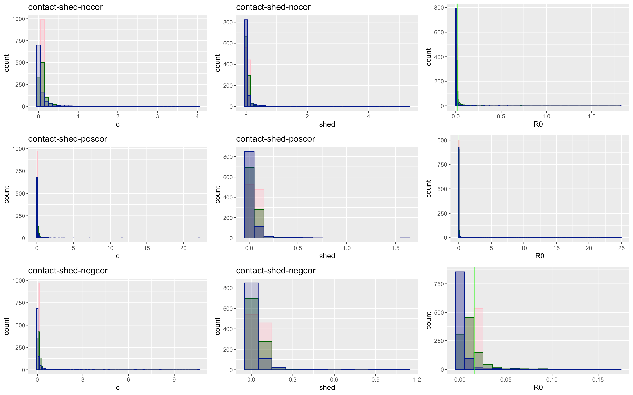
Notes:
Blue=hi variation
Green = medium variation
Pink = low variation
Green line is R0 from just mean values

Slide 3
Contact-Shed | Low | Medium | High
No Covariation
Total | 137218 | 128703 | 21965
Proportion of 0 infections | 0.513 | 0.623 | 0.827
Mean/median secondary infection | 2.05 / 2 | 2.64 / 2 | 5.7 / 2
Positive Covariation
Total | 138846 | 147533 | 61908
Proportion of no infections | 0.514 | 0.670 | 0.861
Mean/median secondary infection | 2.05 / 2 | 3.02 / 2 | 7.17 / 2
Negative Covariation
Total | 136676 | 108204 | 1178
Proportion of no infections | 0.507 | 0.582 | 0.795
Mean/median secondary infection | 2.02 / 2 | 2.39 / 2 | 3.643 / 2

Slide 4
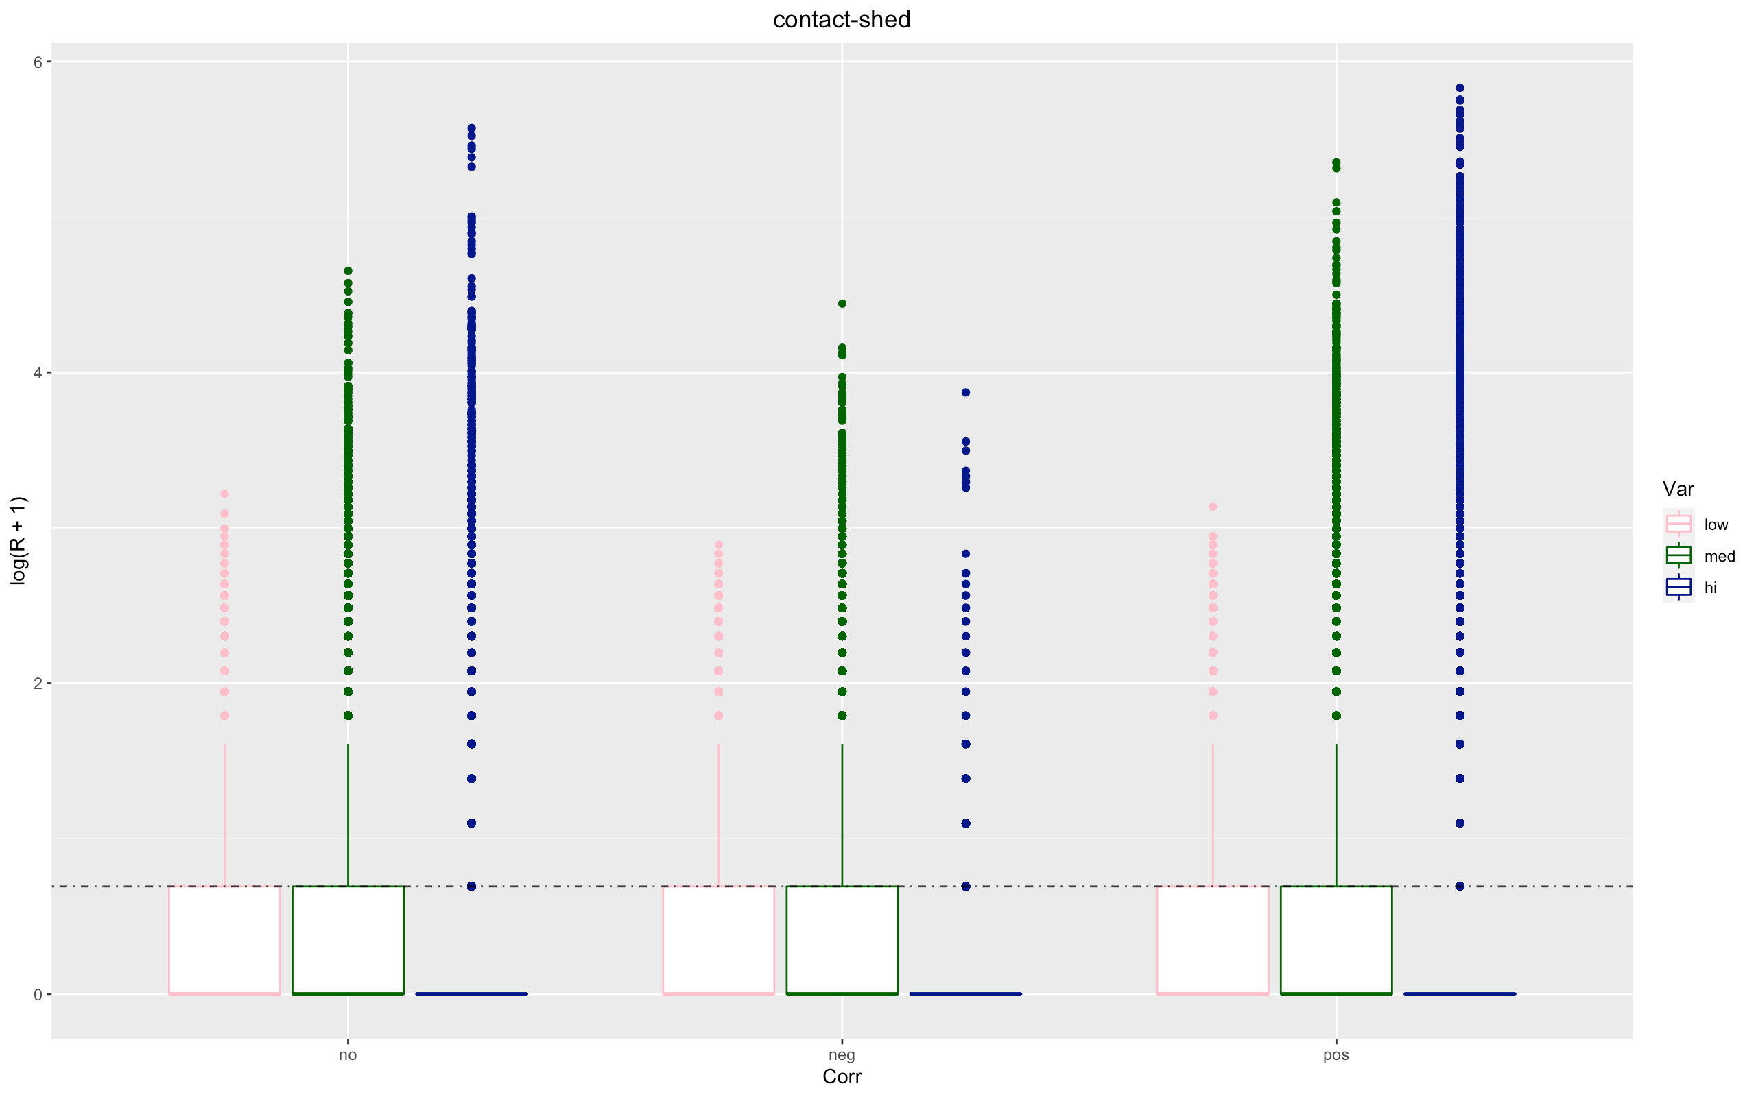

Slide 5
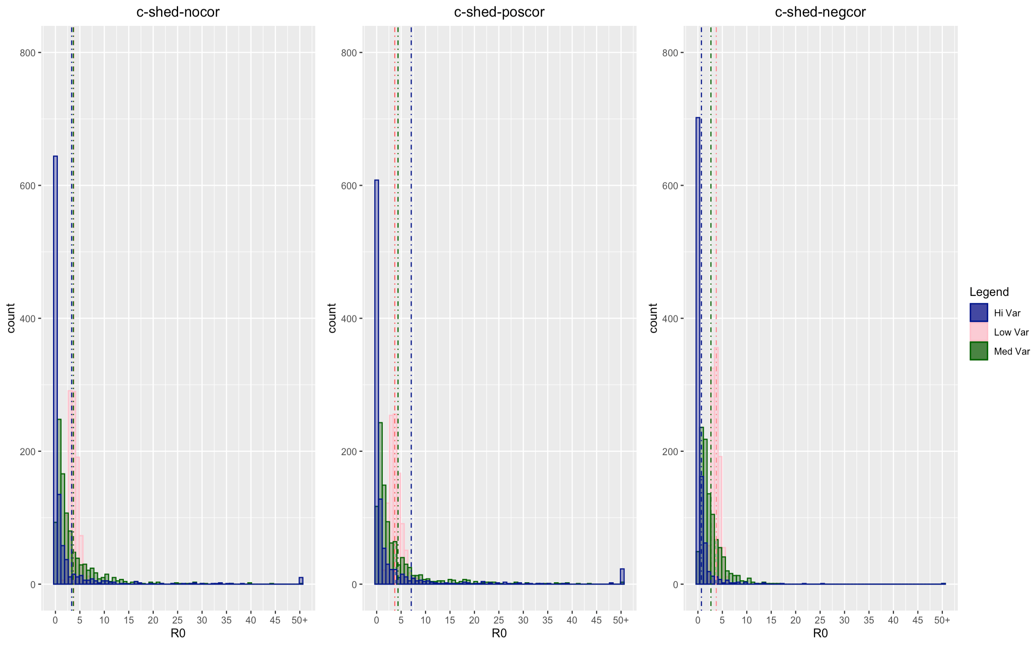

Slide 6
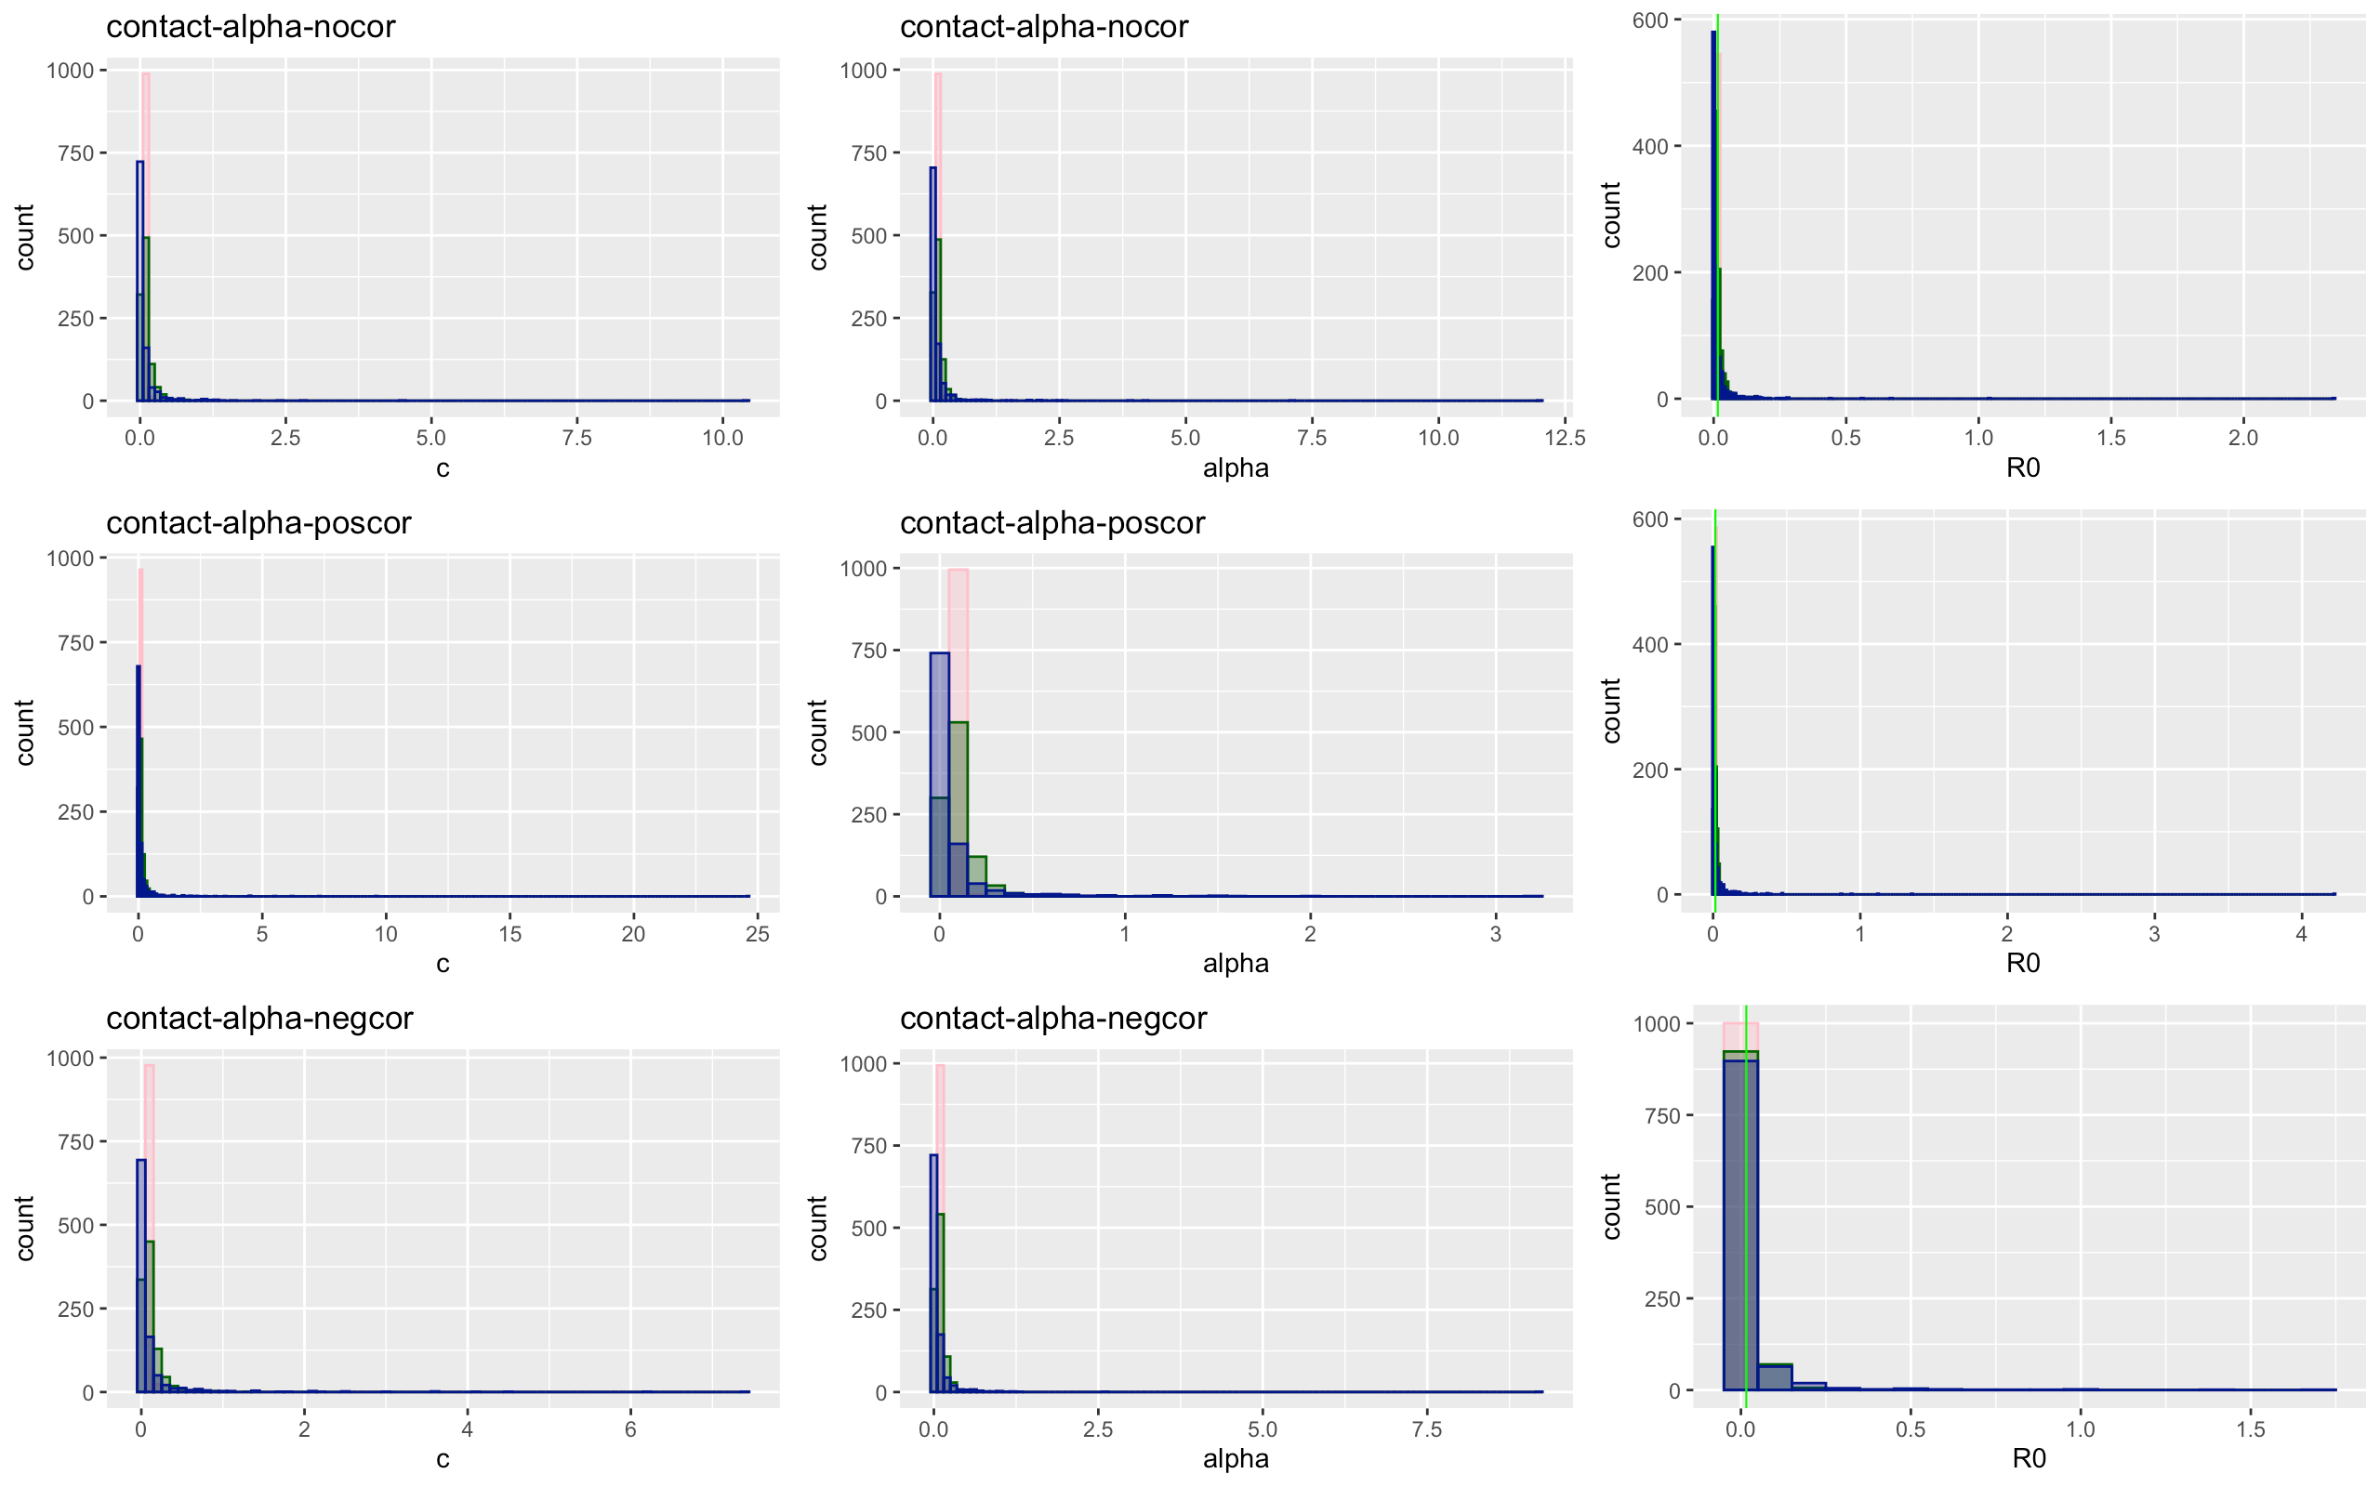

Slide 7
Contact-alpha | Low | Medium | High
No Covariation
Total | 137462 | 128172 | 95958
Proportion of 0 infections | 0.5048232 | 0.5777081 | 0.7326122
Mean/median secondary infection | 2.01 / 1 | 2.362 / 2 | 3.728 / 2
Positive Covariation
Total | 137805 | 127885 | 98910
Proportion of no infections | 0.5043504 | 0.579114 | 0.7460924
Mean/median secondary infection | 2.013162 / 1 | 2.370367 / 1 | 3.92 / 2
Negative Covariation
Total | 137178 | 133676 | 113970
Proportion of no infections | 0.5091414 | 0.6020078 | 0.7675704
Mean/median secondary infection | 2.032791 / 2 | 2.506973 / 2 | 4.291053 / 2

Slide 8
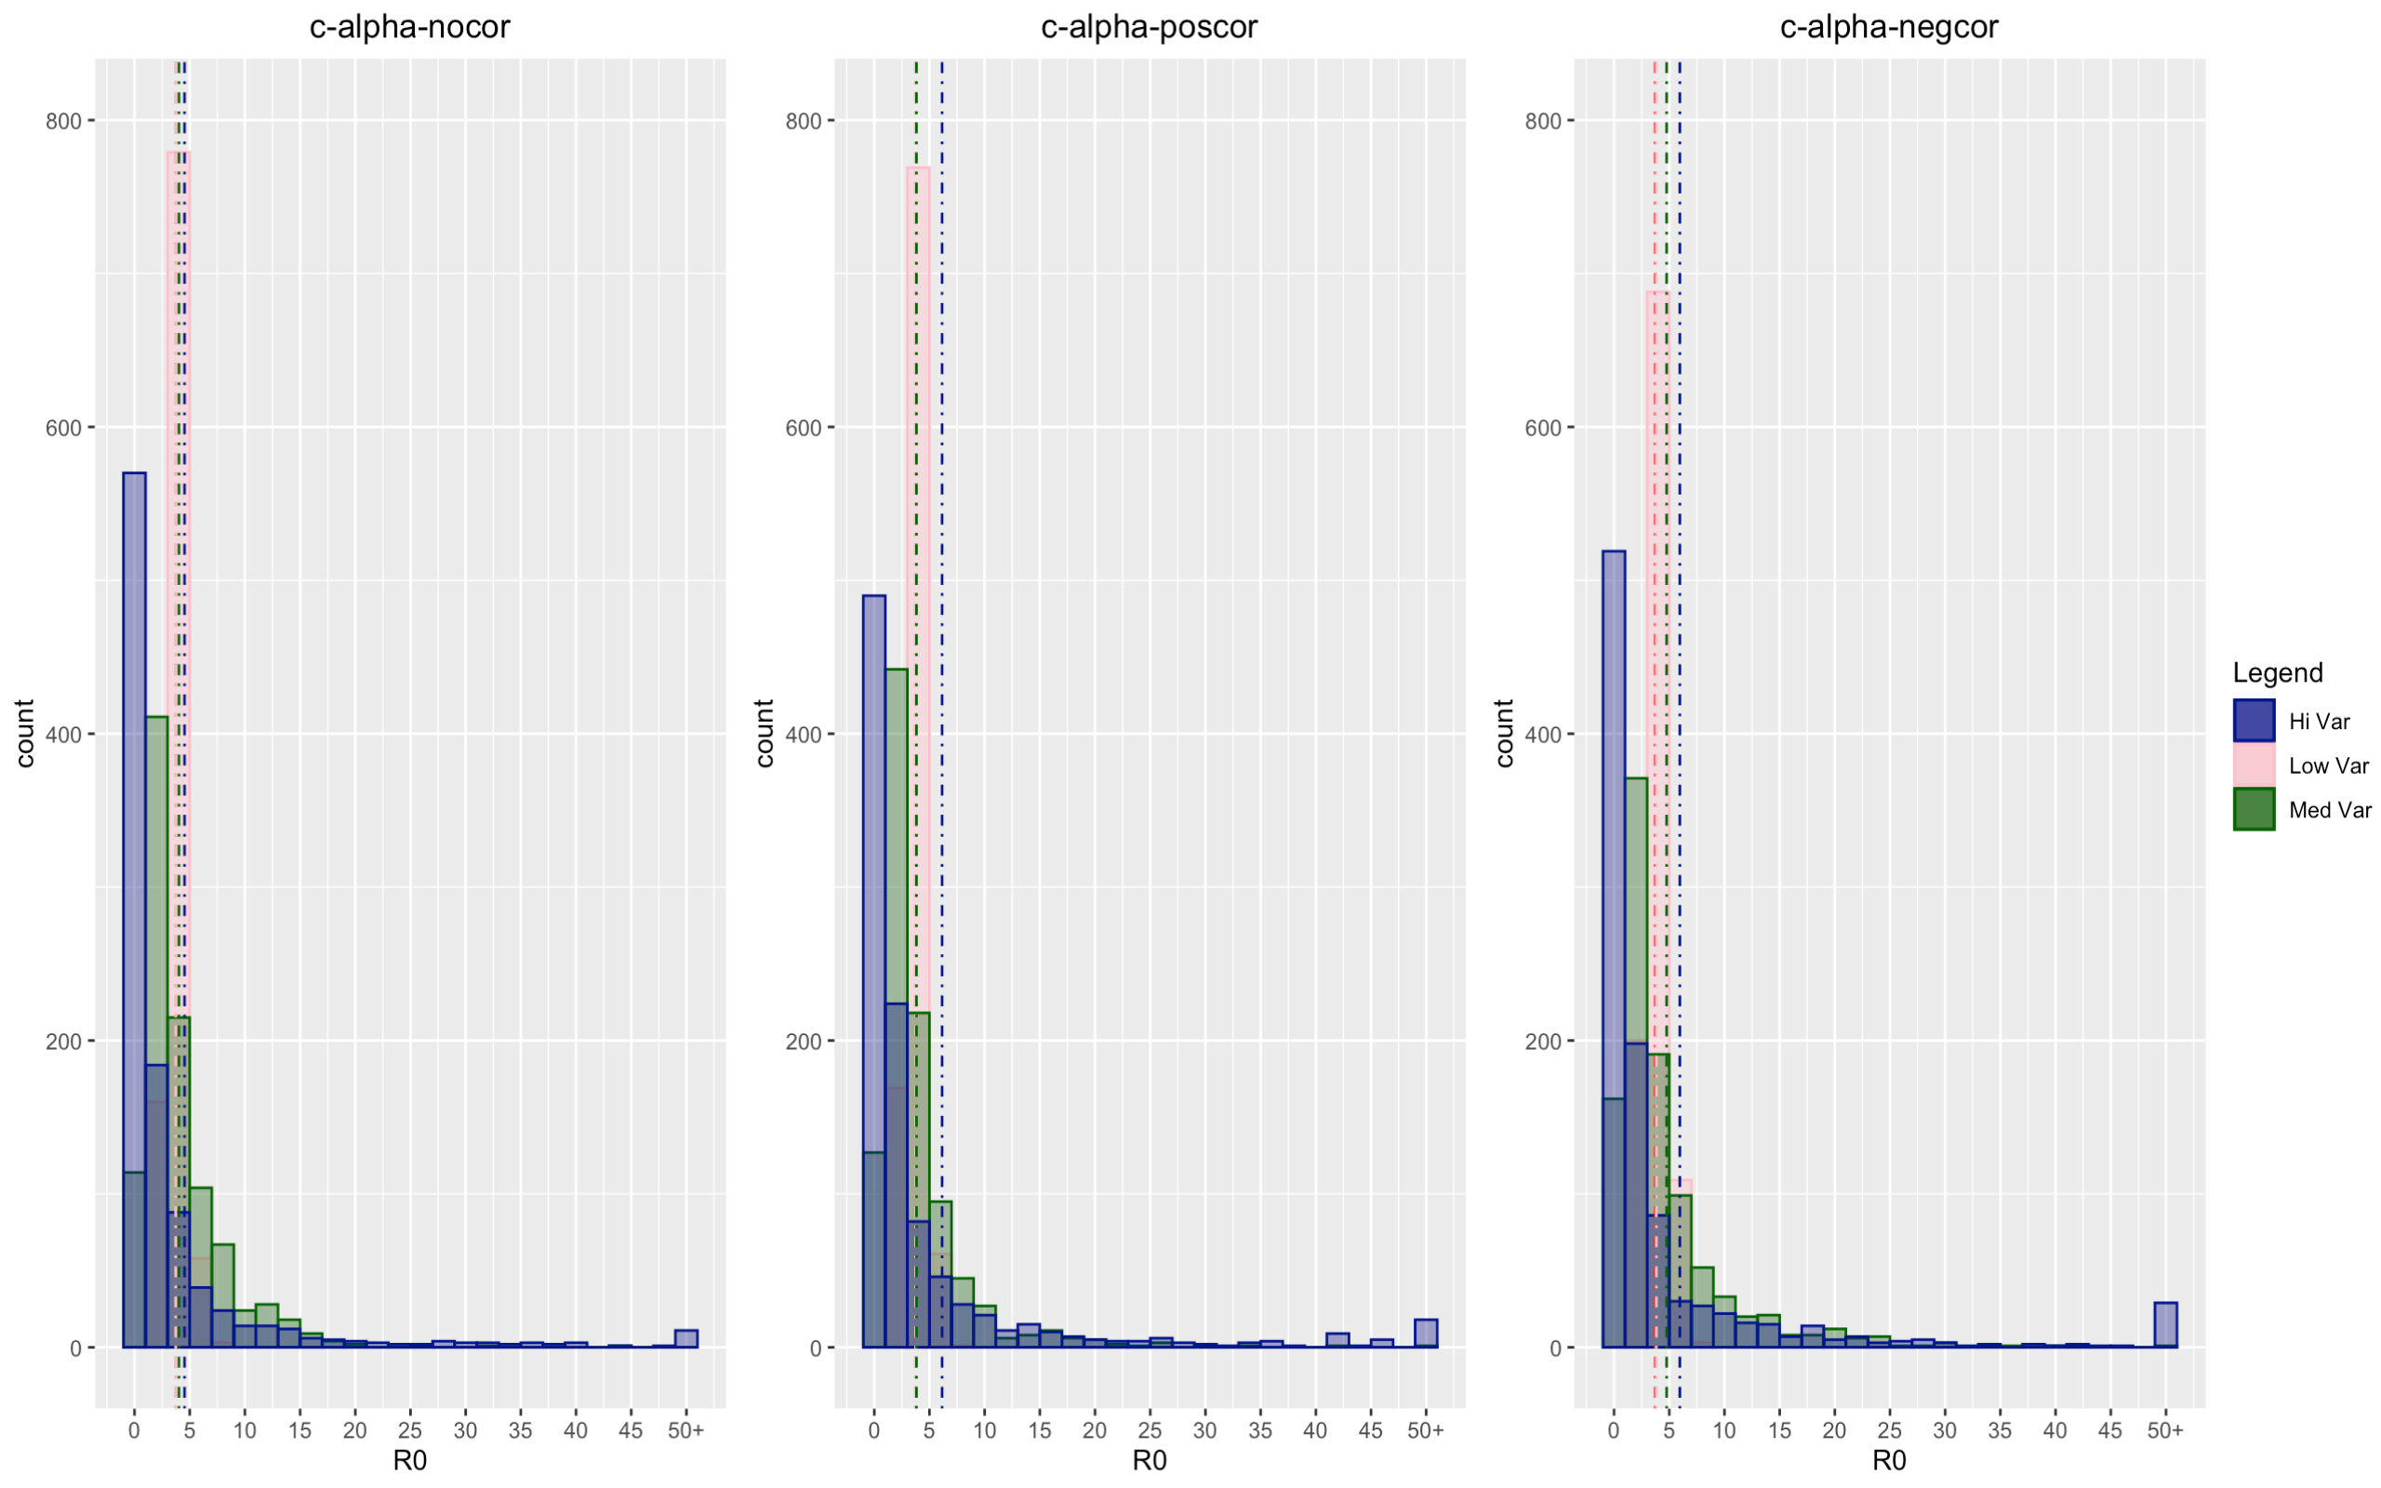

Slide 9
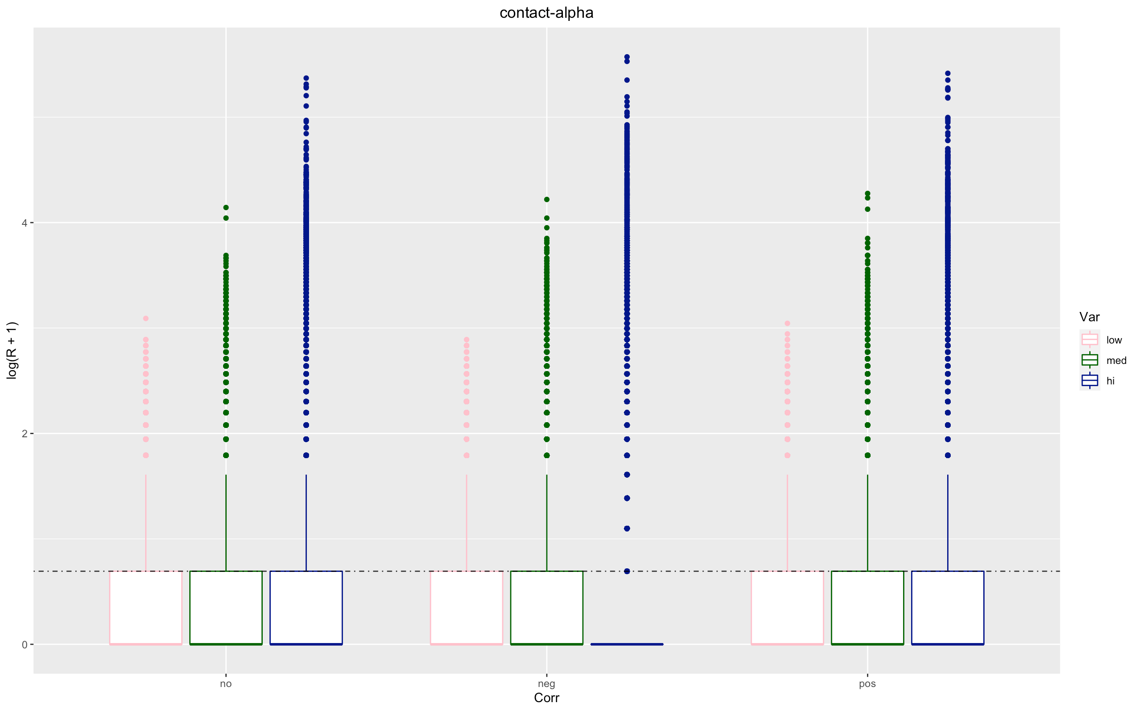

Slide 10
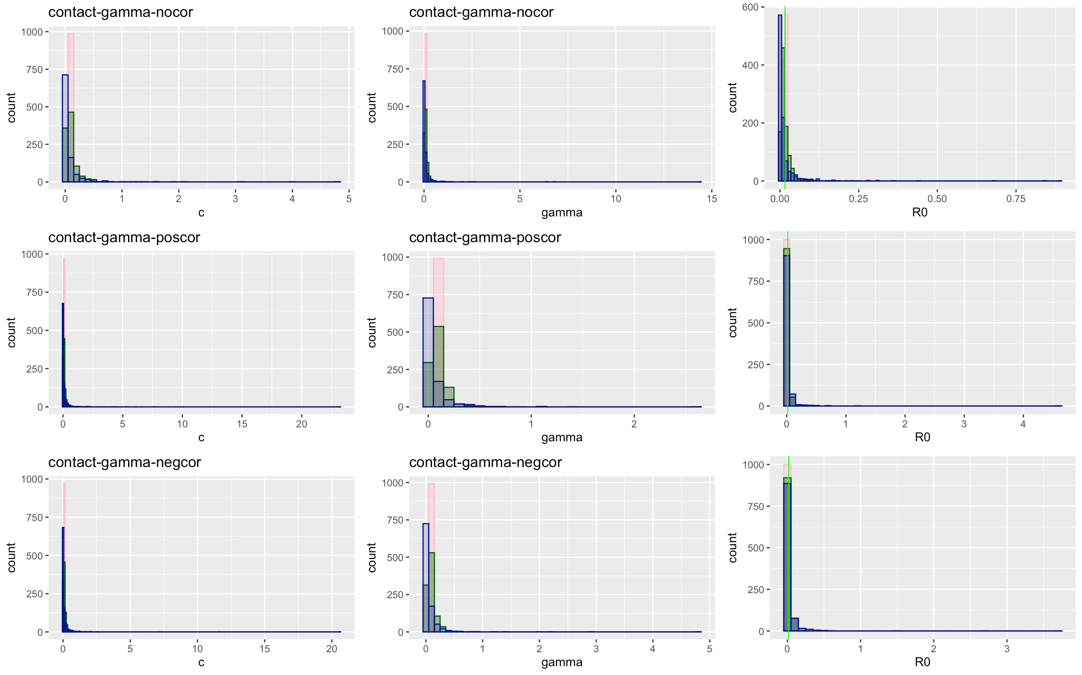

Slide 11
Contact-gamma | Low | Medium | High
No Covariation
Total | 138655 | 139496 | 112168
Proportion of 0 infections | 0.508 | 0.579 | 0.74
Mean/median secondary infection | 2.026 / 1 | 2.369 / 2 | 3.80 / 2
Positive Covariation
Total | 138007 | 143432 | 129929
Proportion of no infections | 0.507 | 0.578 | 0.751
Mean/median secondary infection | 2.026 / 2 | 2.366 / 1 | 4.00 / 2
Negative Covariation
Total | 138423 | 148732 | 163012
Proportion of no infections | 0.511 | 0.602 | 0.769
Mean/median secondary infection | 2.04 / 2 | 2.508 / 2 | 4.313 / 2

Slide 12
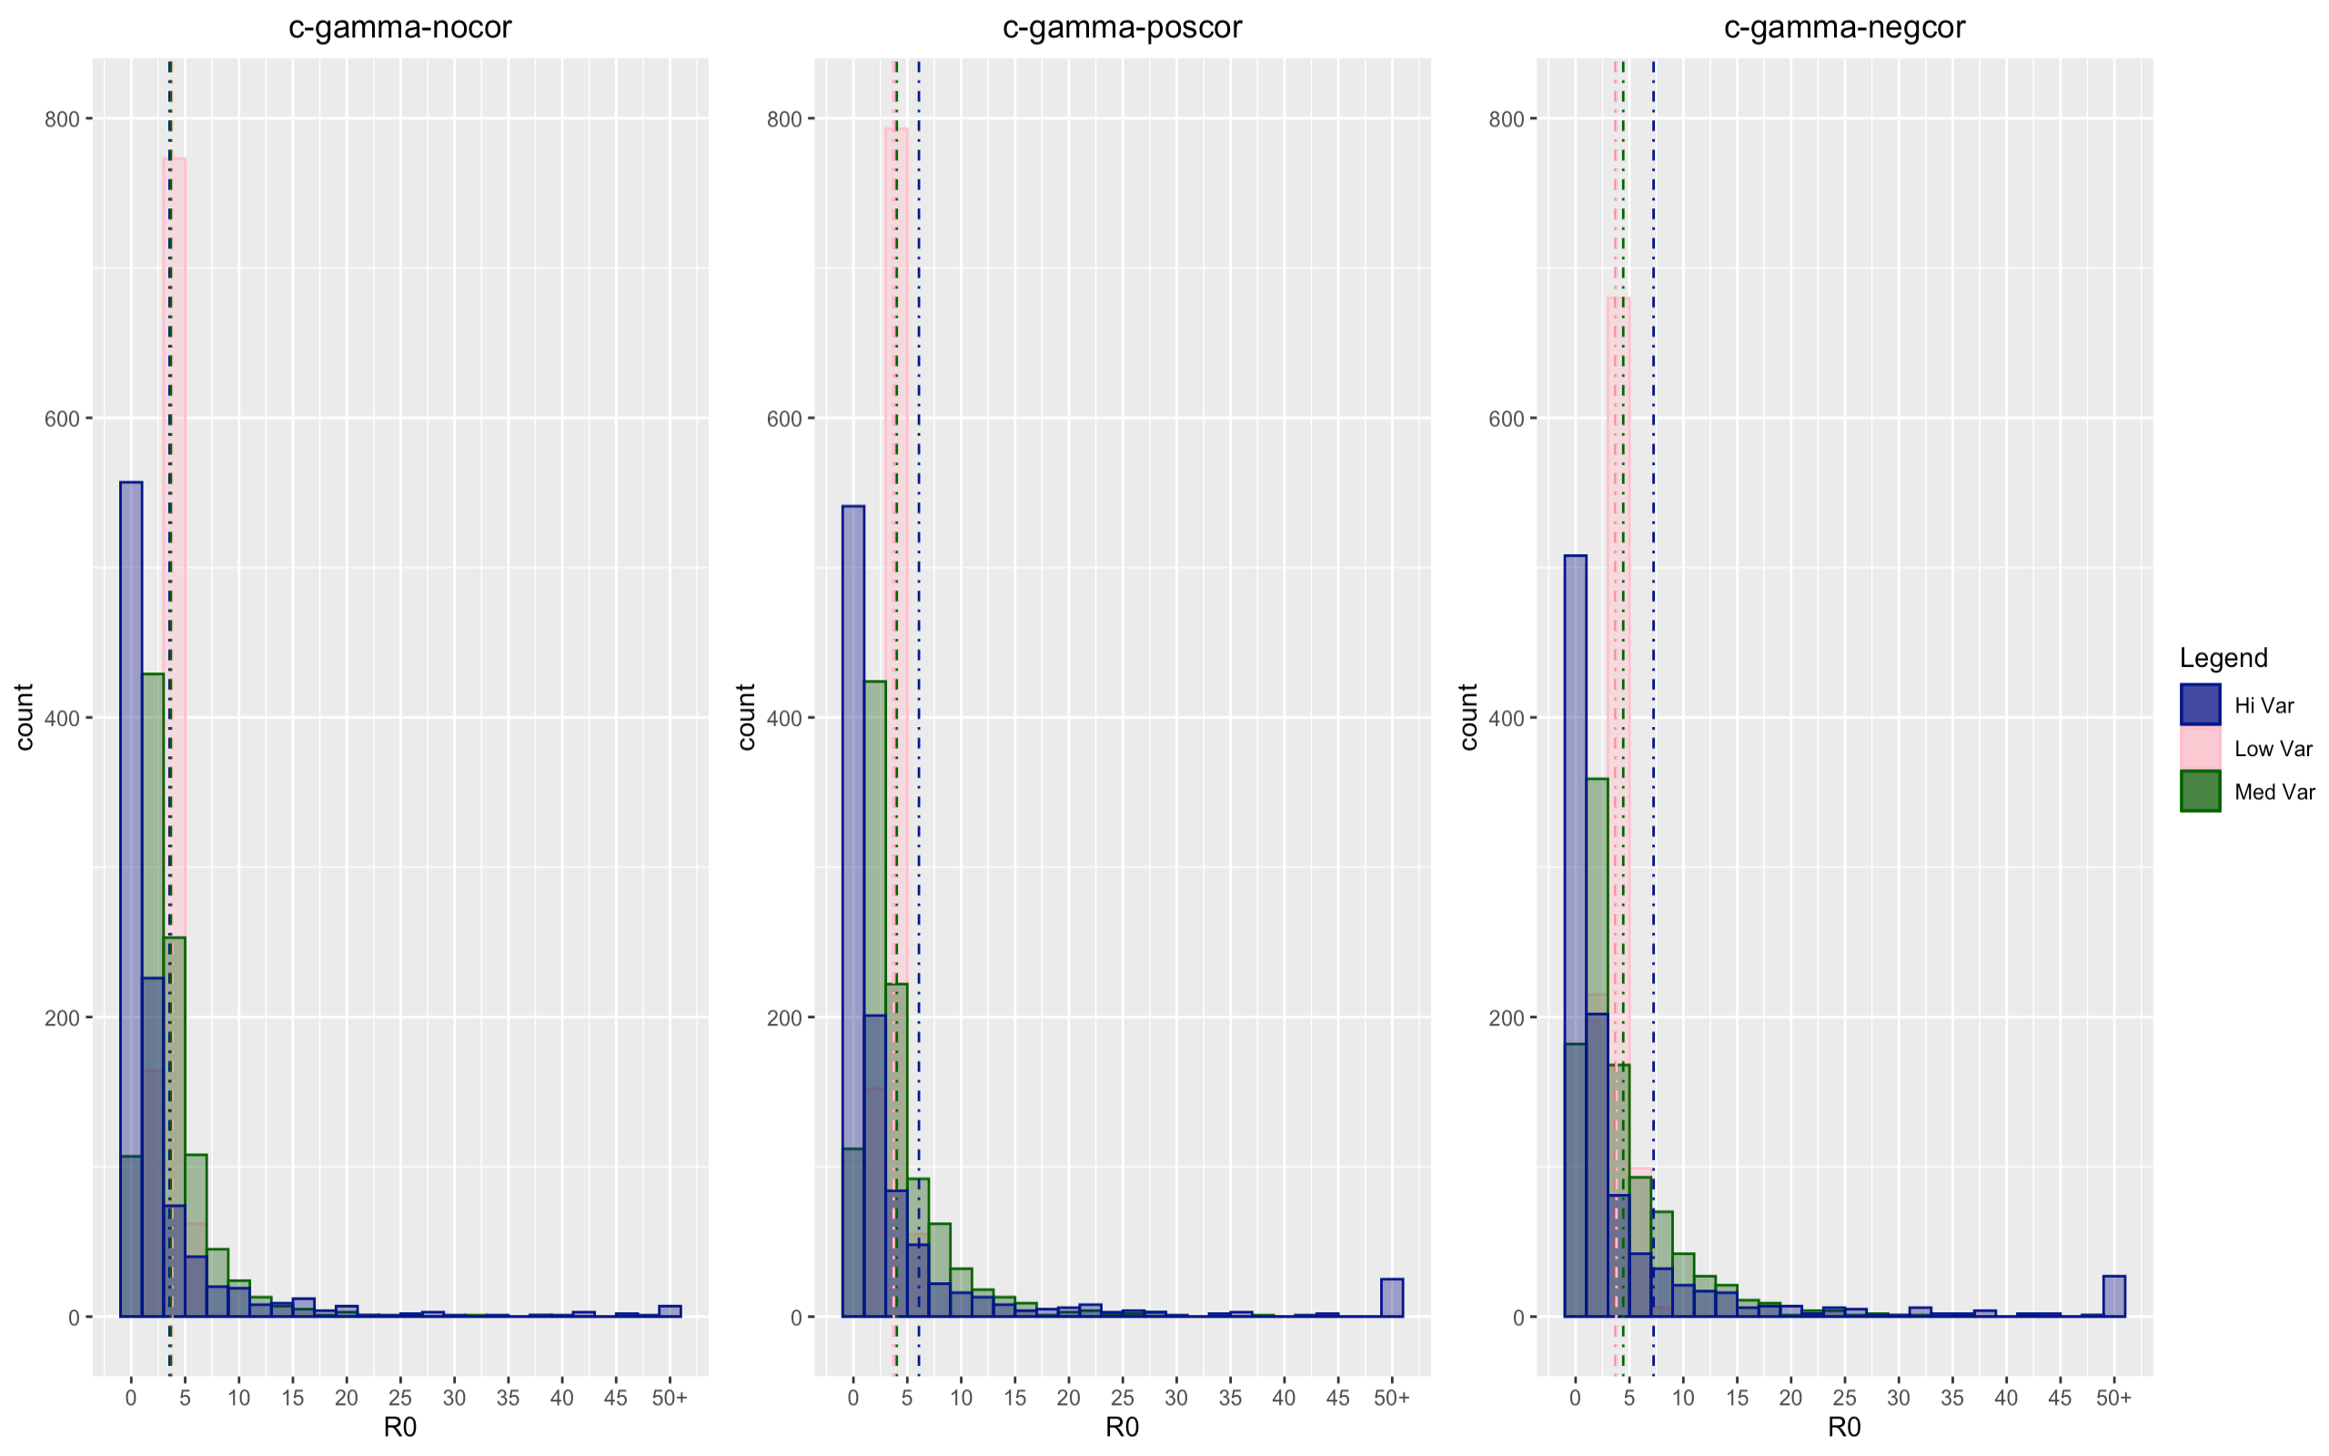

Slide 13
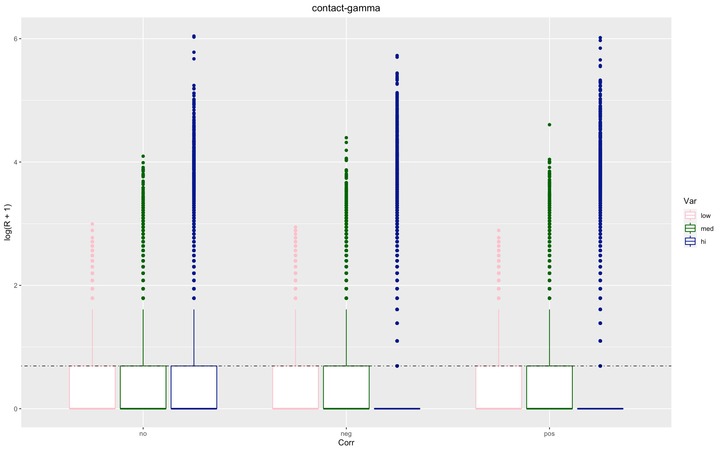

Slide 14
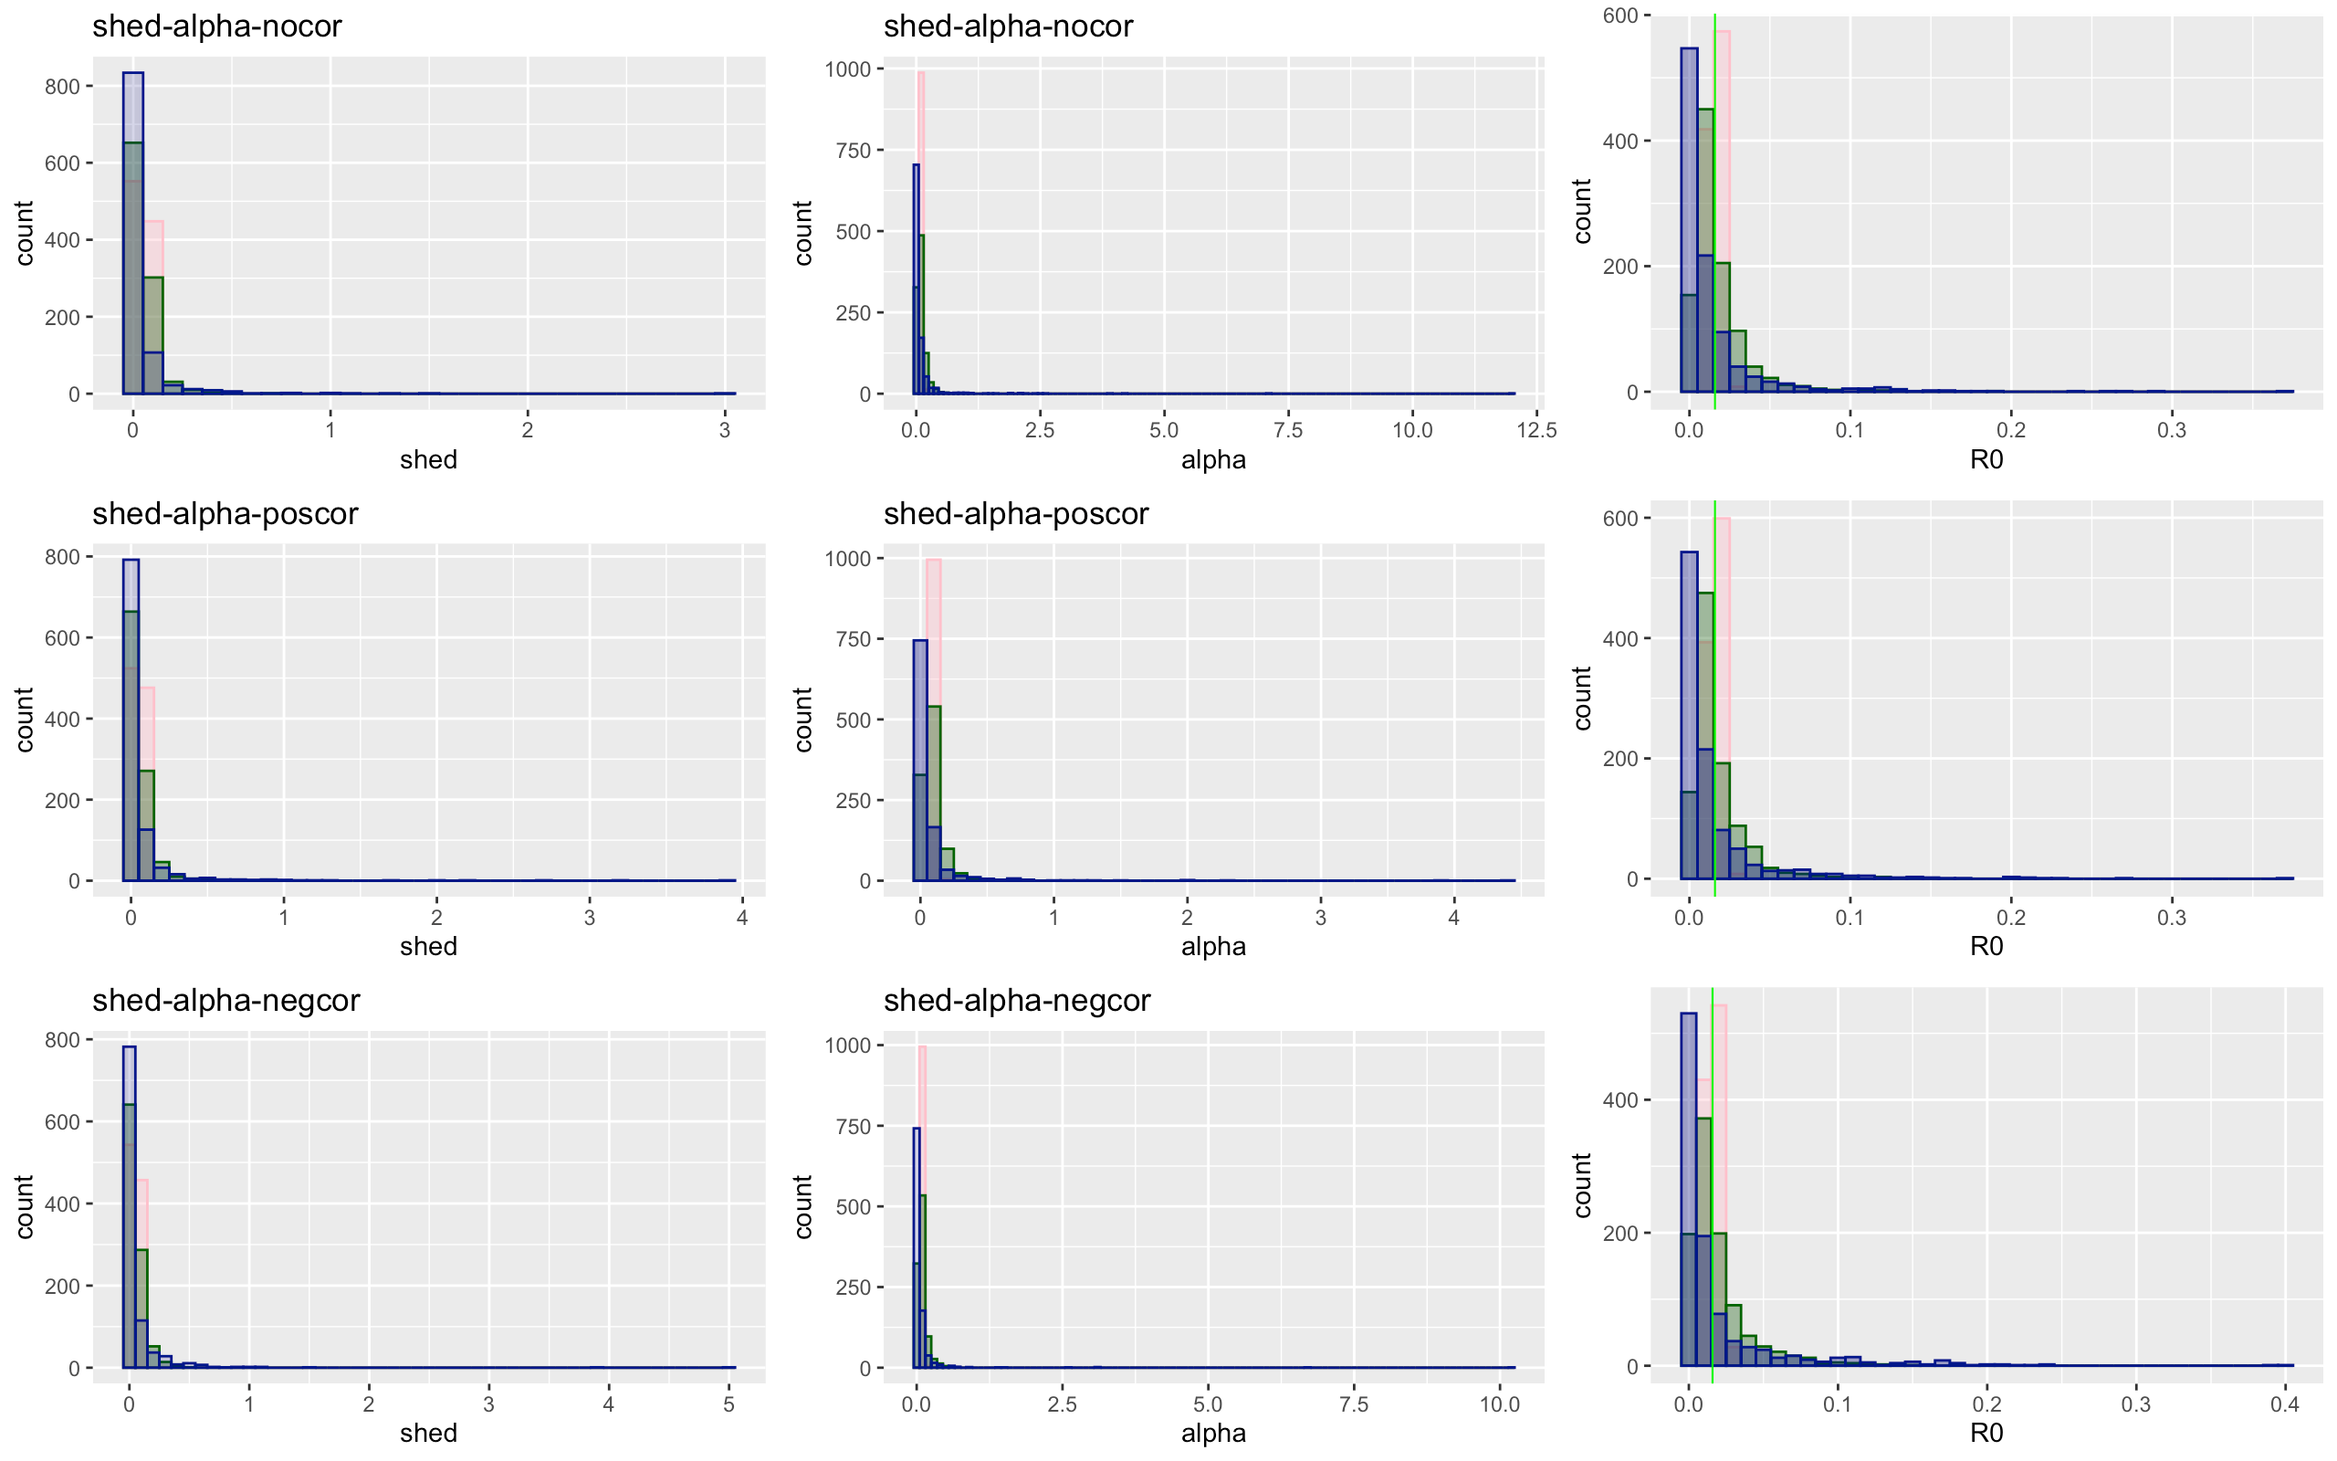

Slide 15
Shed - alpha | Low | Medium | High
No Covariation
Total | 137647 | 126587 | 86420
Proportion of 0 infections | 0.505 | 0.570 | 0.704
Mean/median secondary infection | 2.018 / 2 | 2.317 / 2 | 3.37 / 2
Positive Covariation
Total | 136852 | 128321 | 87554
Proportion of no infections | 0.506 | 0.569 | 0.7025
Mean/median secondary infection | 2.020 / 2 | 2.315 / 2 | 3.351 / 2
Negative Covariation
Total | 137482 | 131597 | 105400
Proportion of no infections | 0.507 | 0.589 | 0.726
Mean/median secondary infection | 2.024 / 1 | 2.43 / 2 | 3.63 / 2

Slide 16
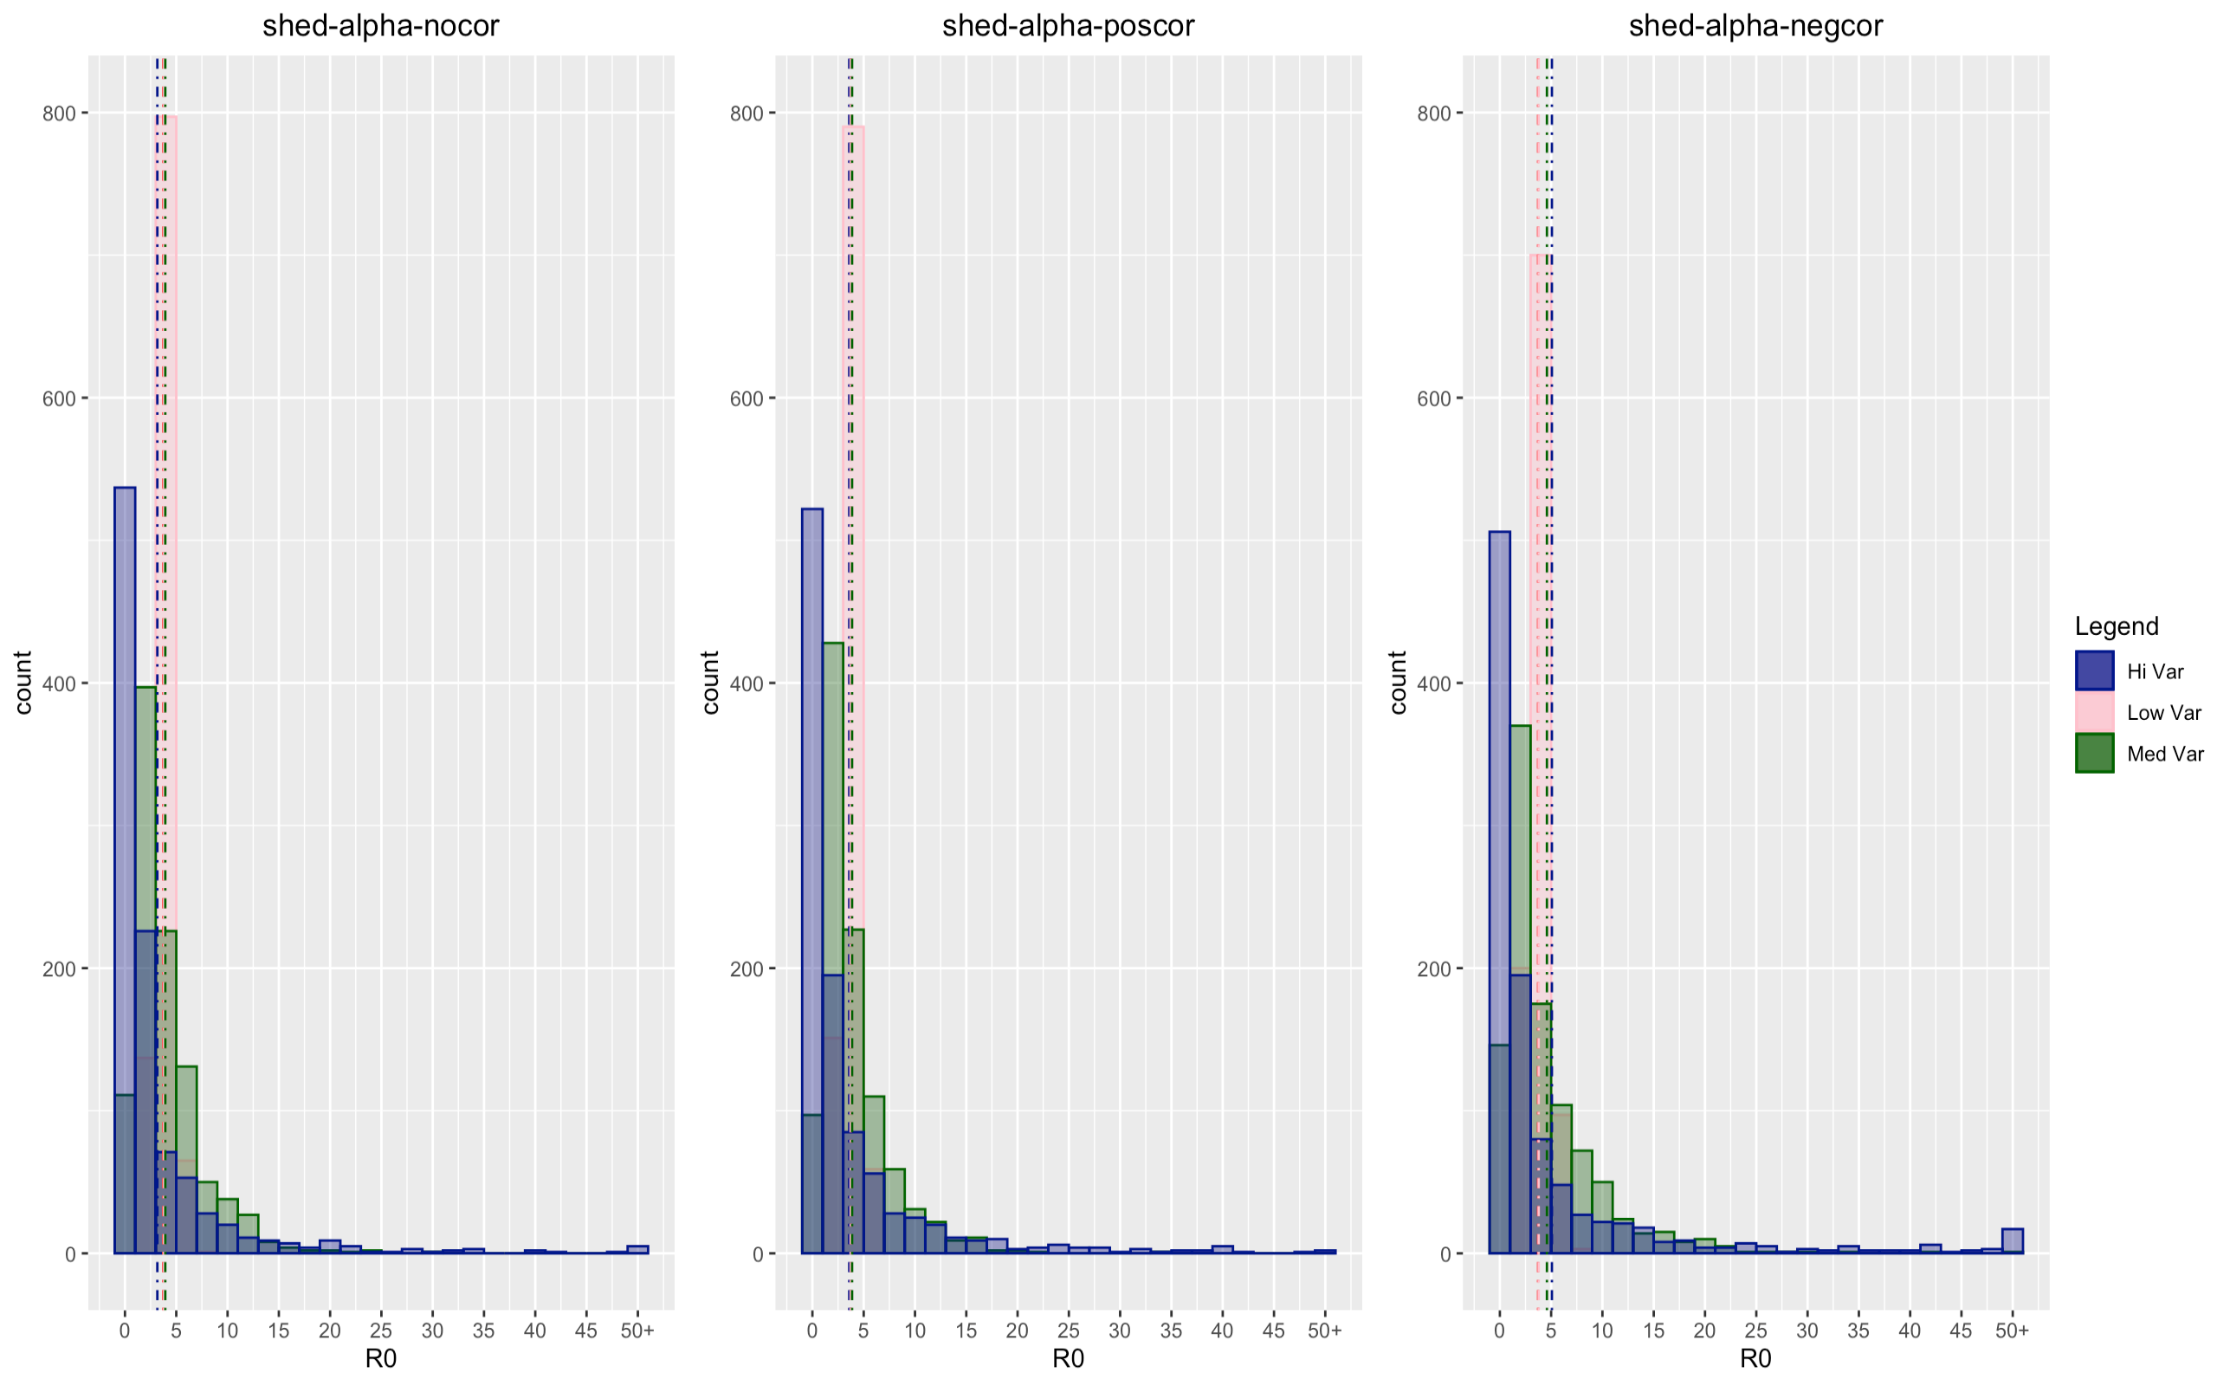

Slide 17
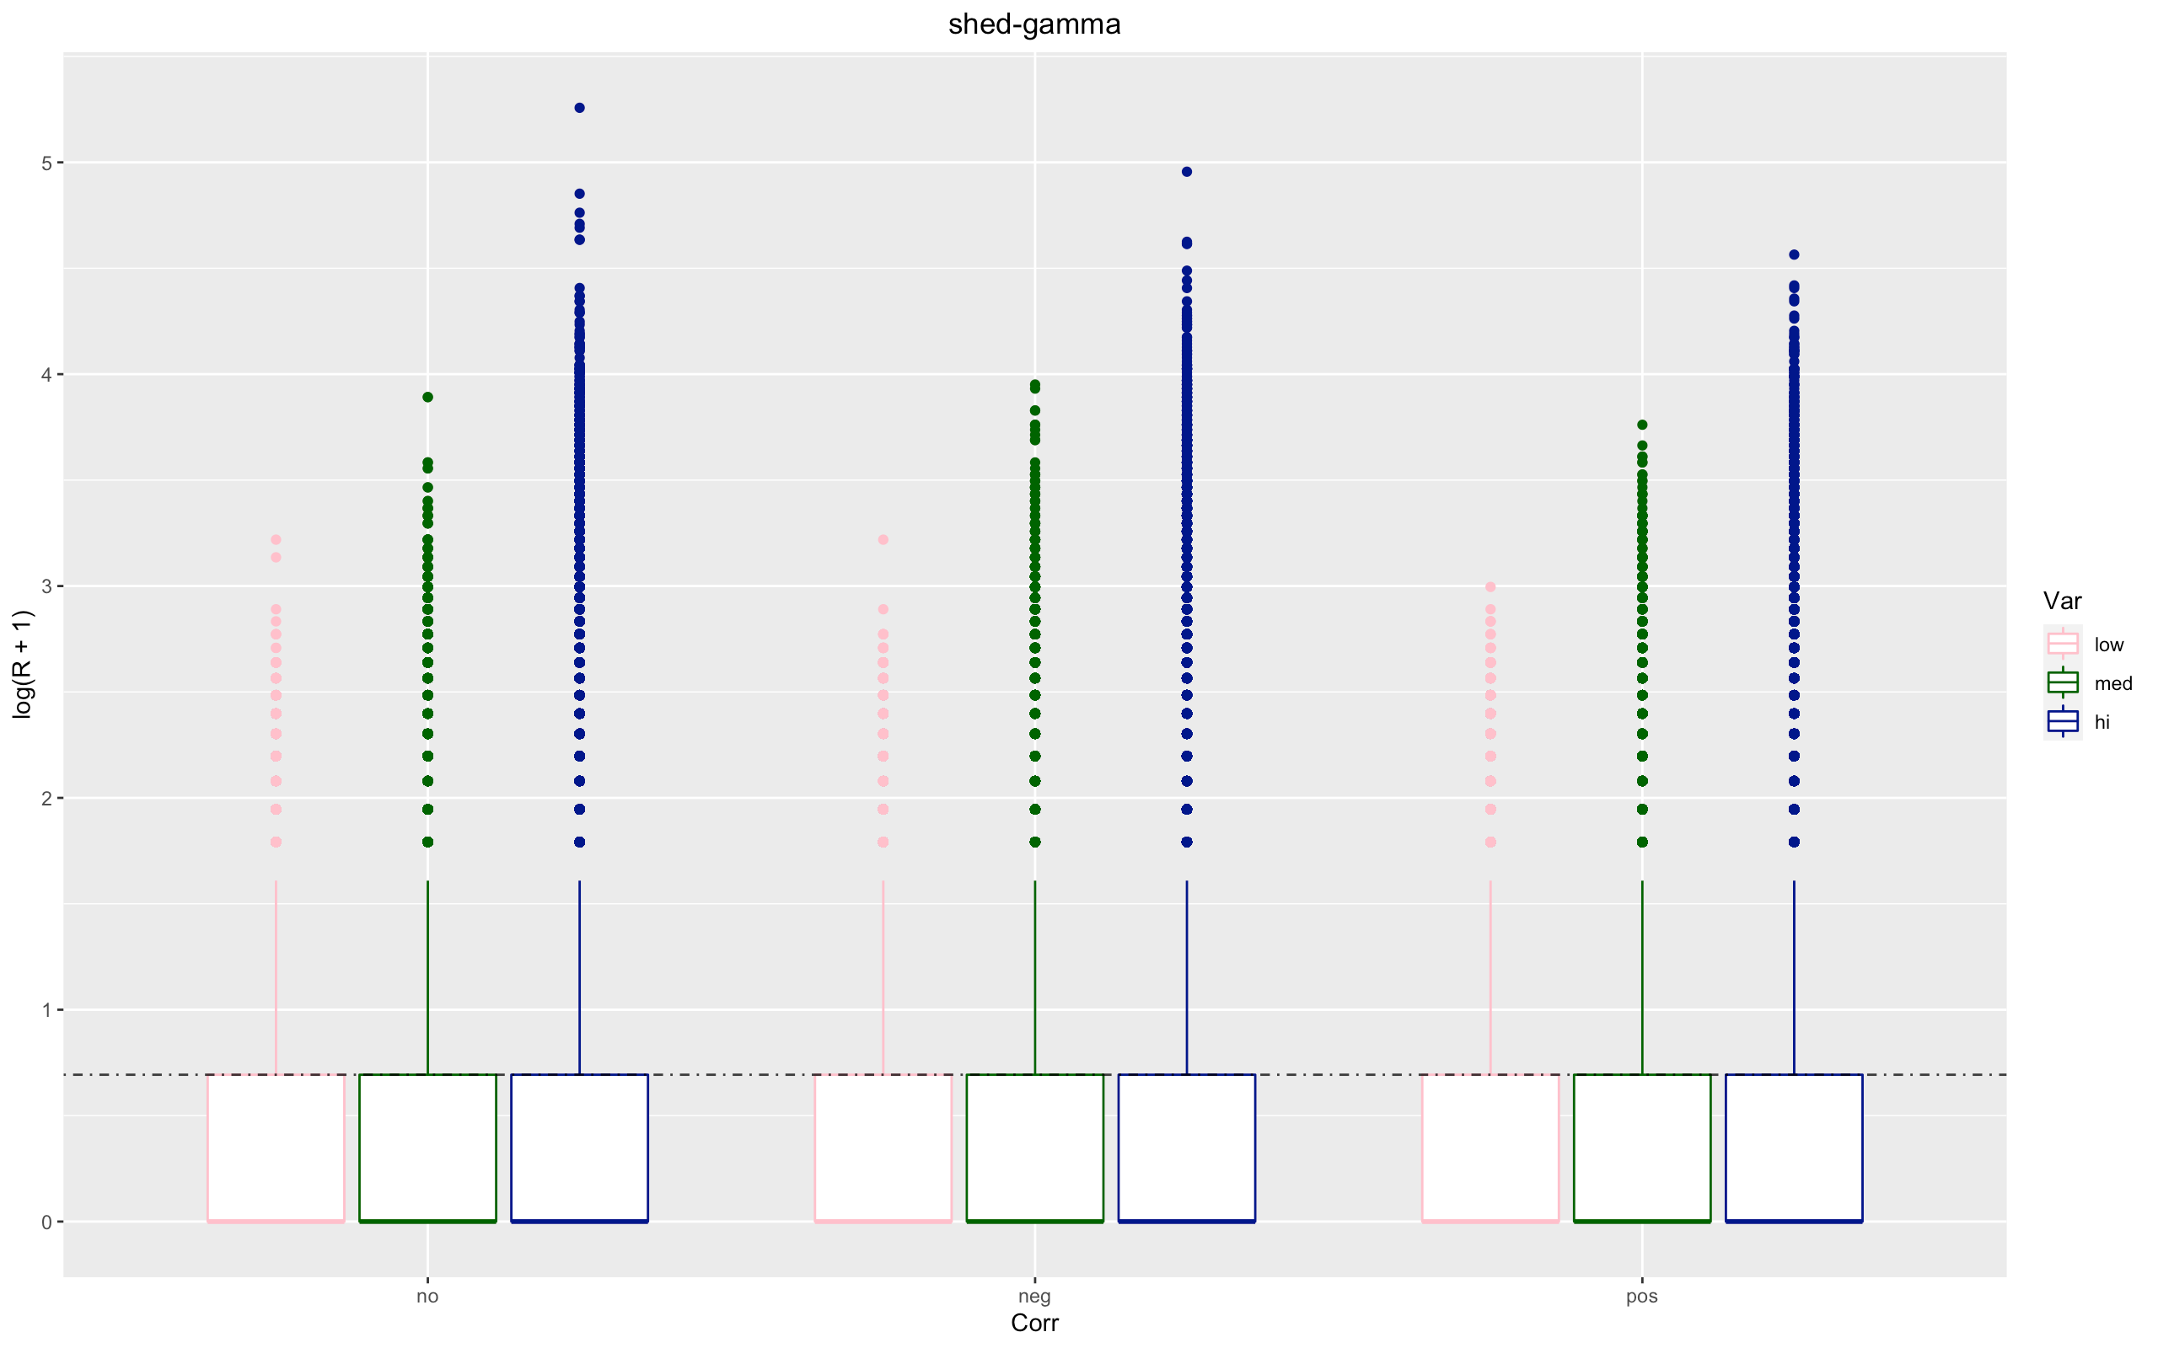

Slide 18
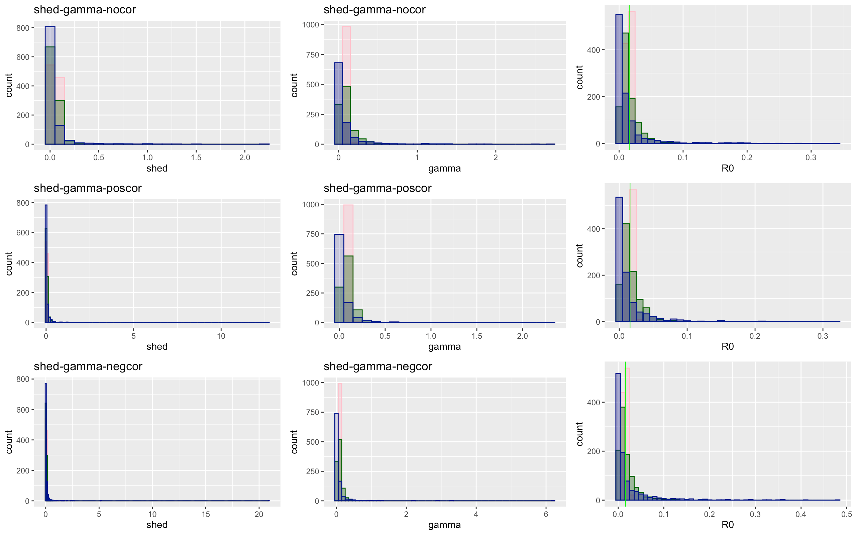

Slide 19
Shed - gamma | Low | Medium | High
No Covariation
Total | 138073 | 137687 | 110986
Proportion of 0 infections | 0.505 | 0.568 | 0.705
Mean/median secondary infection | 2.017 / 2 | 2.313 / 2 | 3.386 / 2
Positive Covariation
Total | 138498 | 138928 | 125219
Proportion of no infections | 0.504 | 0.570 | 0.705
Mean/median secondary infection | 2.013 / 1 | 2.318 / 2 | 3.382 / 2
Negative Covariation
Total | 138654 | 145770 | 132267
Proportion of no infections | 0.509 | 0.591 | 0.726
Mean/median secondary infection | 2.030 / 2 | 2.439 / 2 | 3.654 / 2

Slide 21
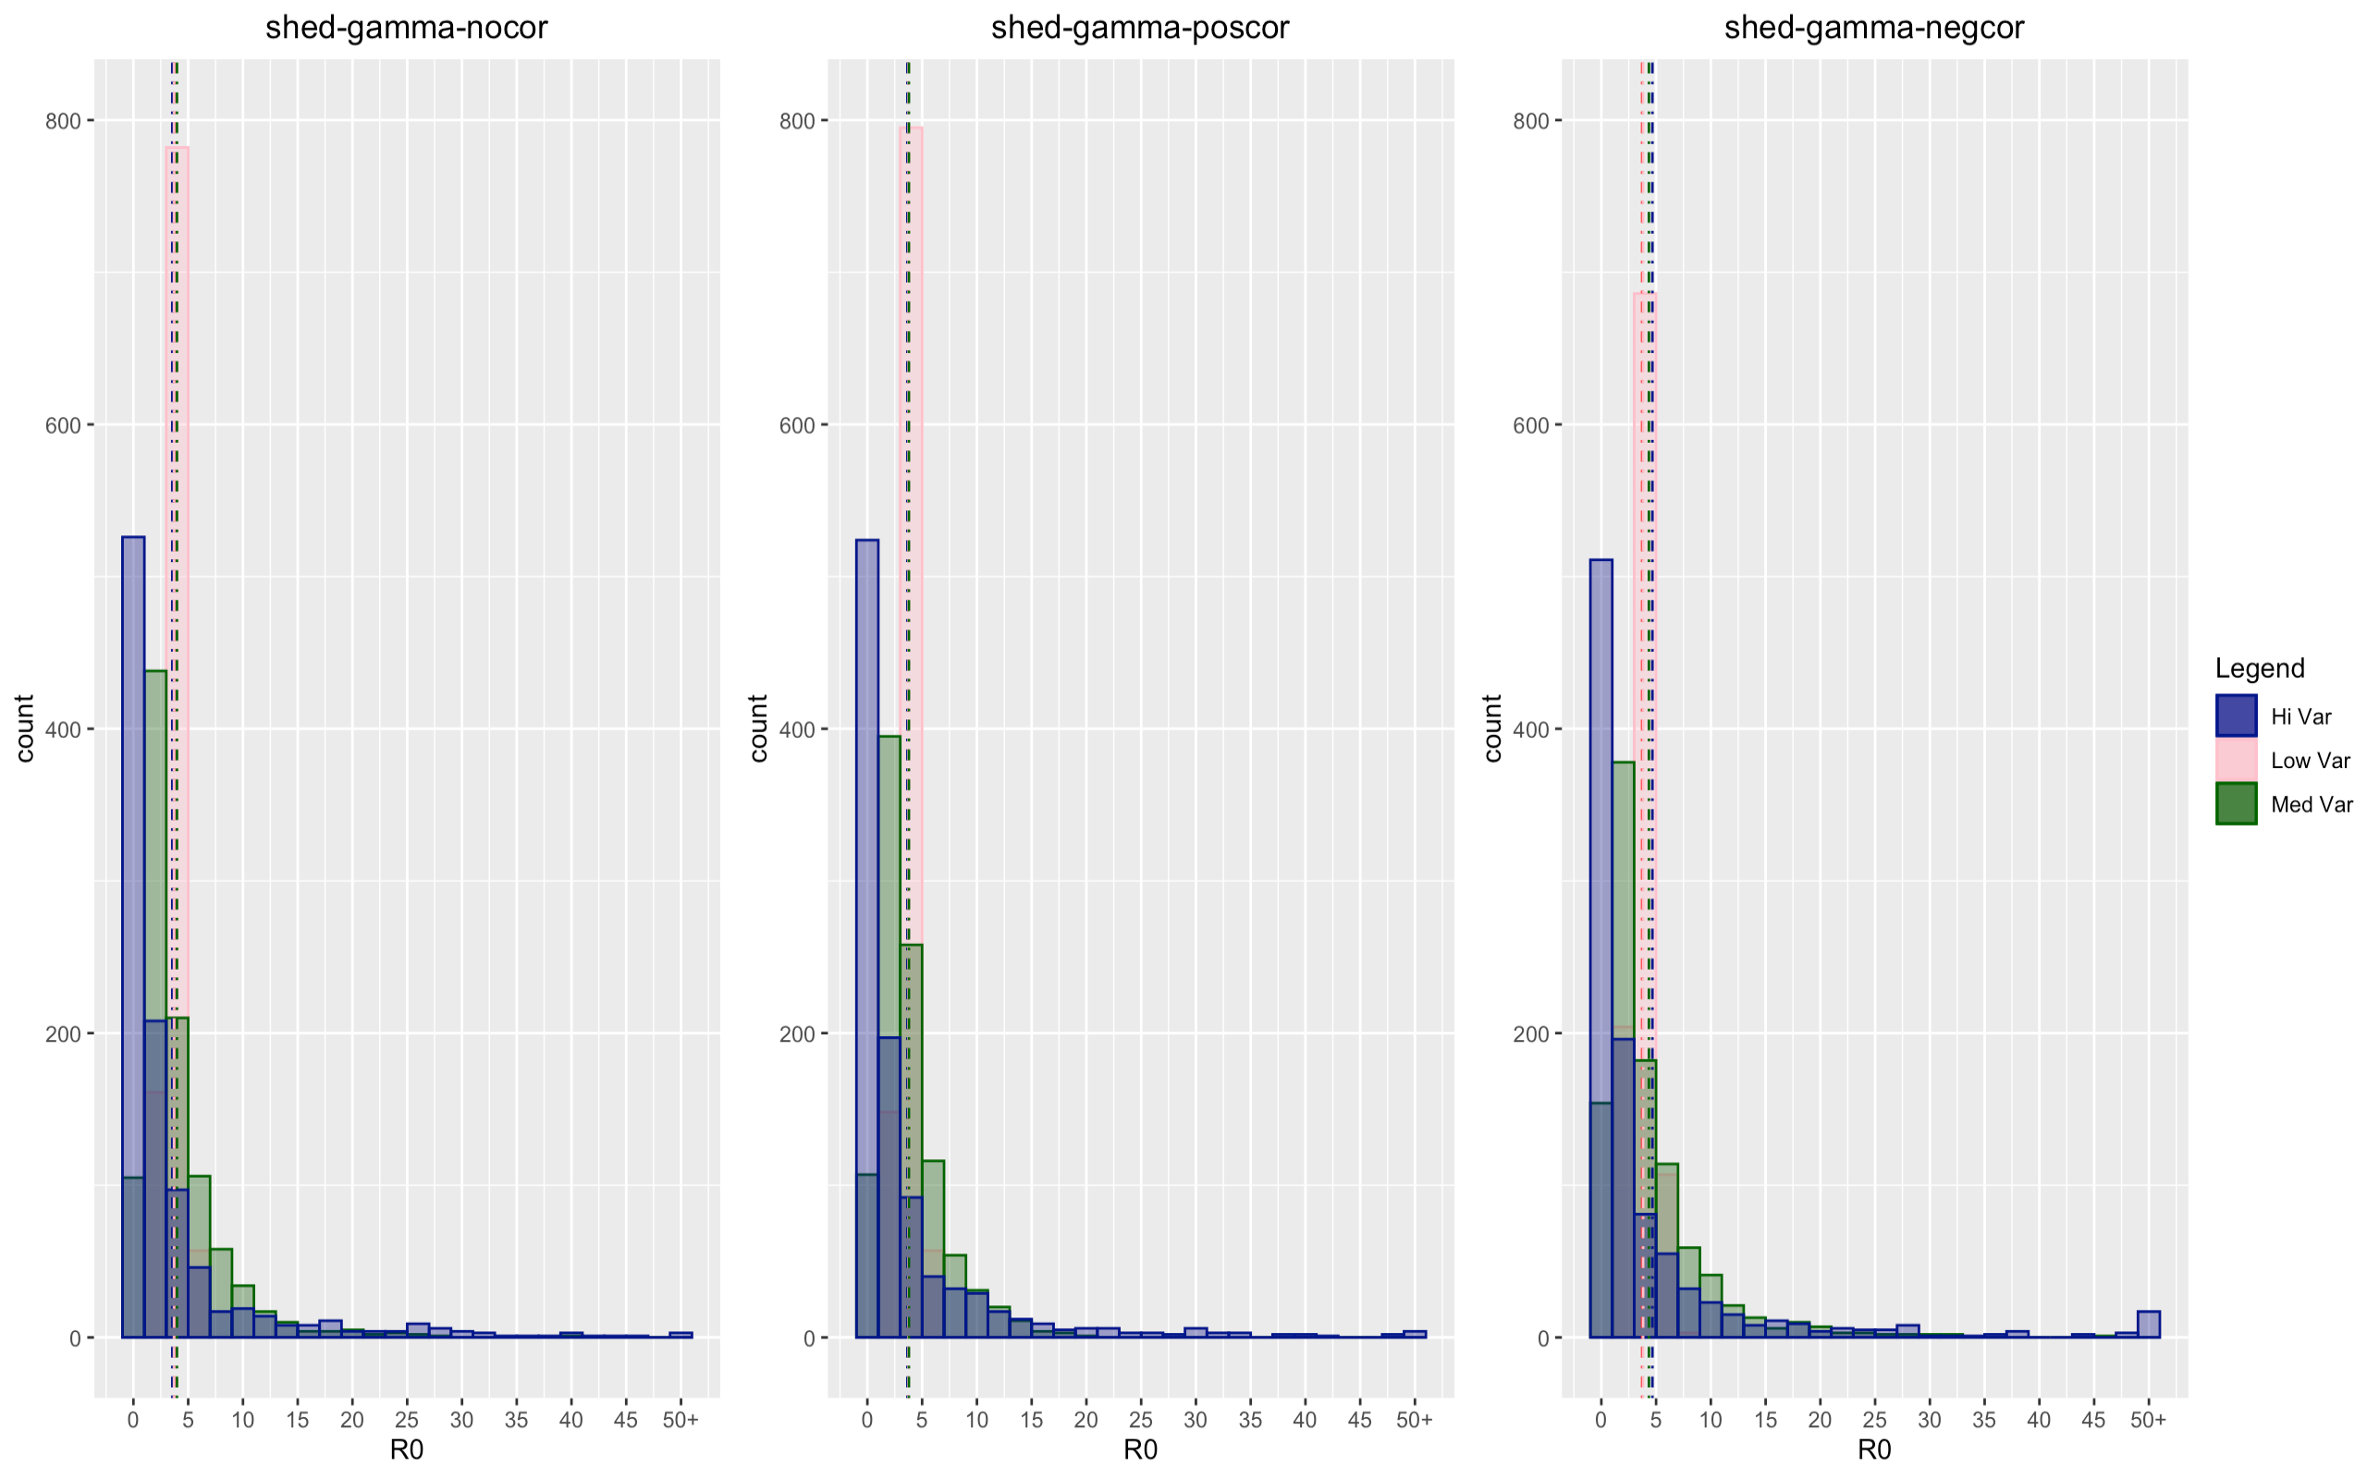

Slide 22
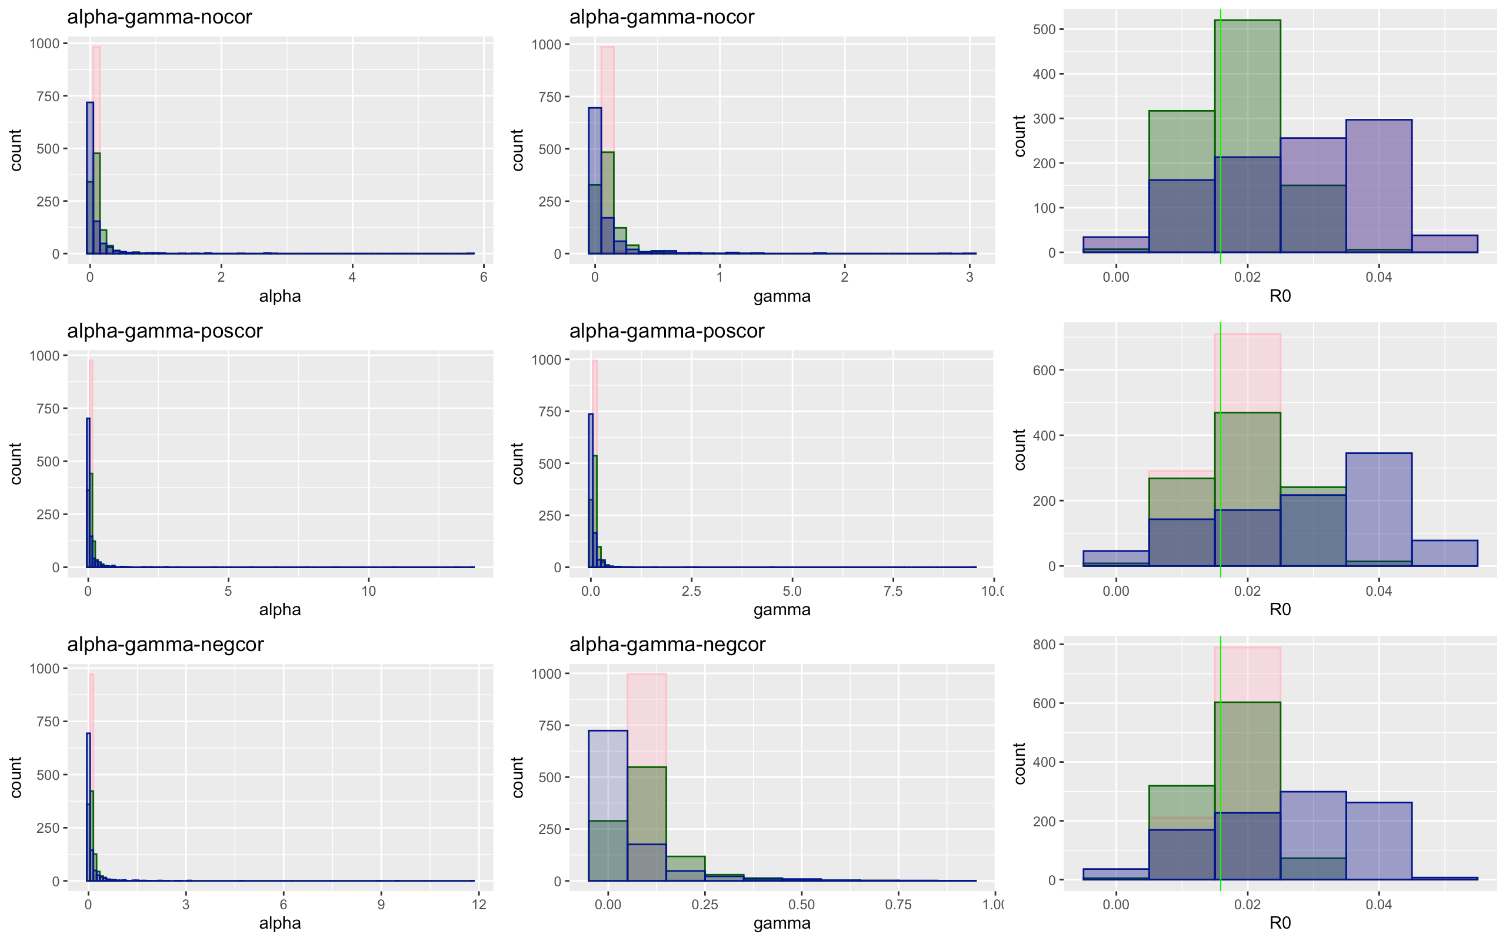

Slide 23
Alpha – gamma | Low | Medium | High
No Covariation
Total | 137637 | 138319 | 132893
Proportion of 0 infections | 0.502 | 0.513 | 0.530
Mean/median secondary infection | 2.005 / 2 | 2.049 / 2 | 2.123 / 2
Positive Covariation
Total | 134953 | 139547 | 137483
Proportion of no infections | 0.502 | 0.5172 | 0.527
Mean/median secondary infection | 2.002 / 2 | 2.067 / 2 | 2.109 / 2
Negative Covariation
Total | 137355 | 136998 | 139328
Proportion of no infections | 0.5019 | 0.512 | 0.5230
Mean/median secondary infection | 2.003 / 2 | 2.043 / 2 | 2.0919 / 2

Slide 24
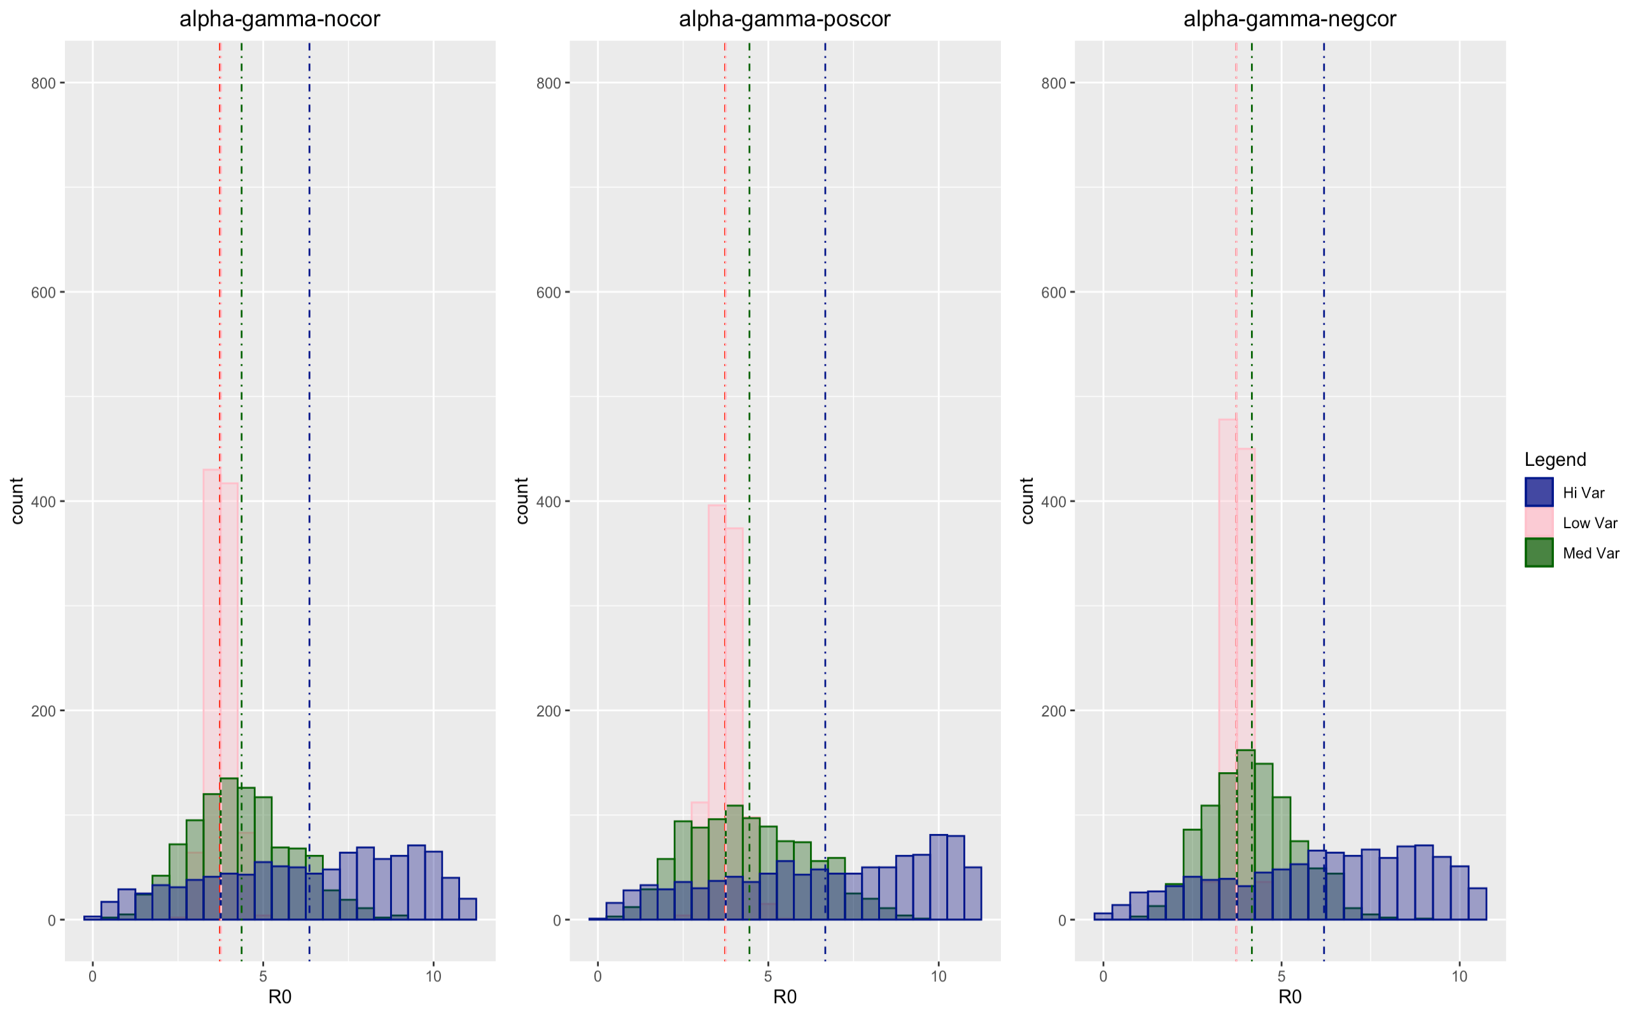

Slide 25
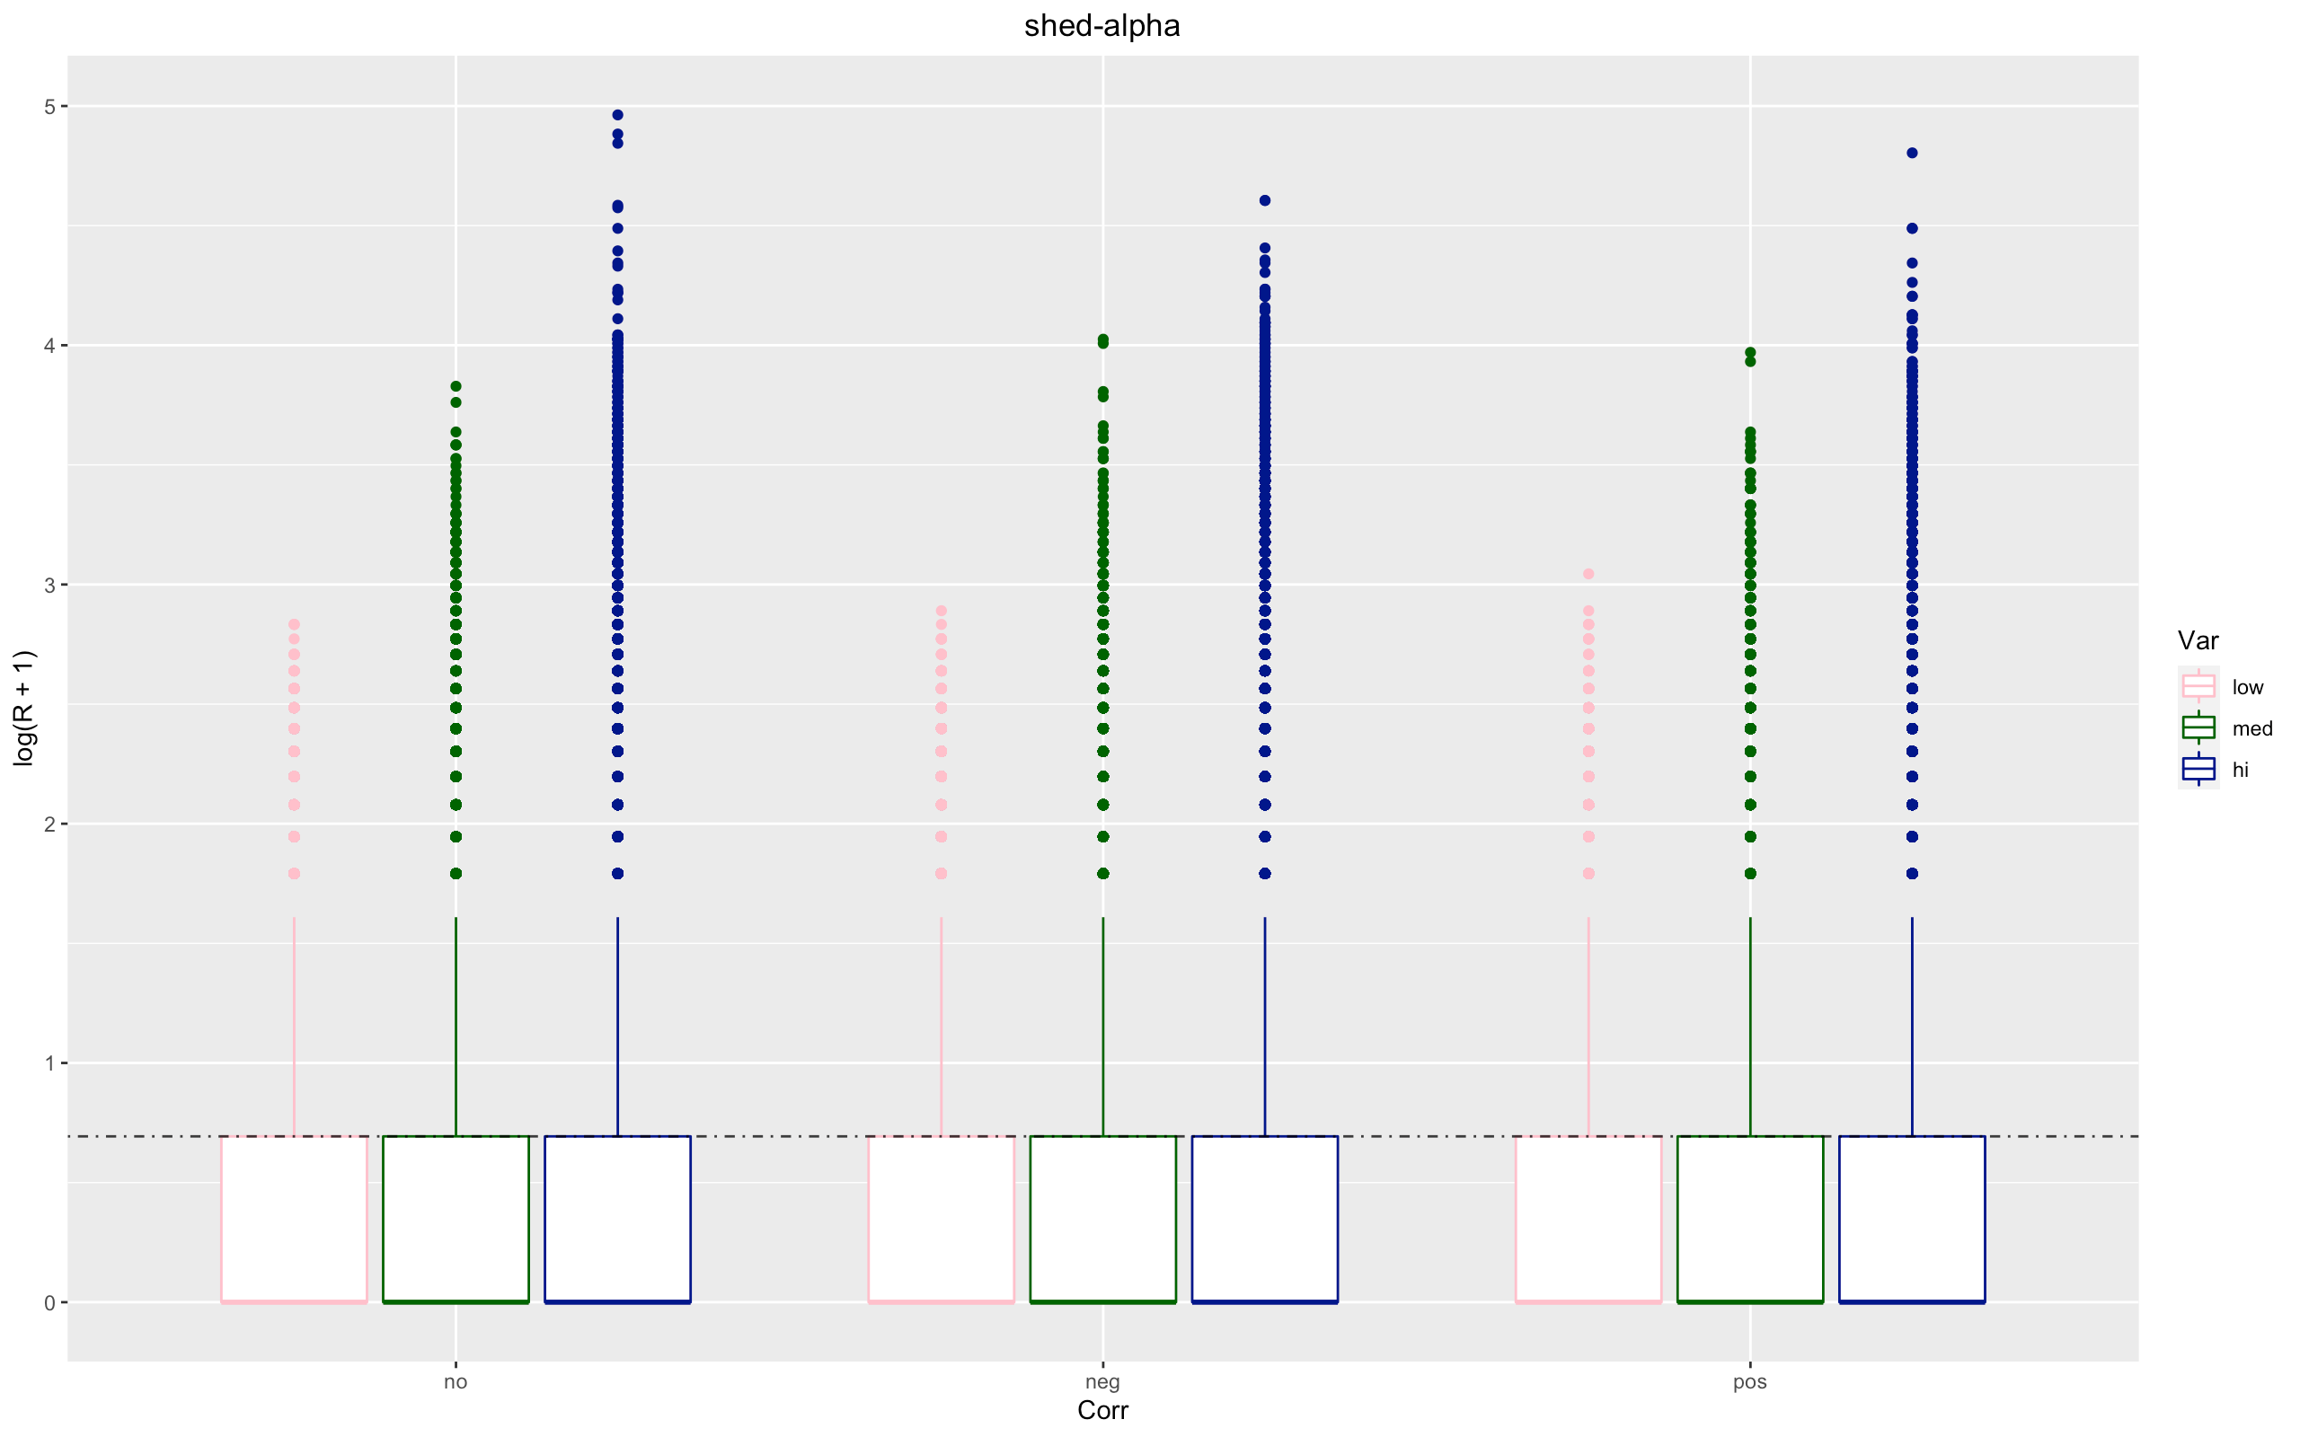

Slide 26
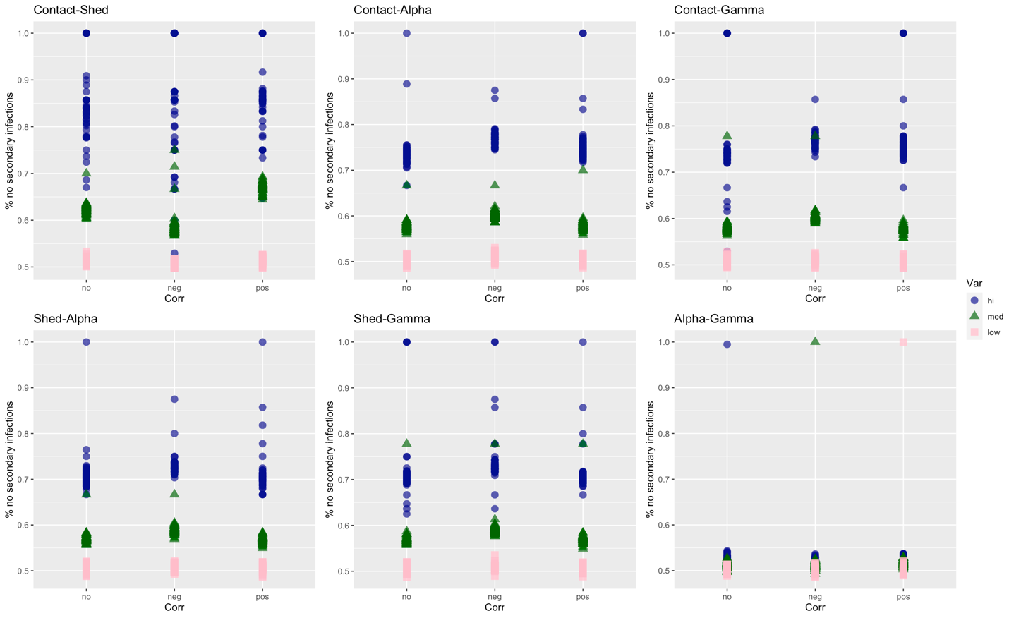

Slide 27
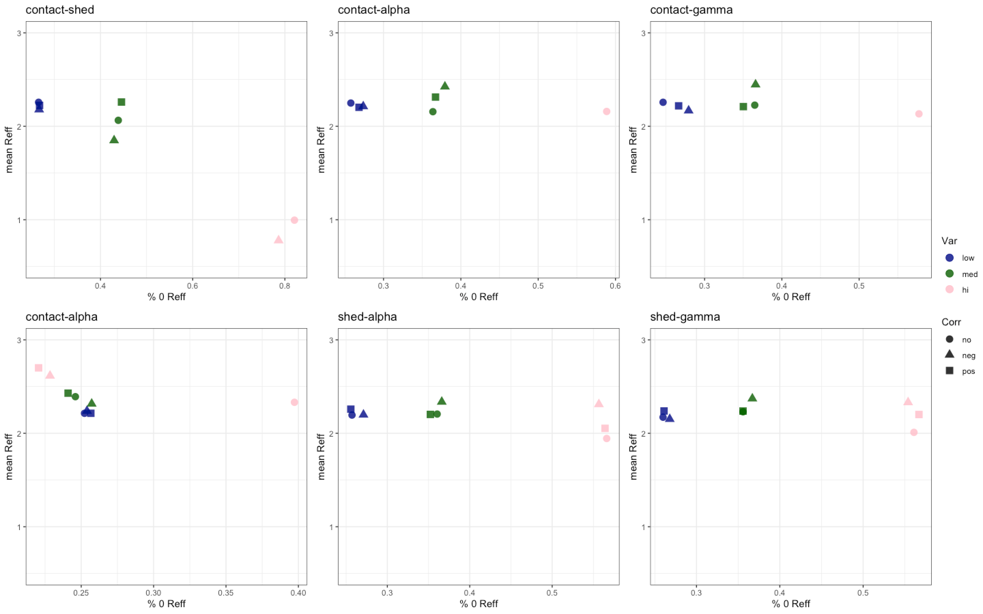

Slide 28
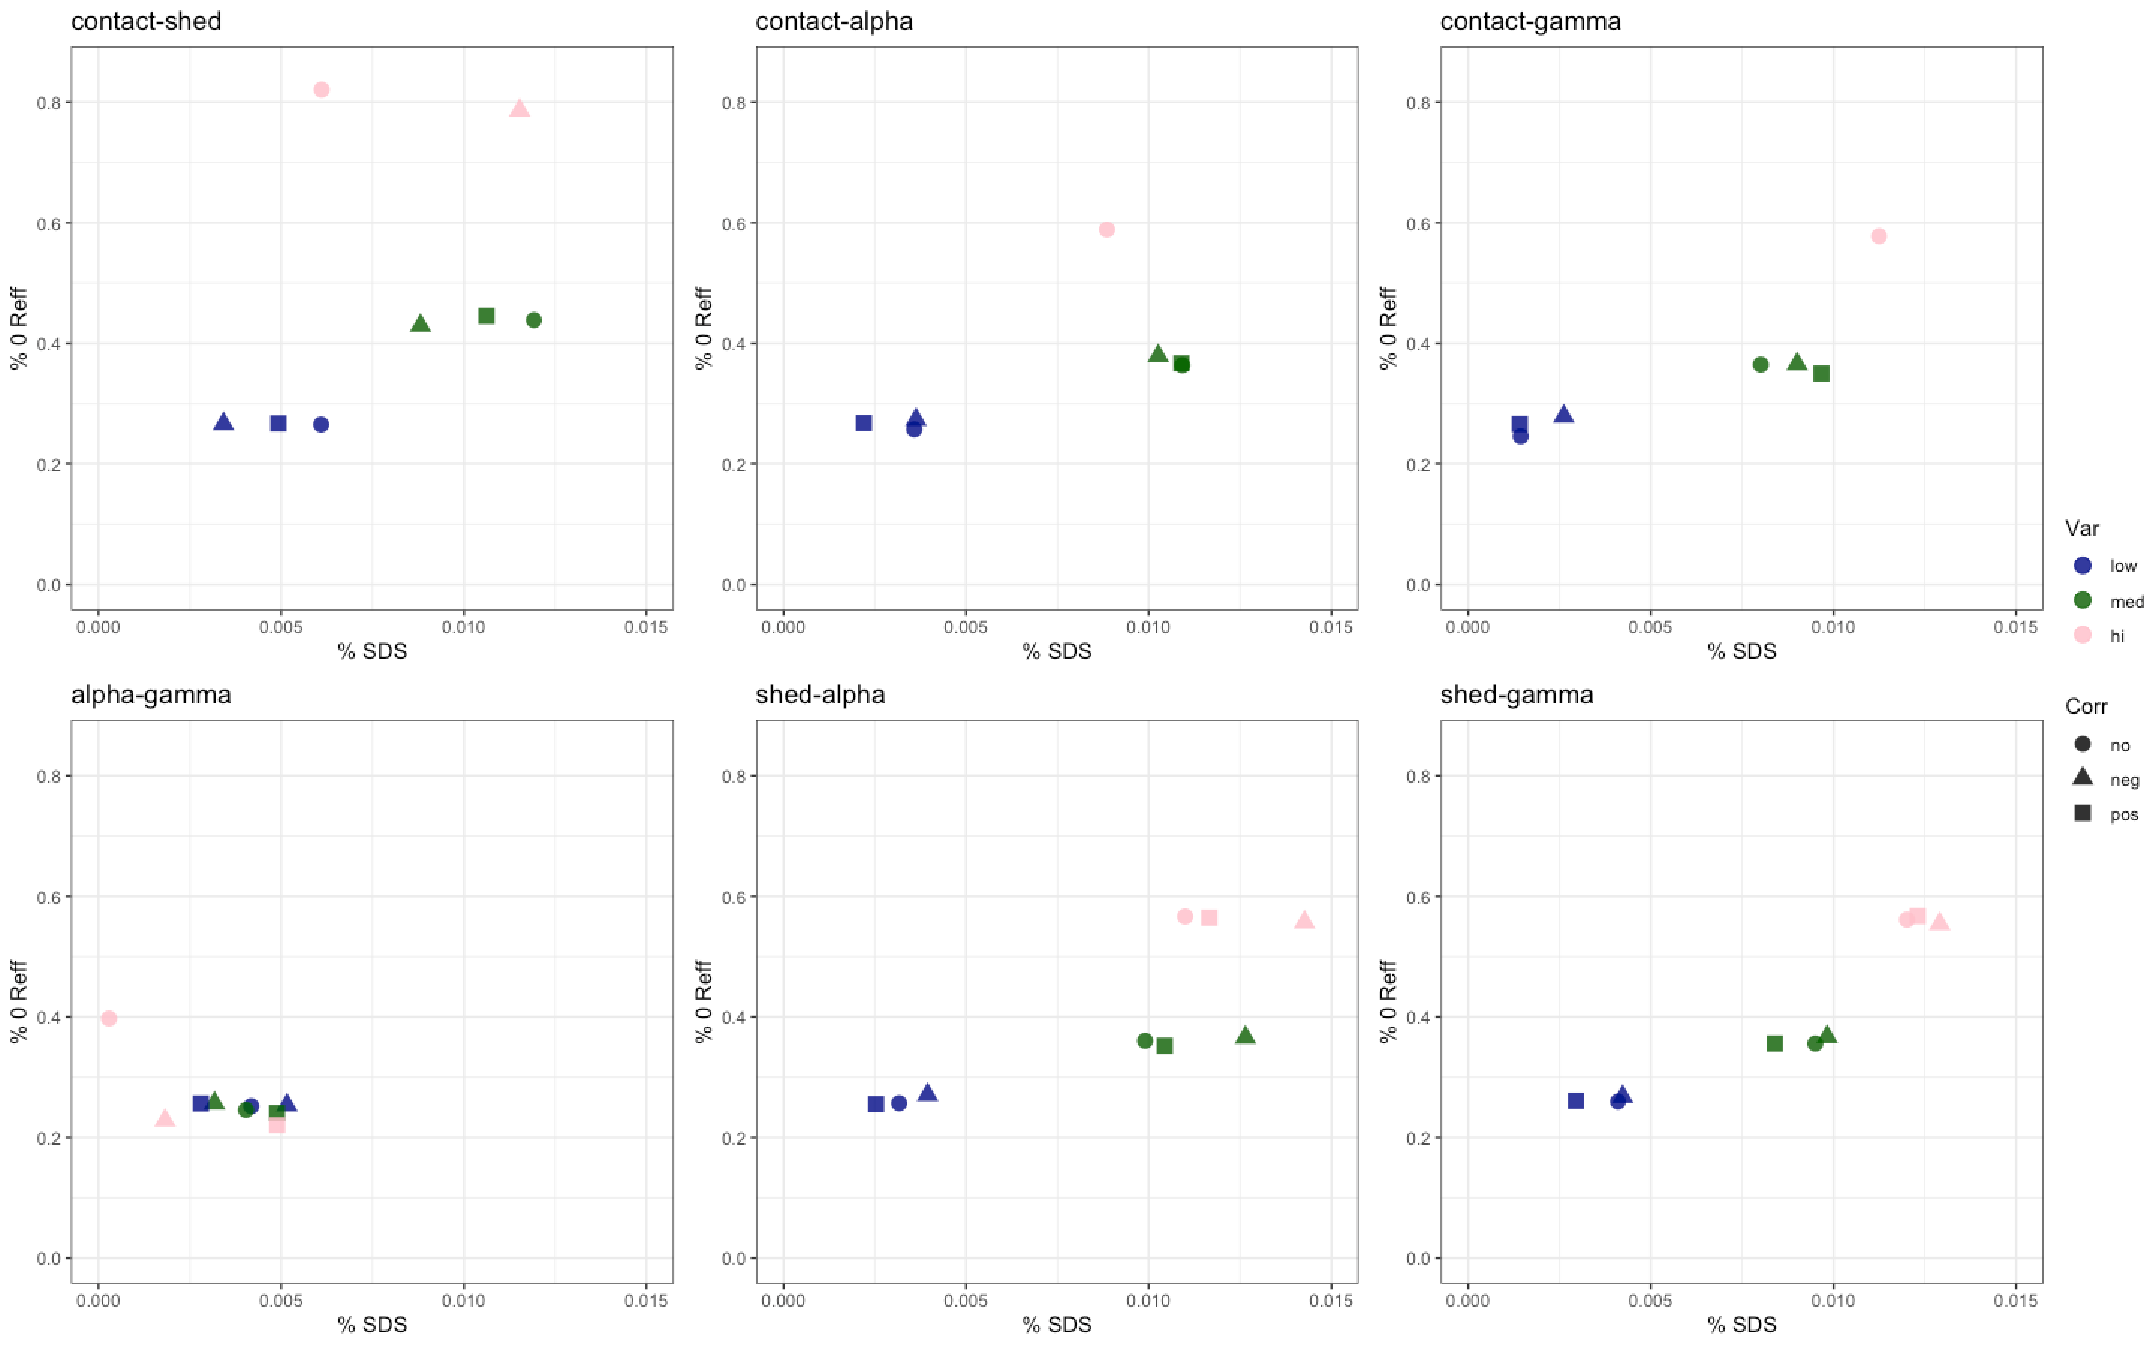

Slide 29
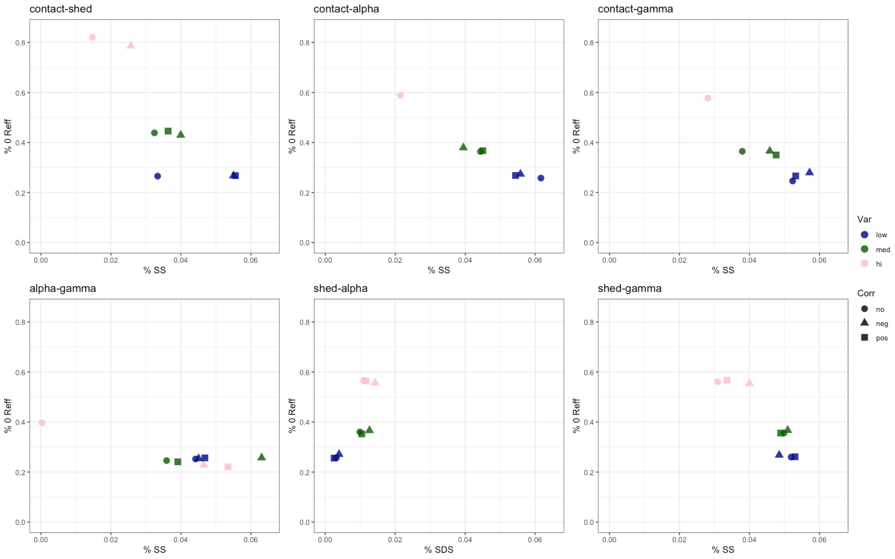

Slide 30
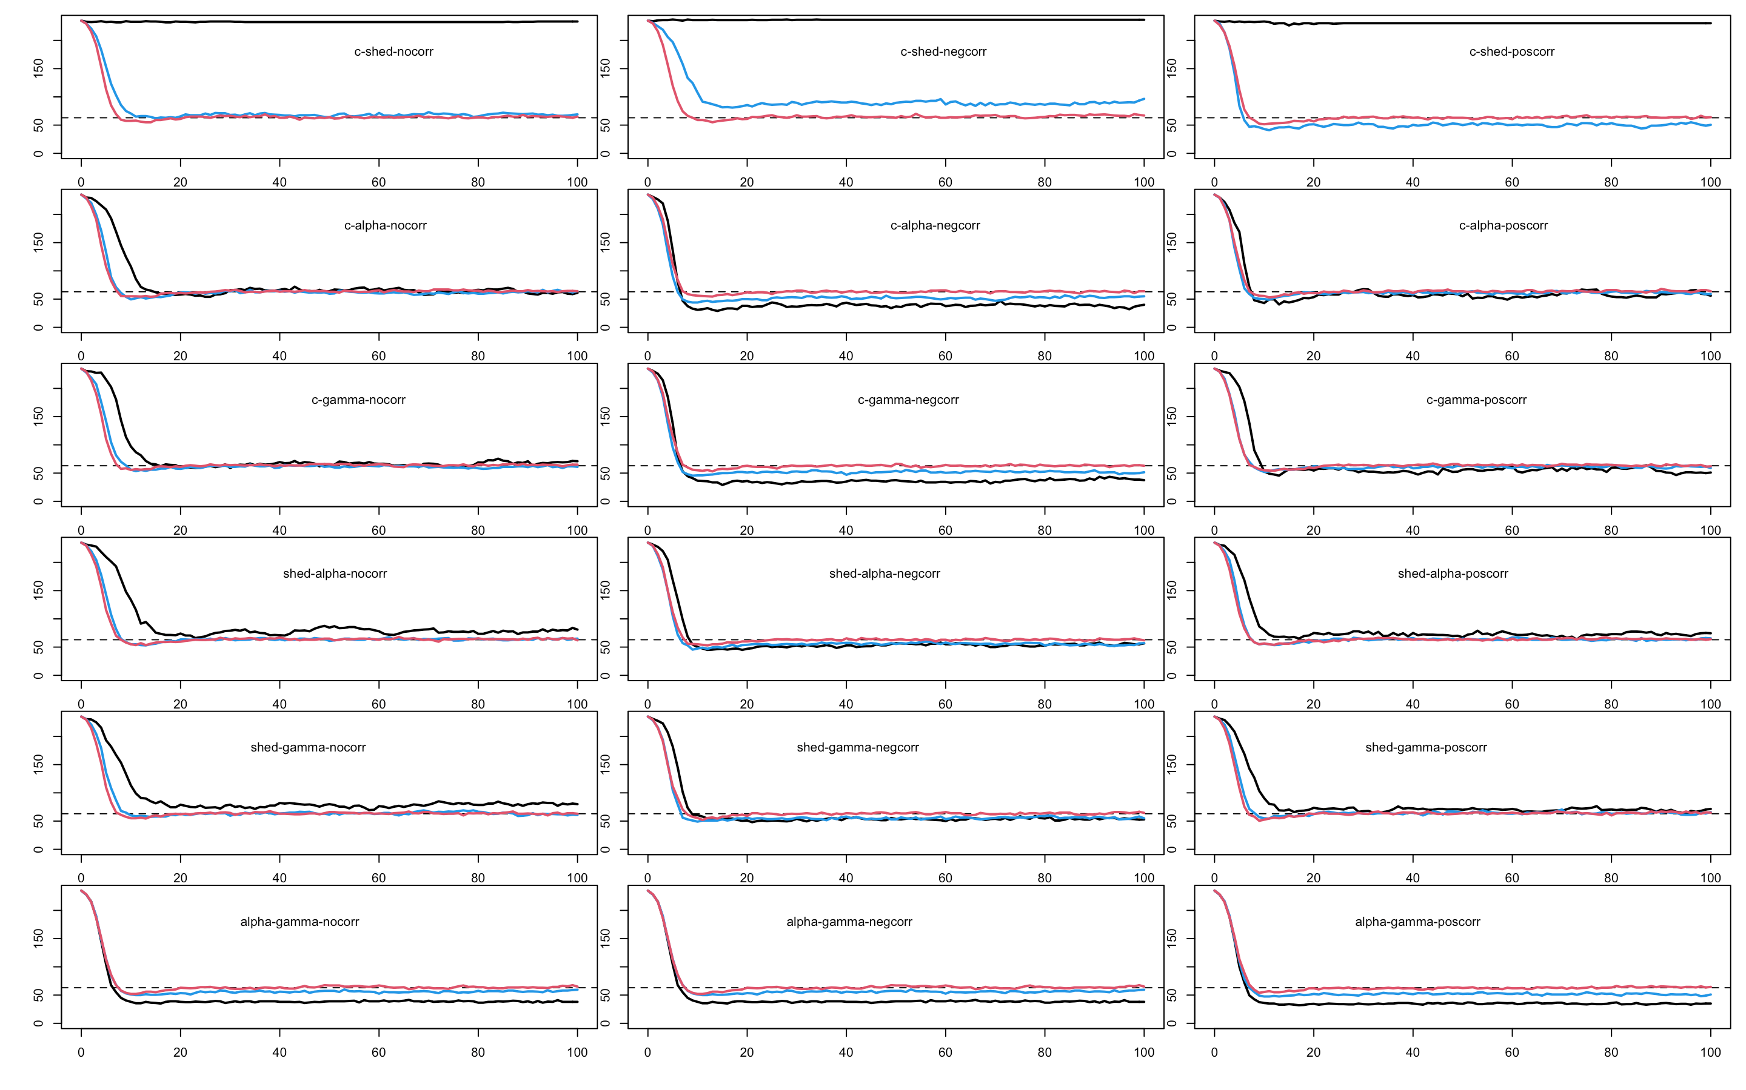

Slide 31
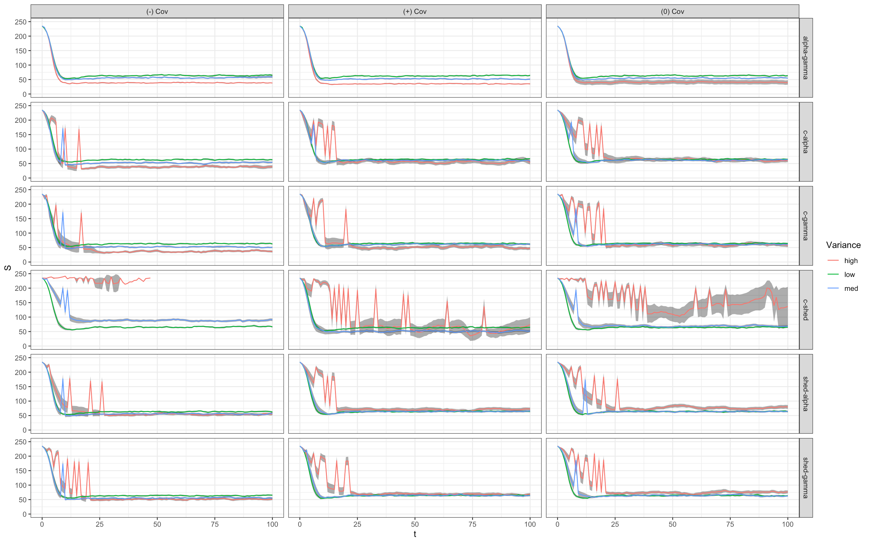
Notes:
Why sooooo different…. ☹

Slide 32
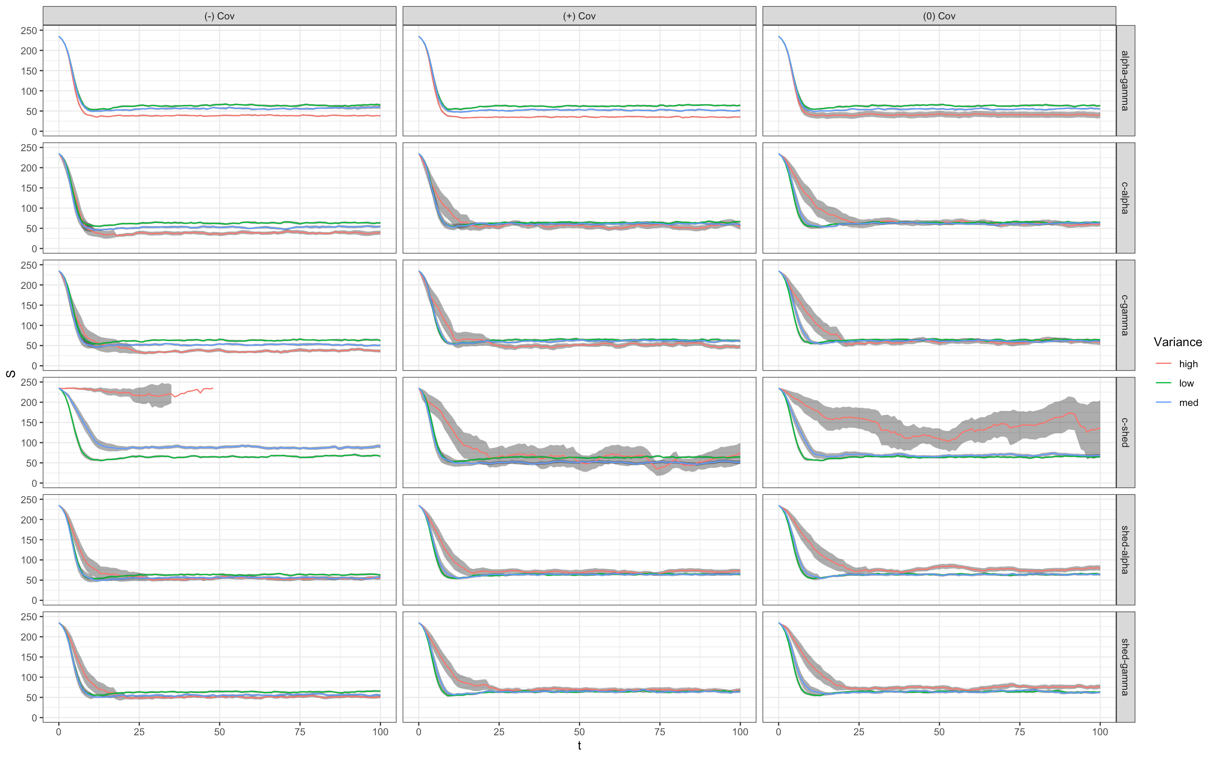

Slide 33
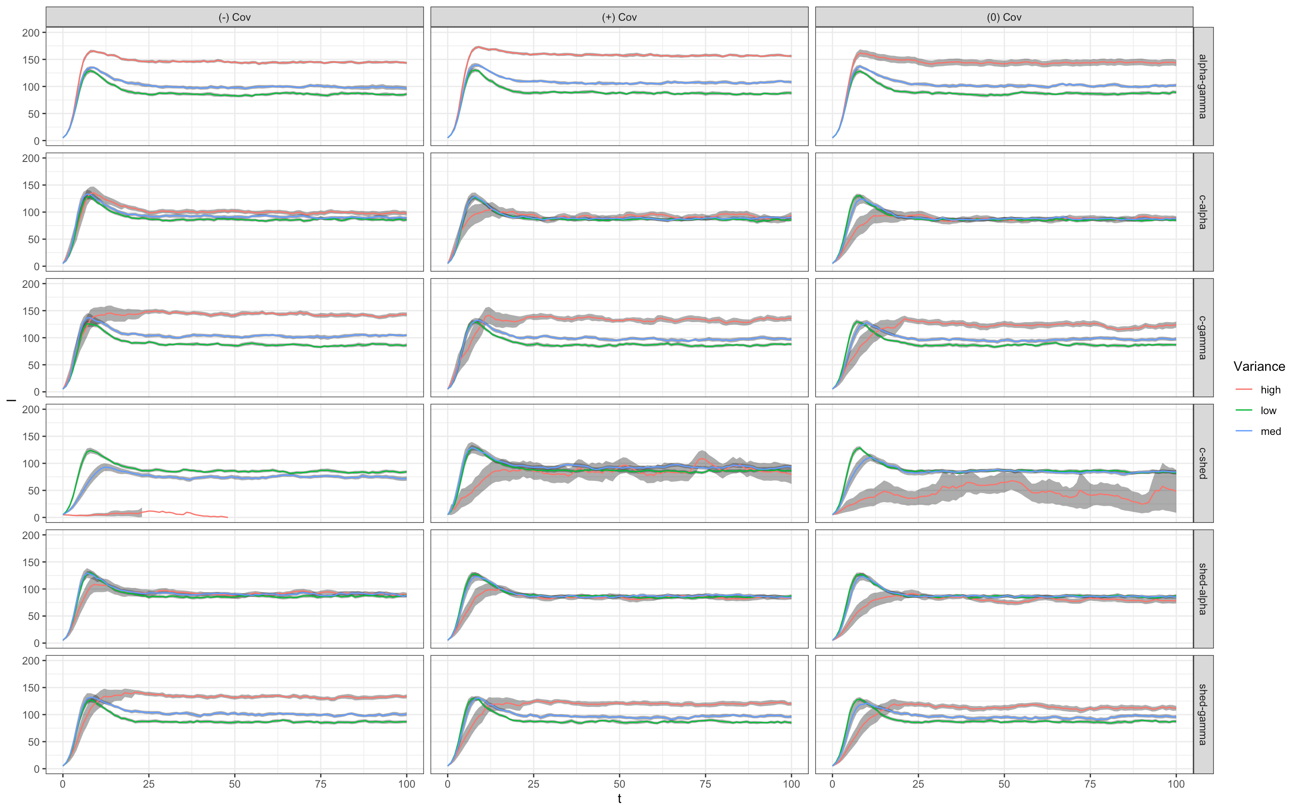

Slide 34
High R0 plots

Slide 35
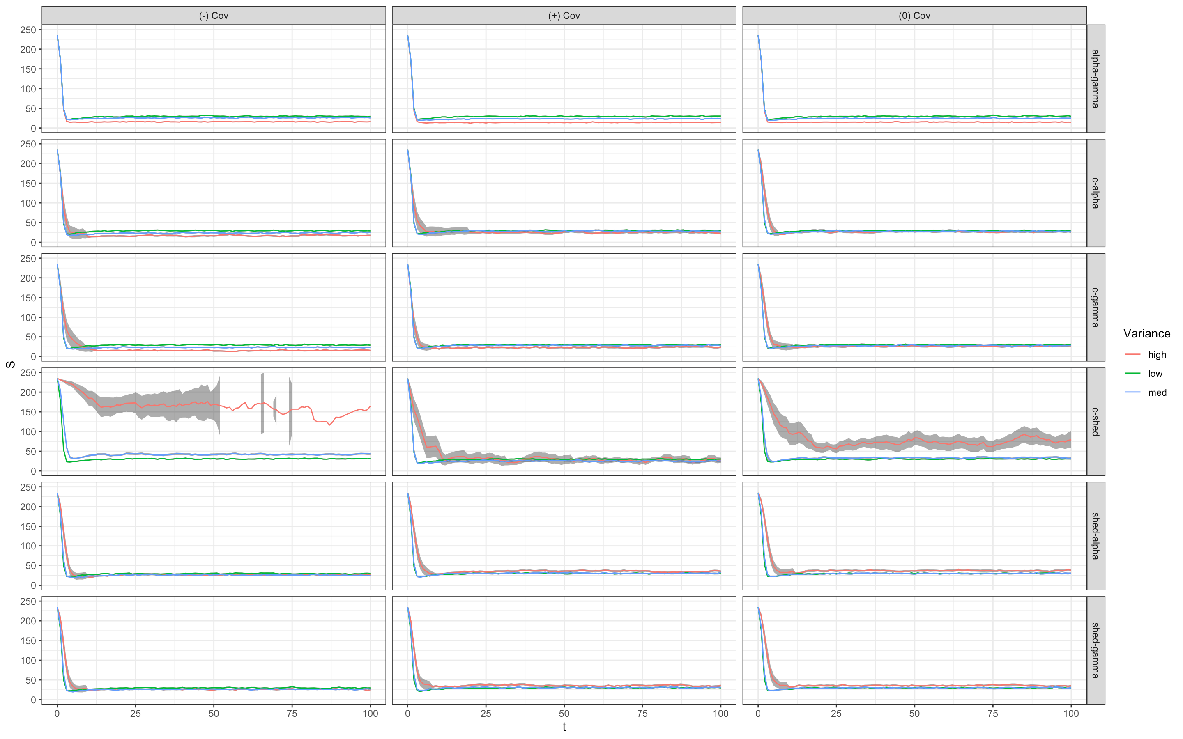
S individuals

Slide 36
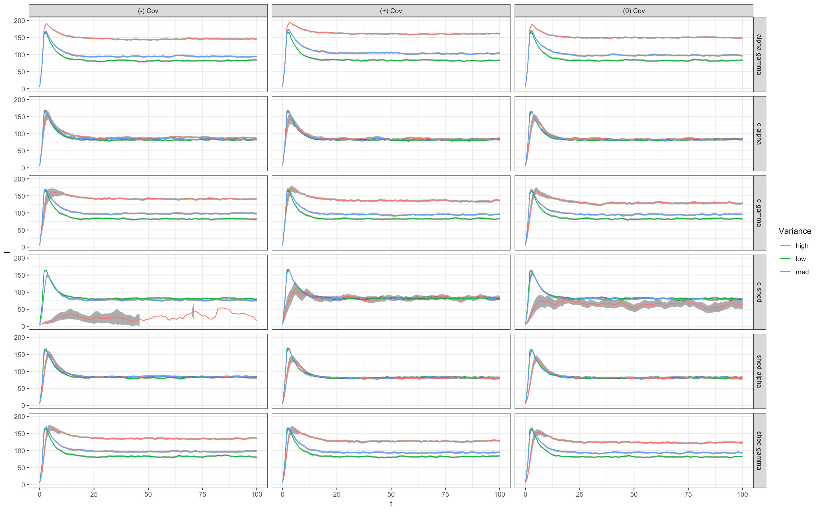
I individuals

Slide 37
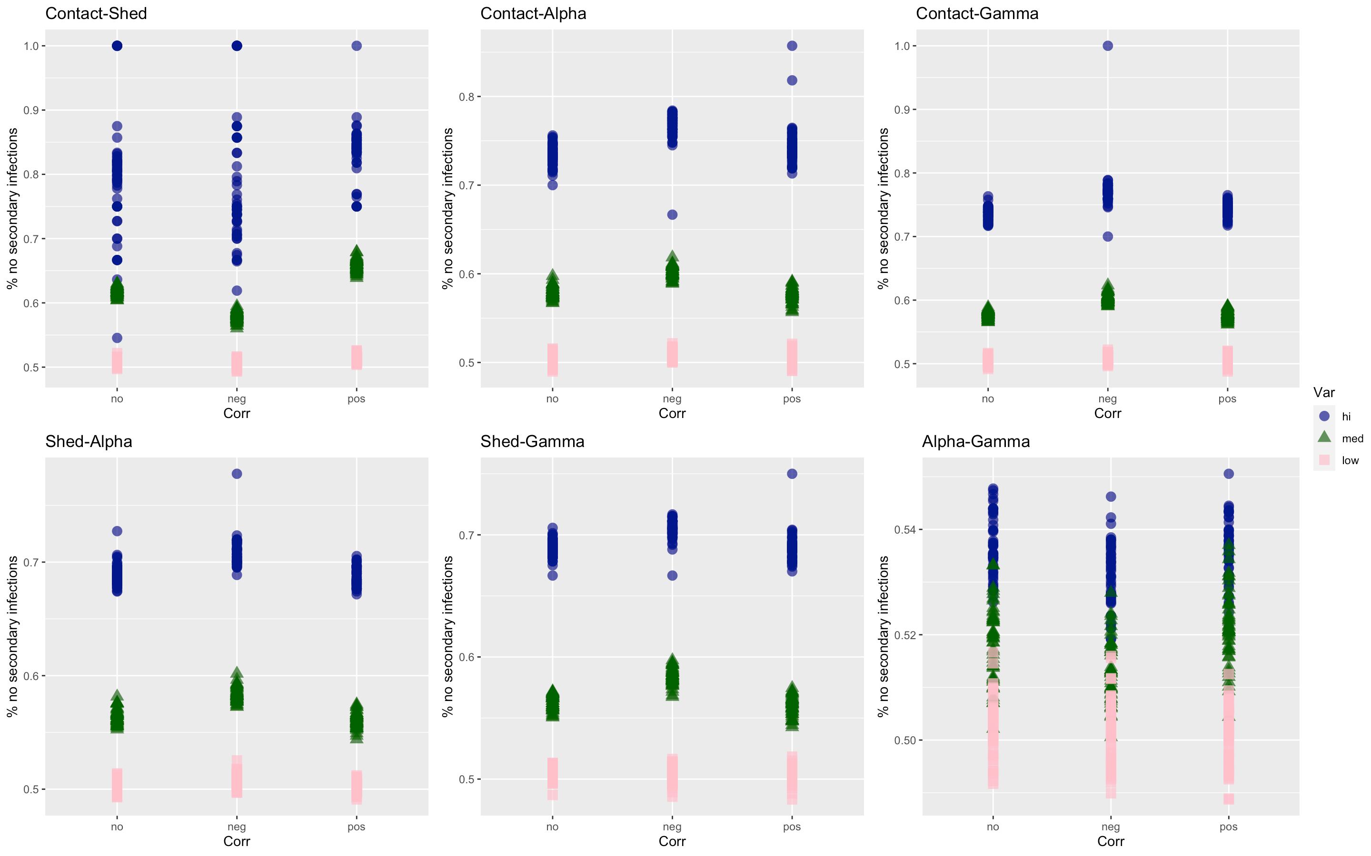

Slide 39
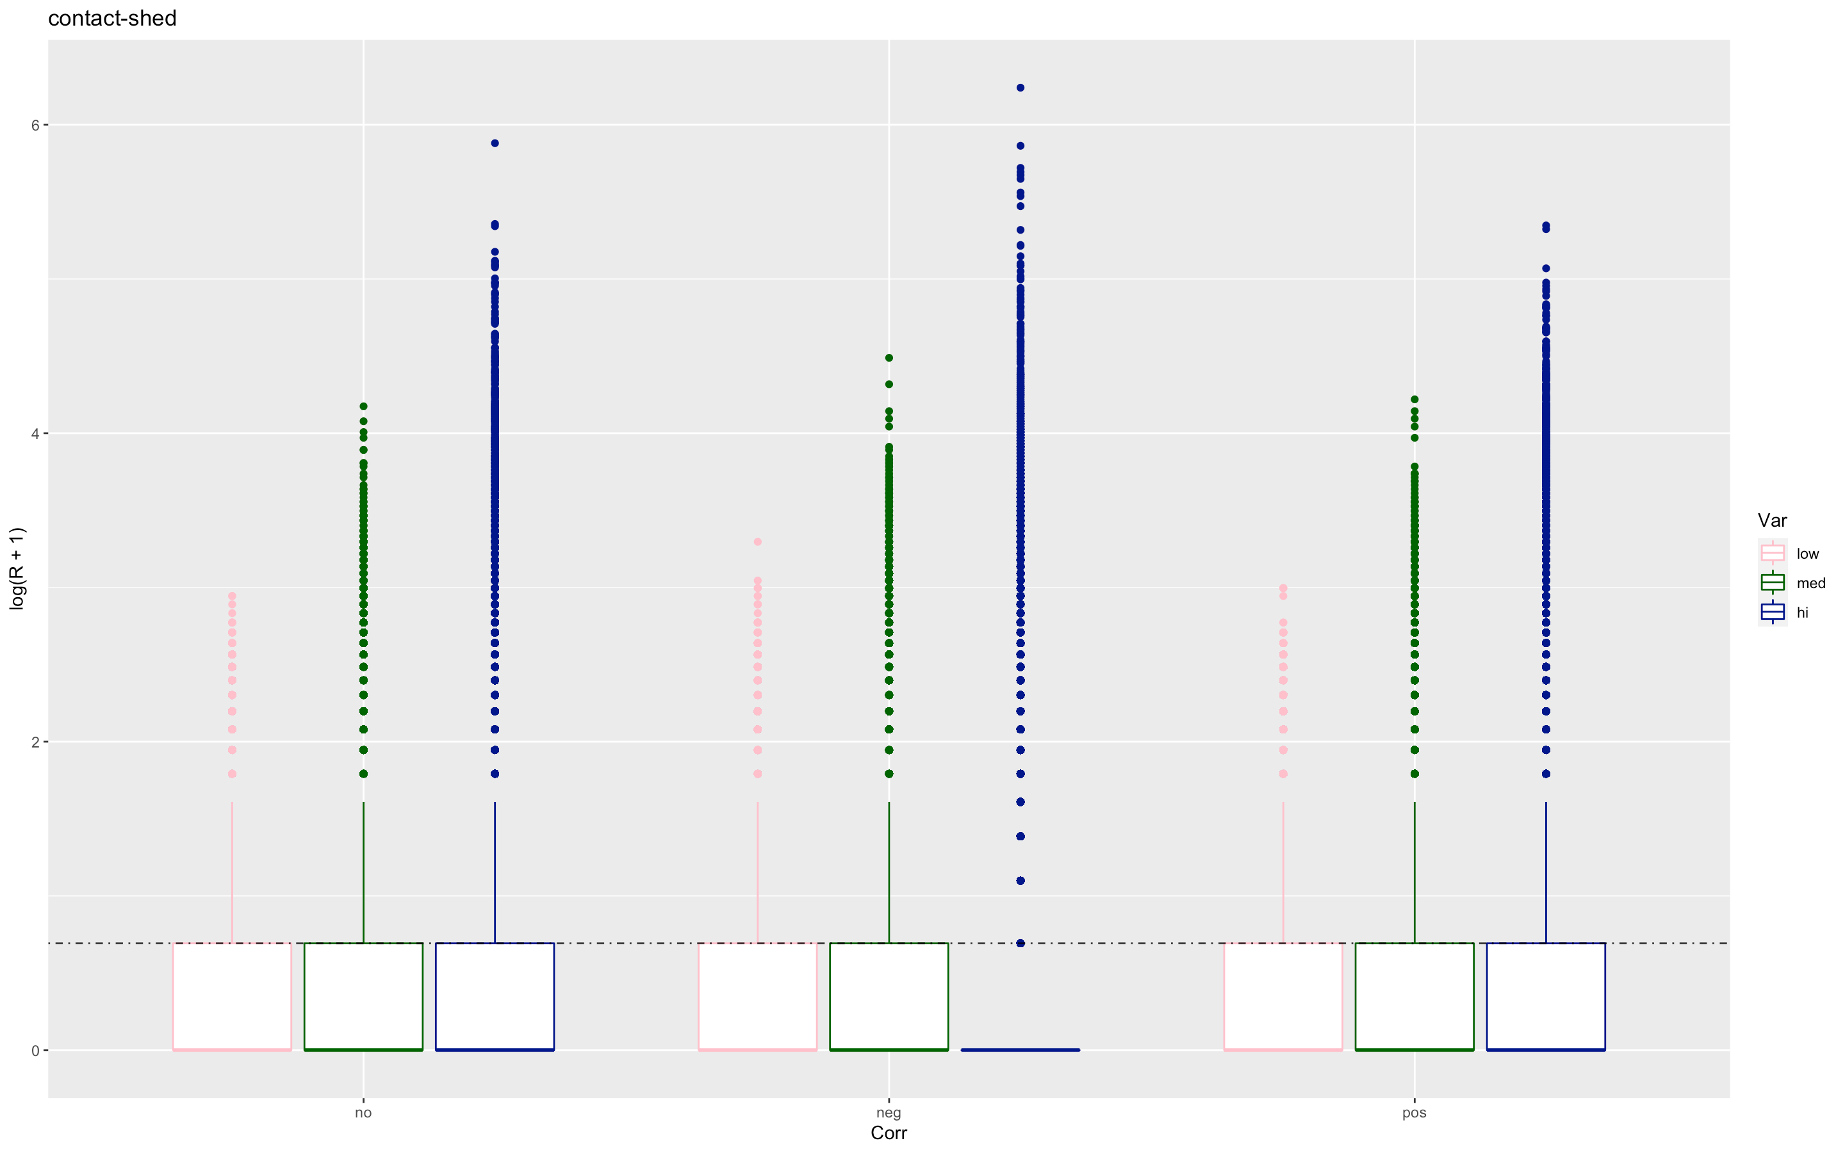
Contact shed

Slide 40
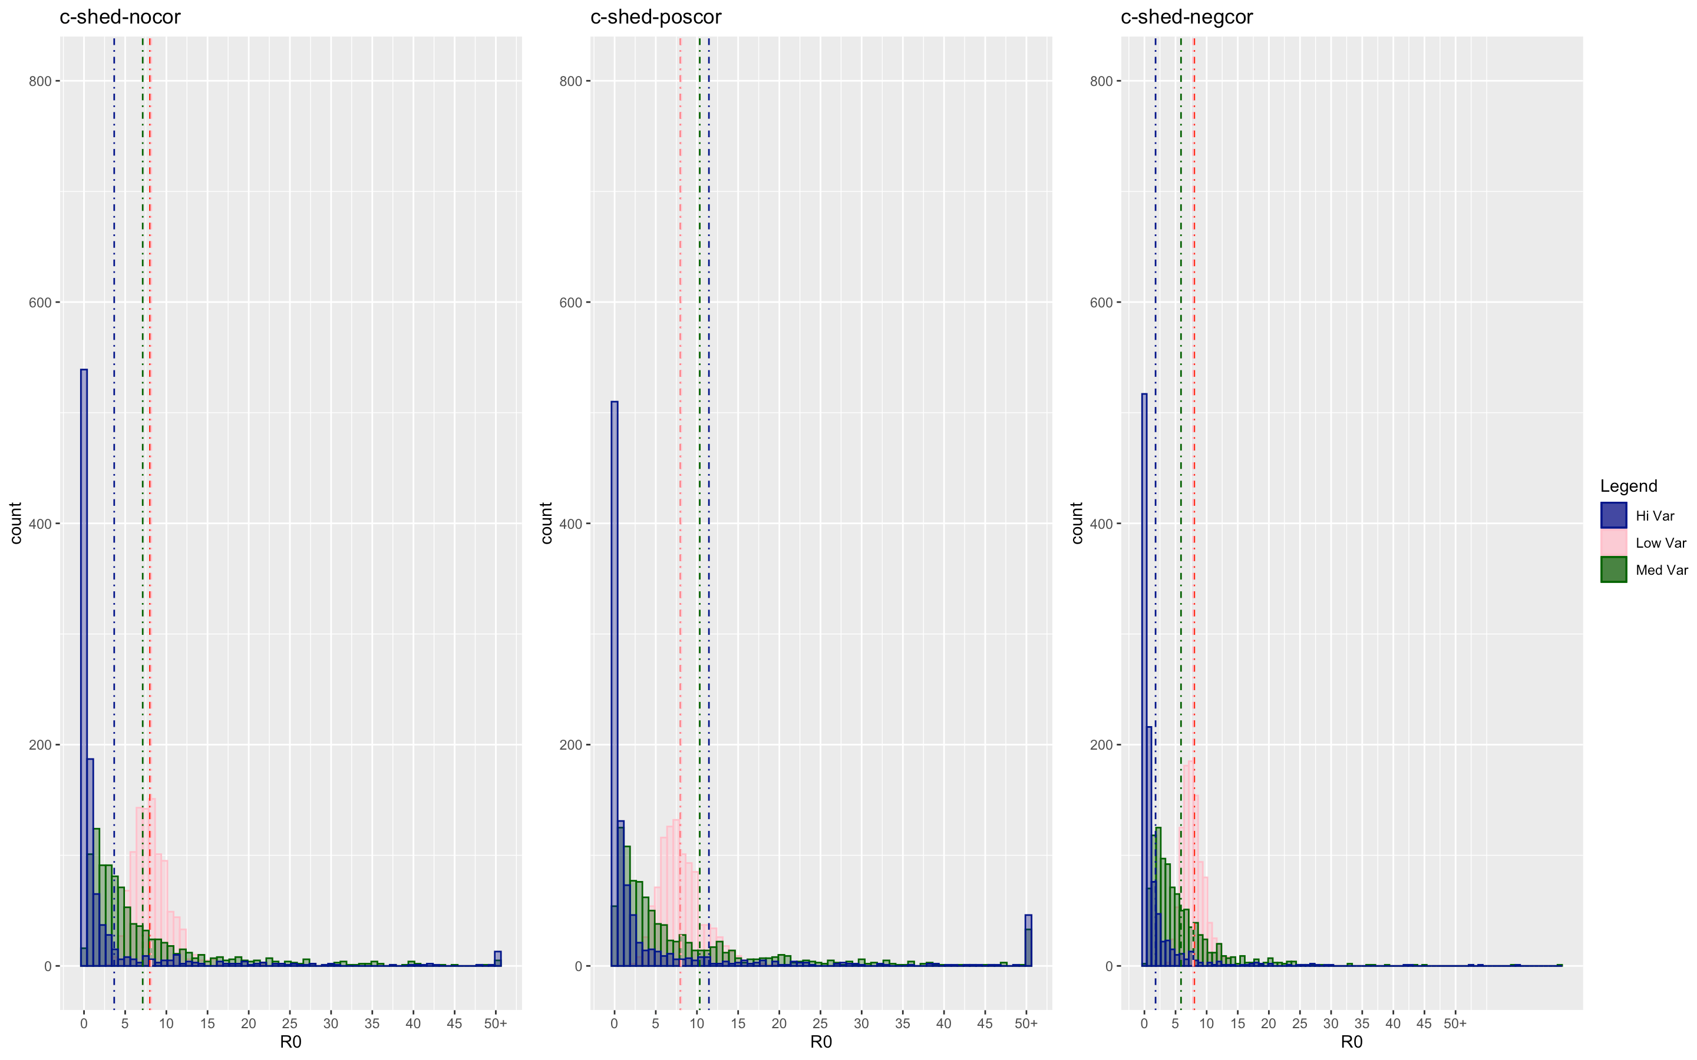

Slide 41

Contact alpha

Slide 42
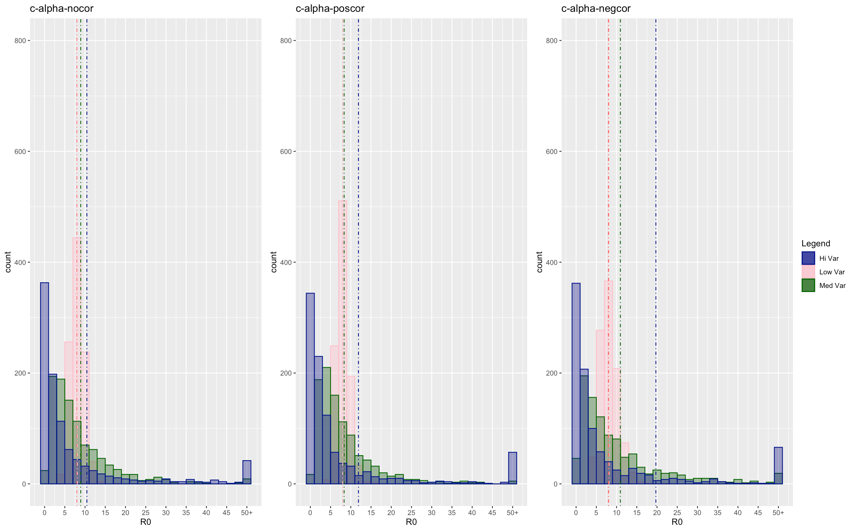

Slide 43
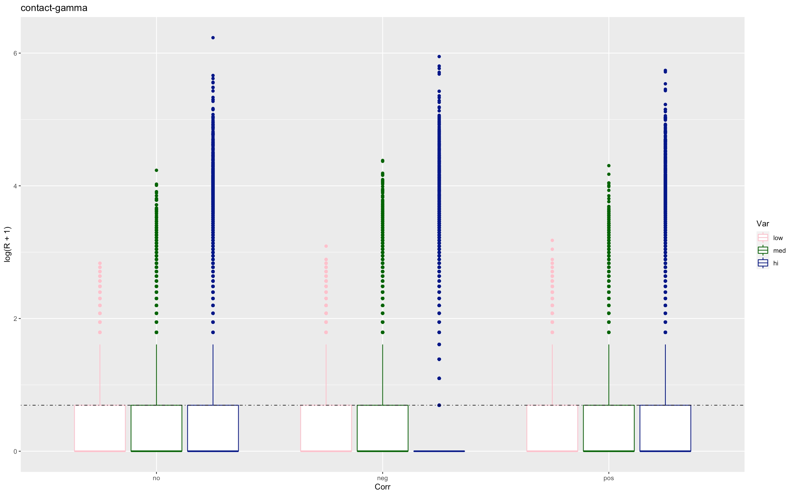
Contact gamma

Slide 44
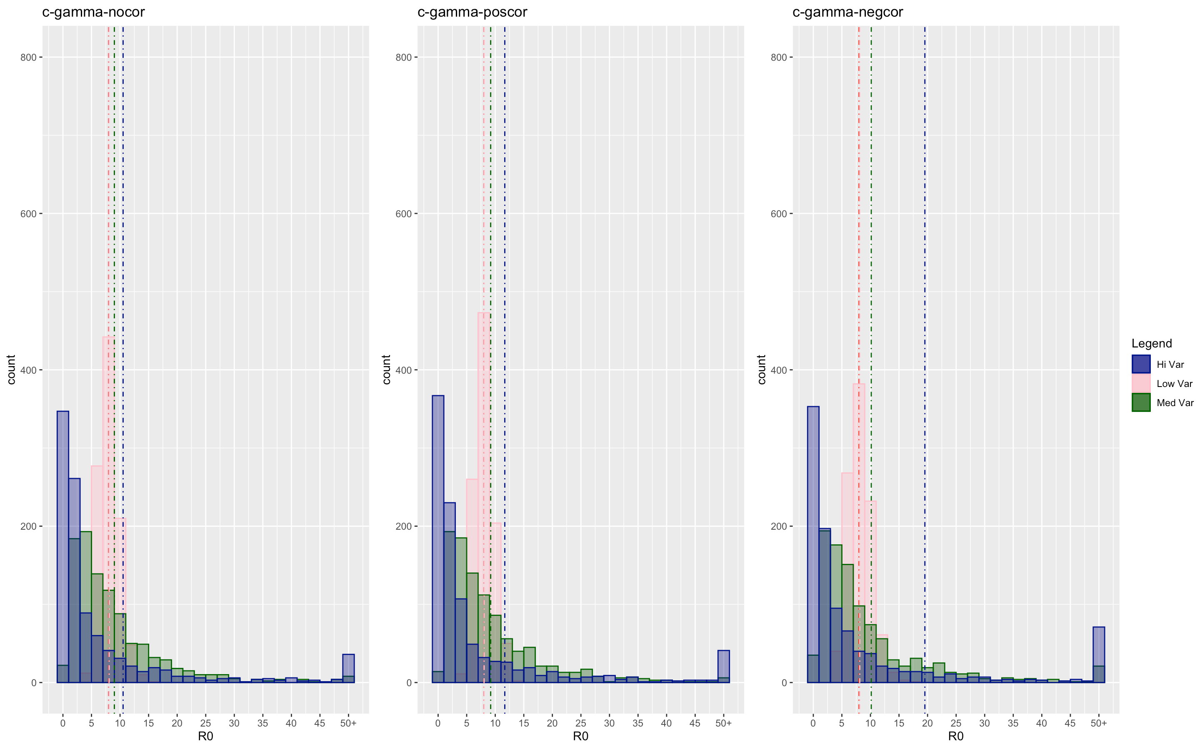

Slide 45
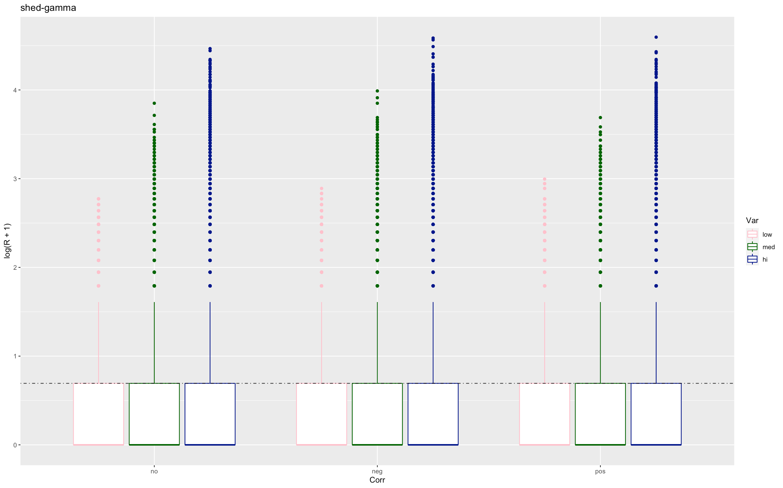
Shed gamma

Slide 46
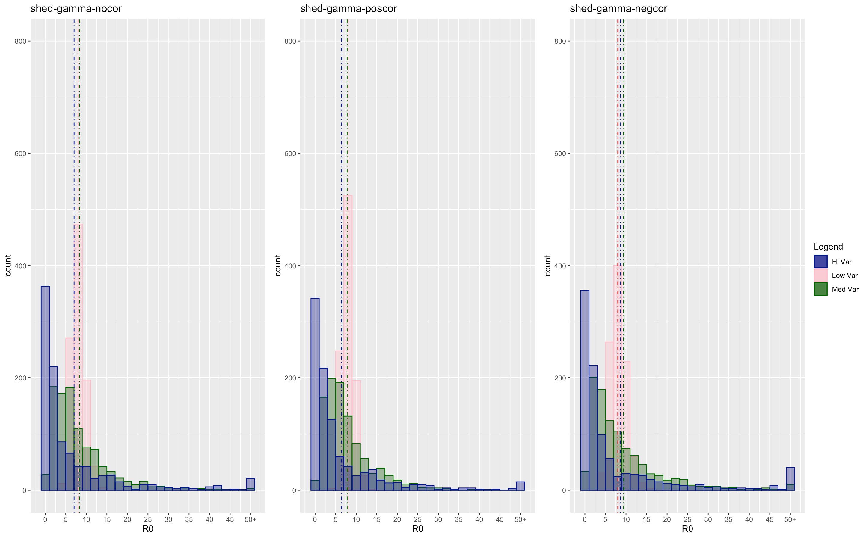

Slide 47
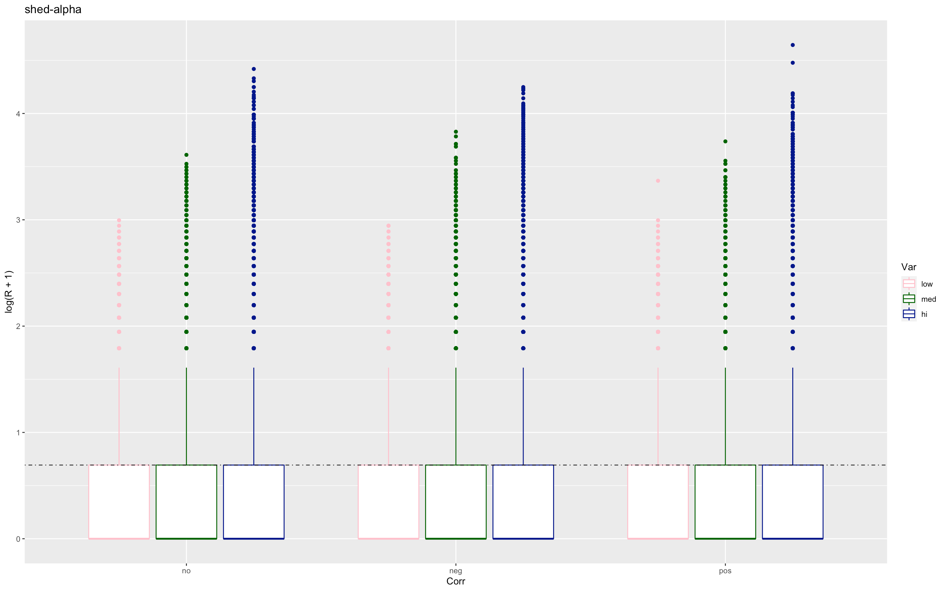
Shed alpha

Slide 48
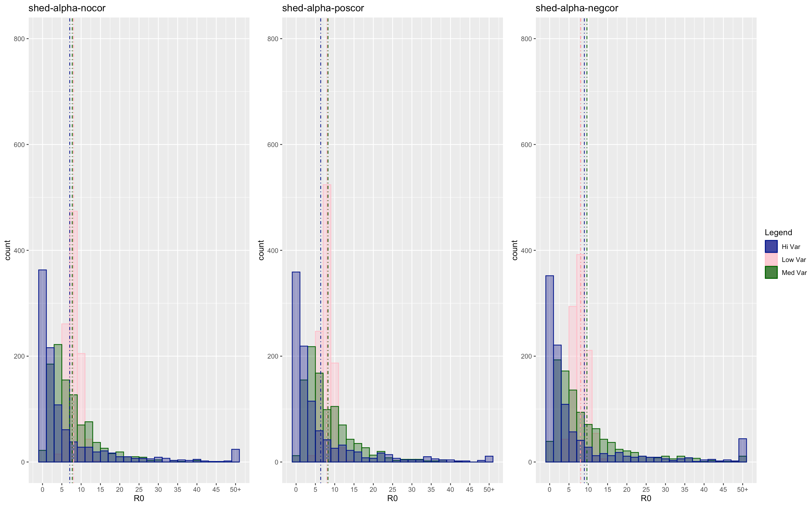

Slide 49
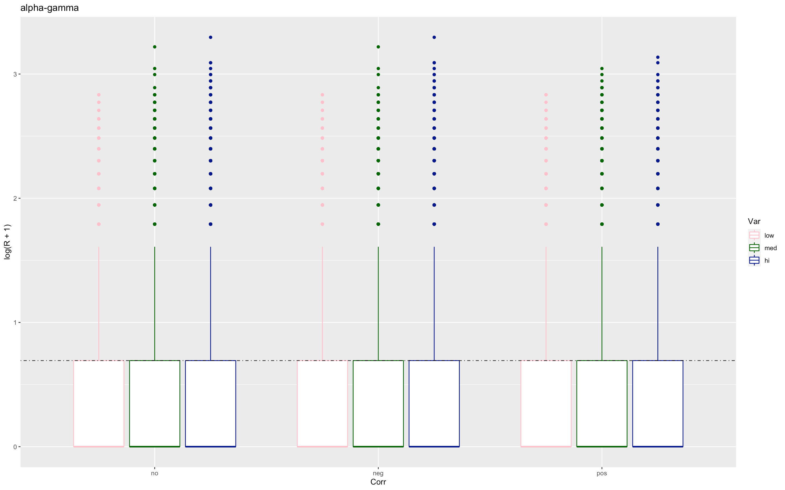
Alpha gamma

Slide 50
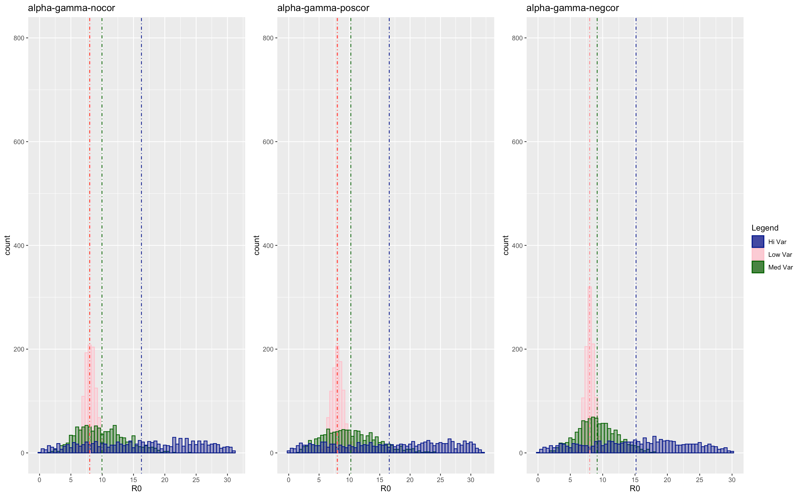

Slide 51
Low R0 plotszas

Slide 52
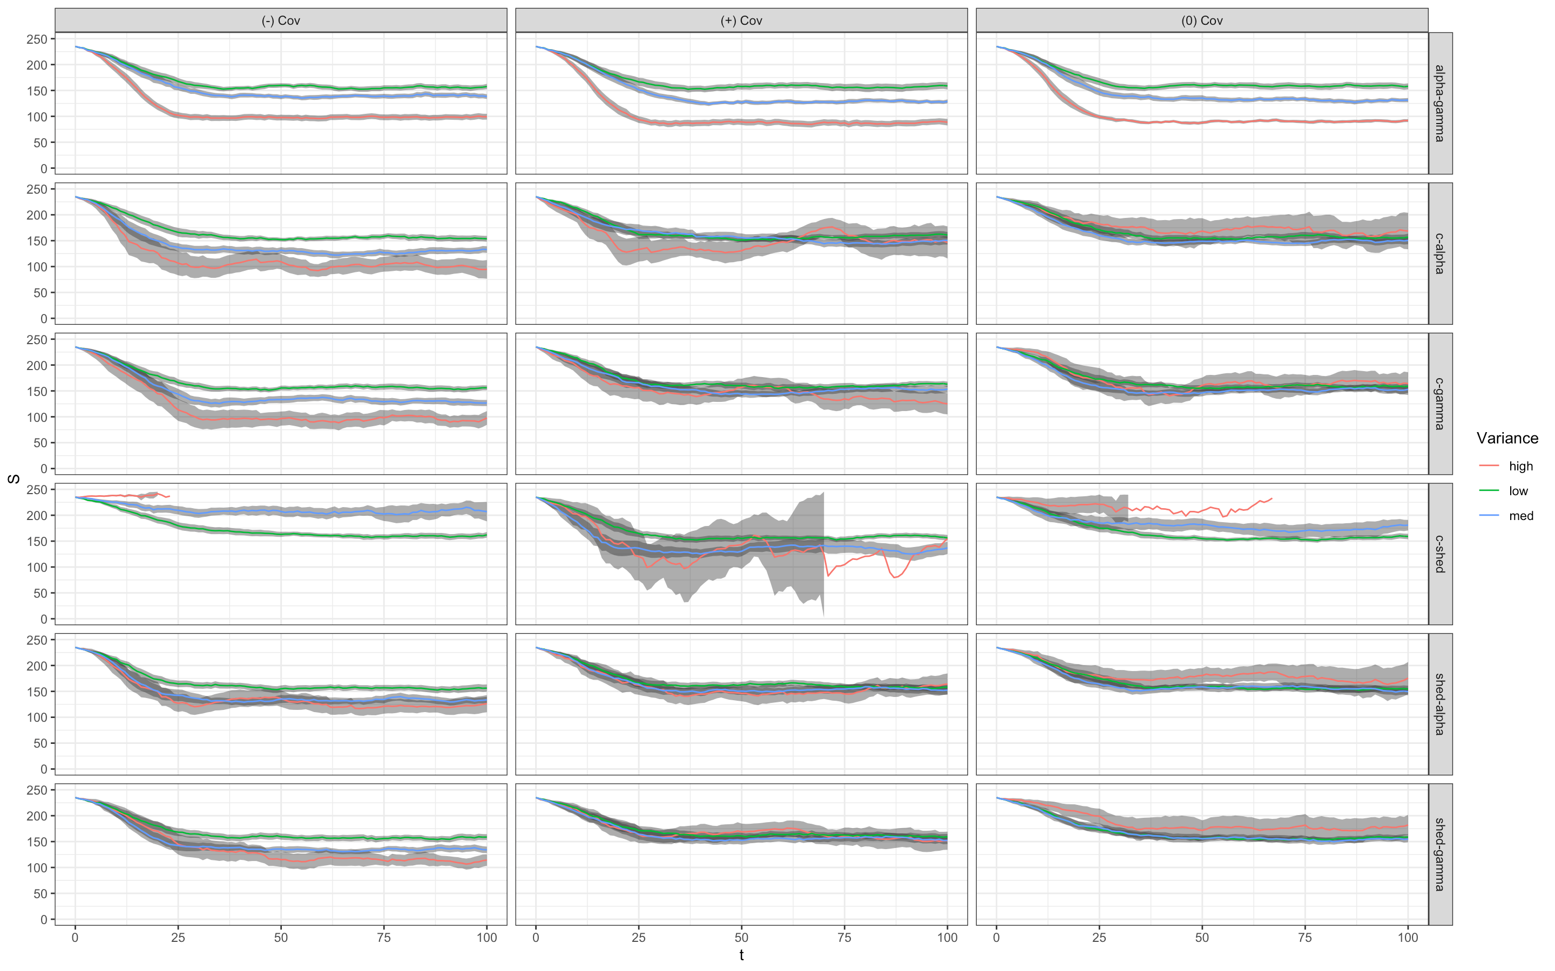

Slide 53
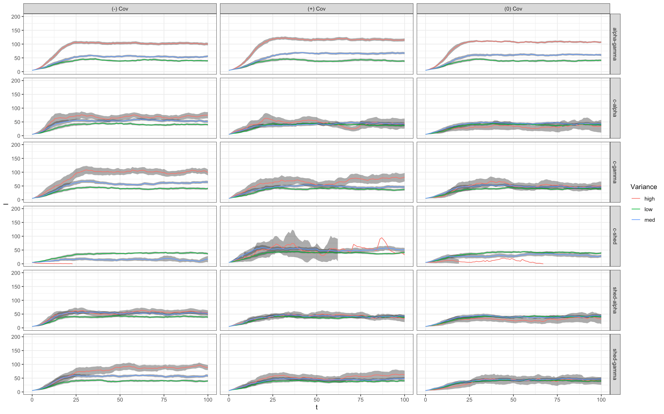

Slide 54
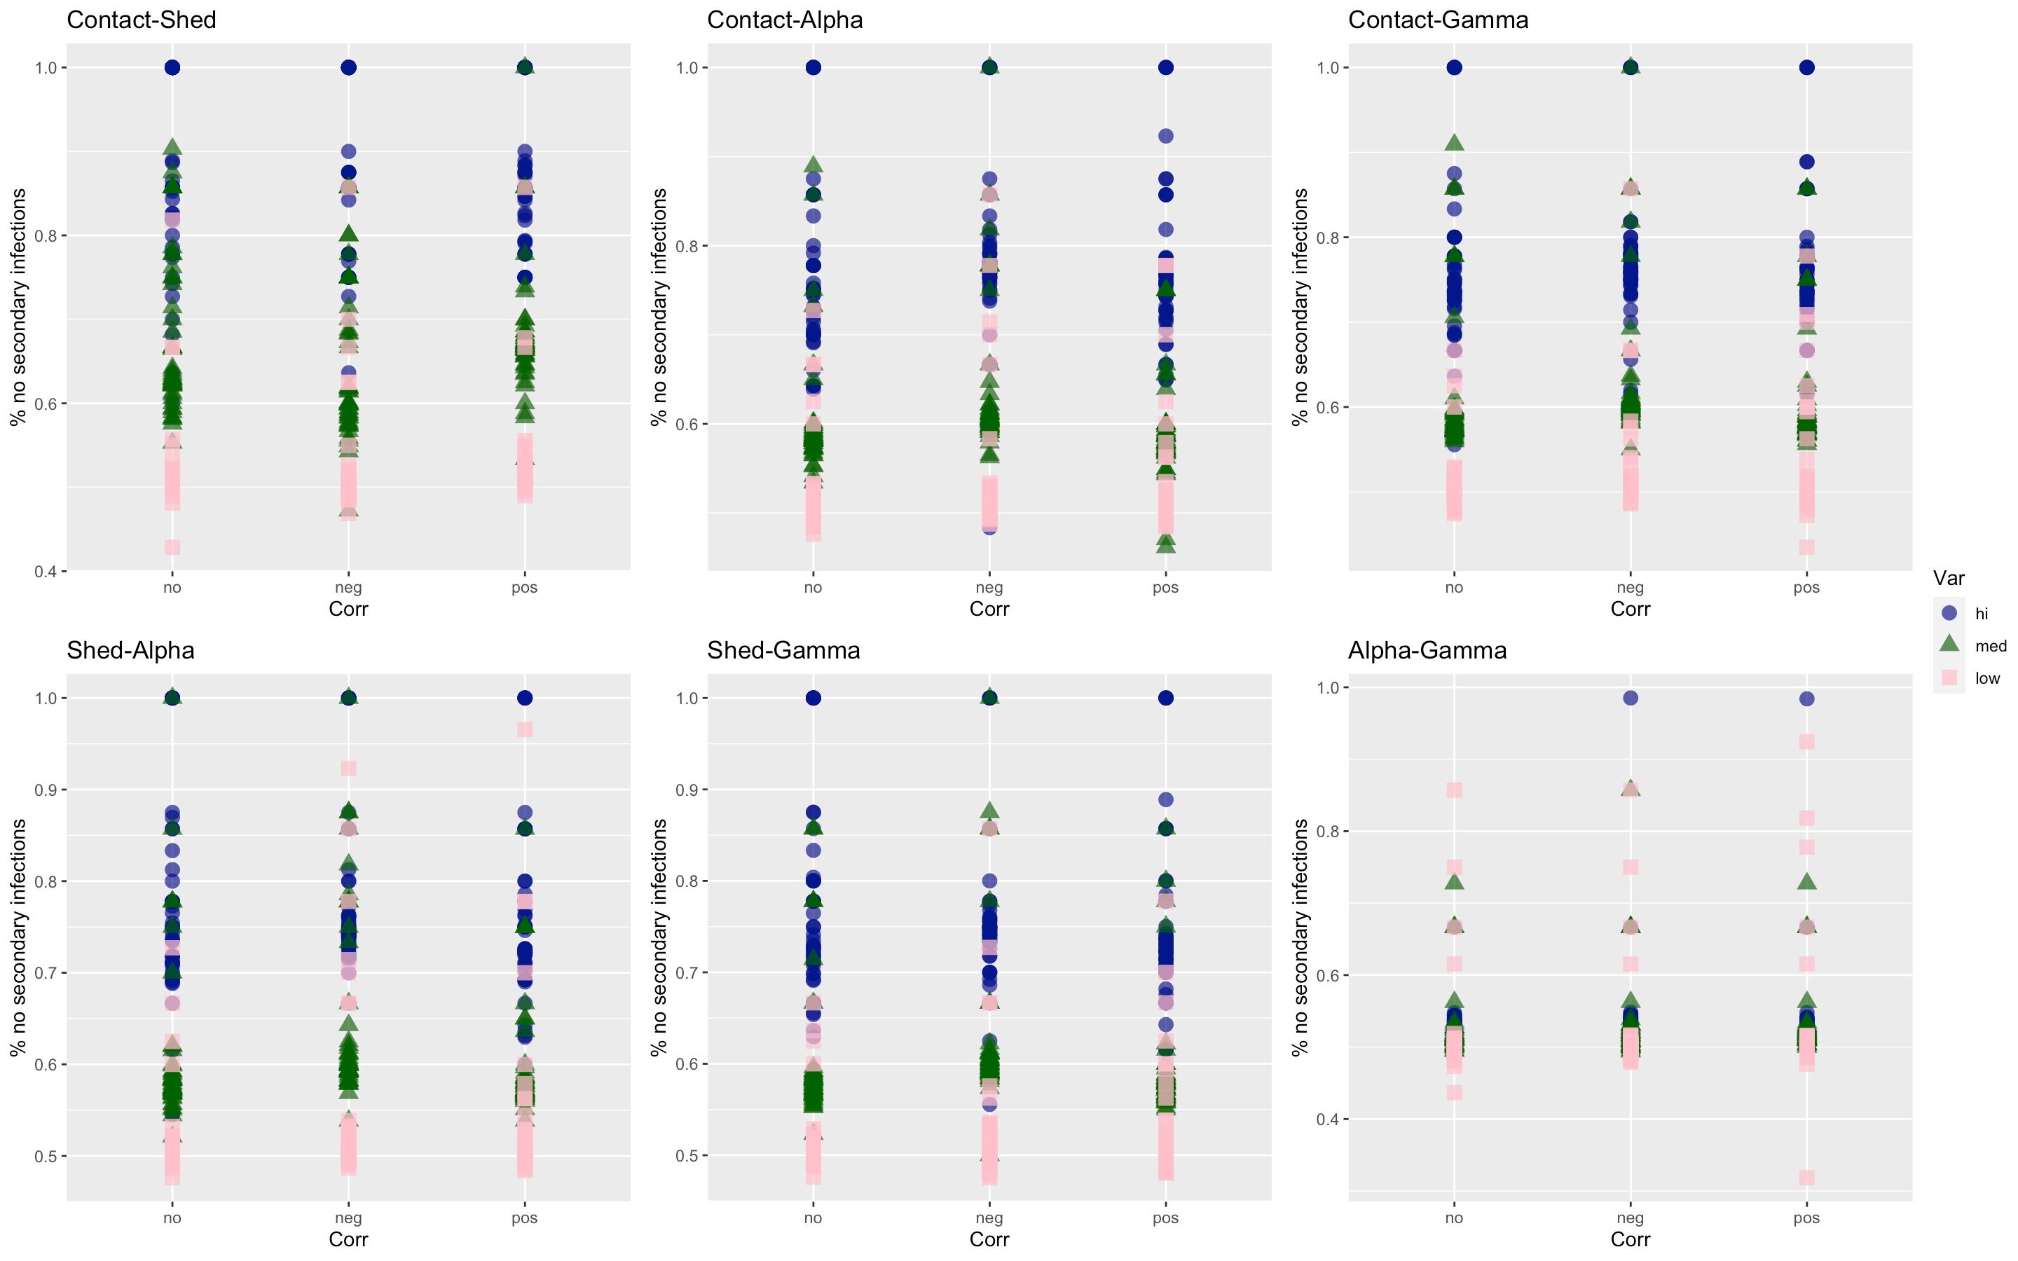

Slide 55
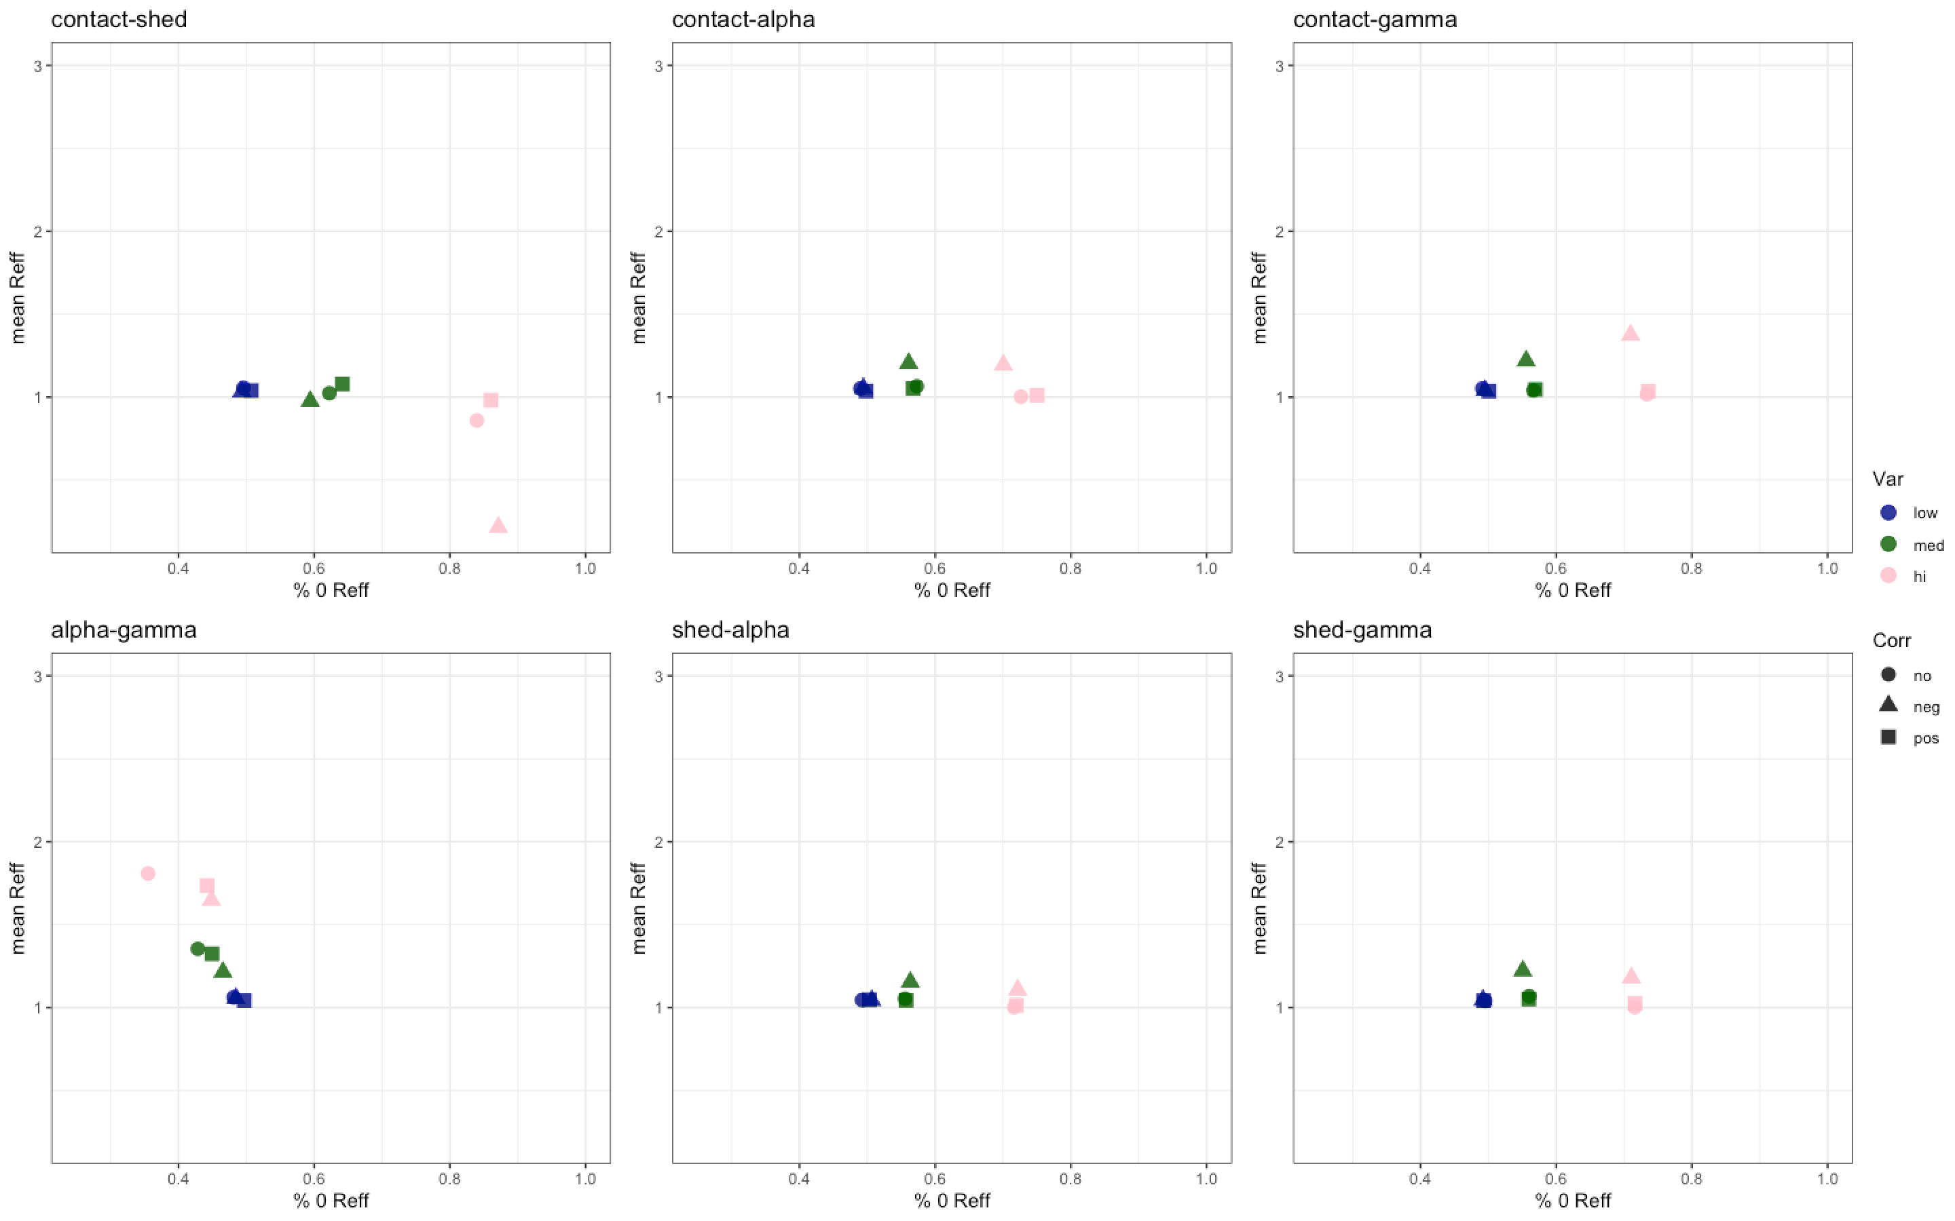

Slide 56
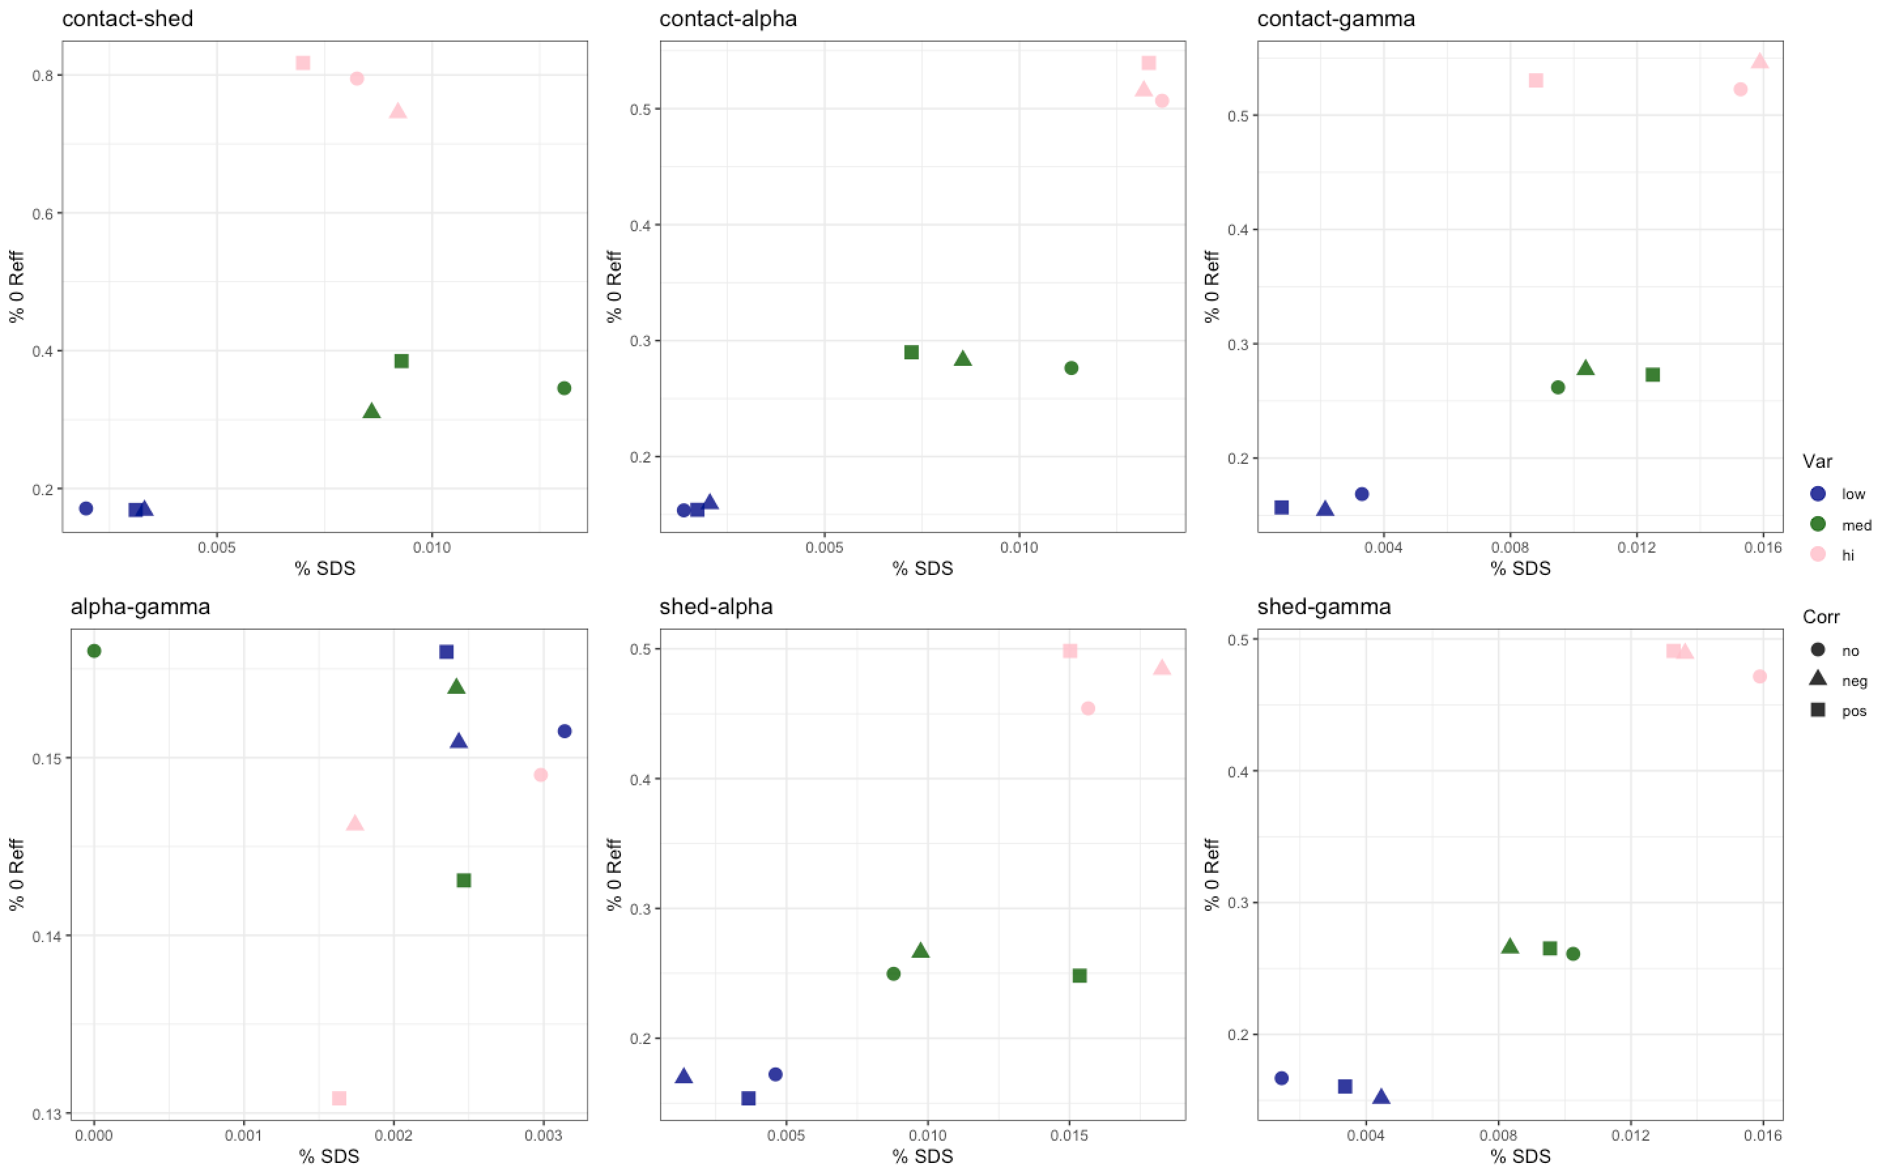
Hi R0
Hi R0

Slide 58
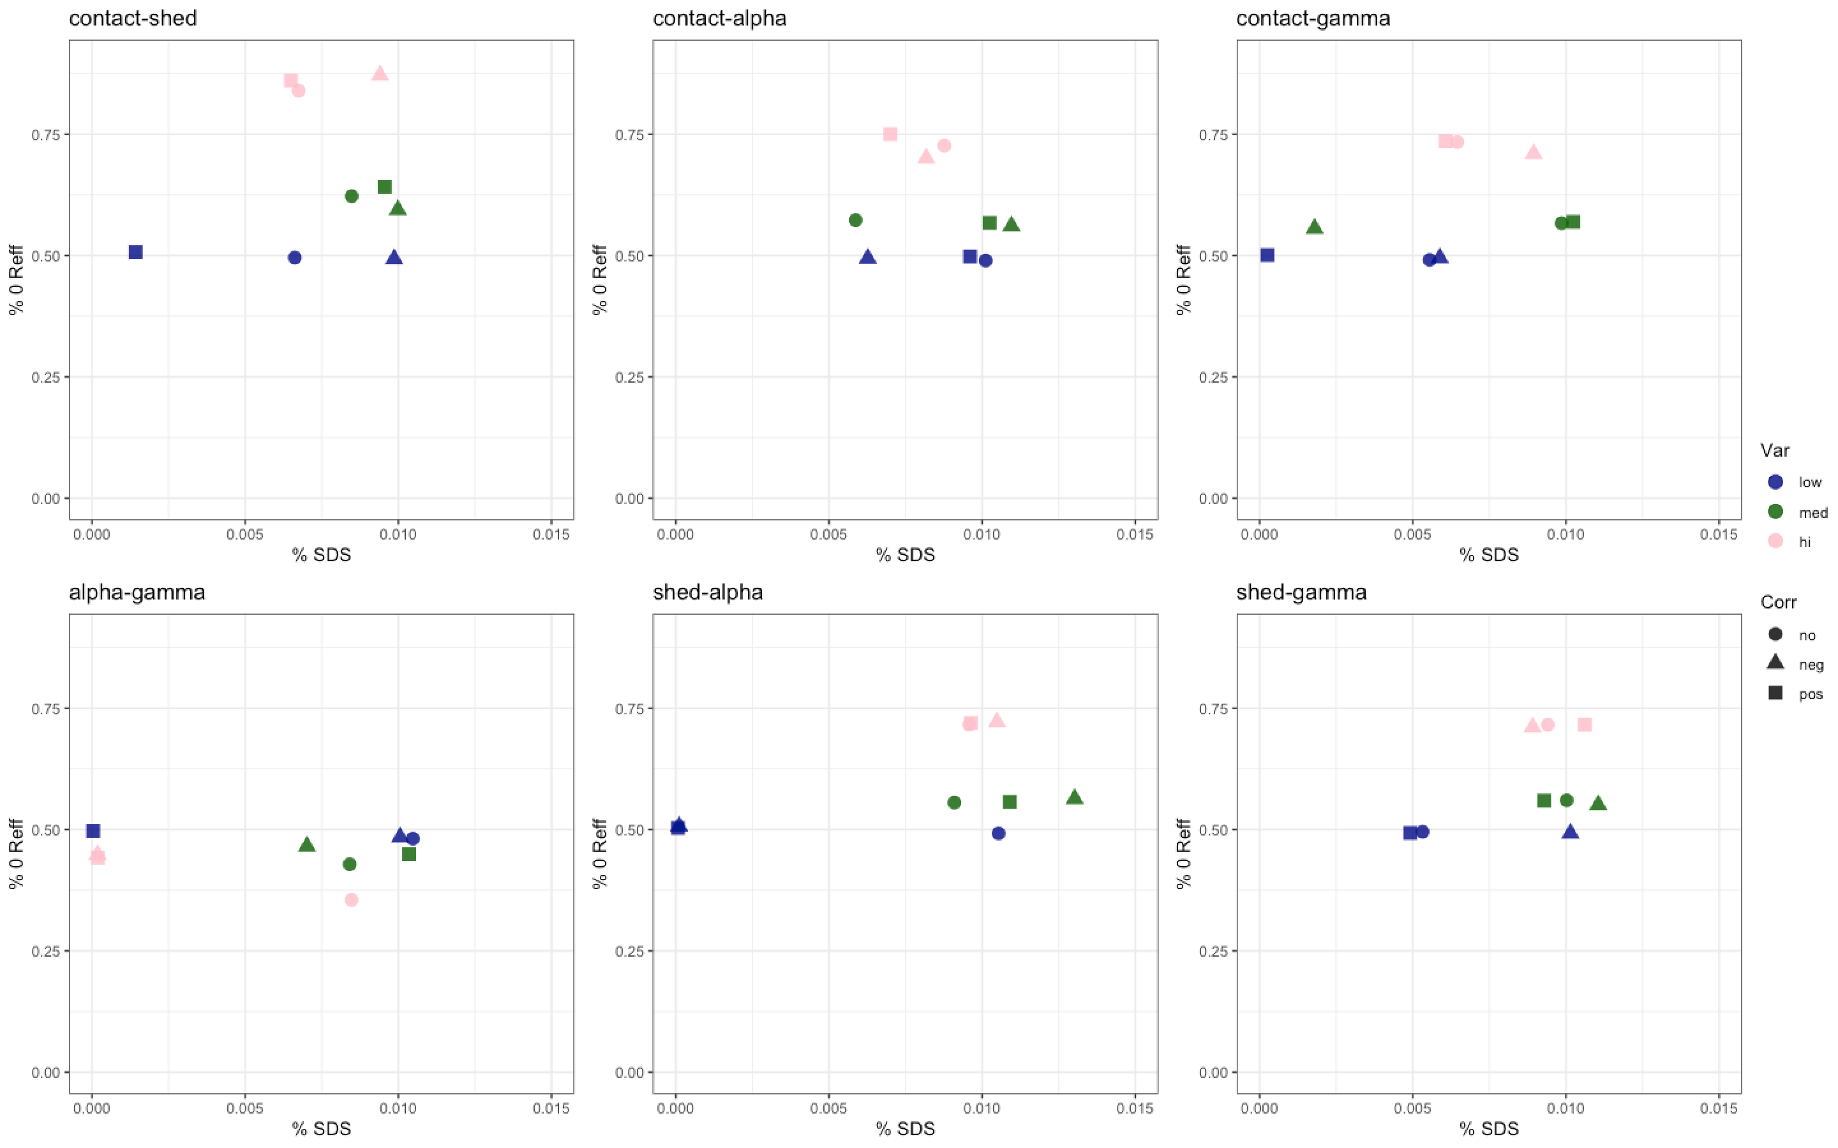

Slide 59
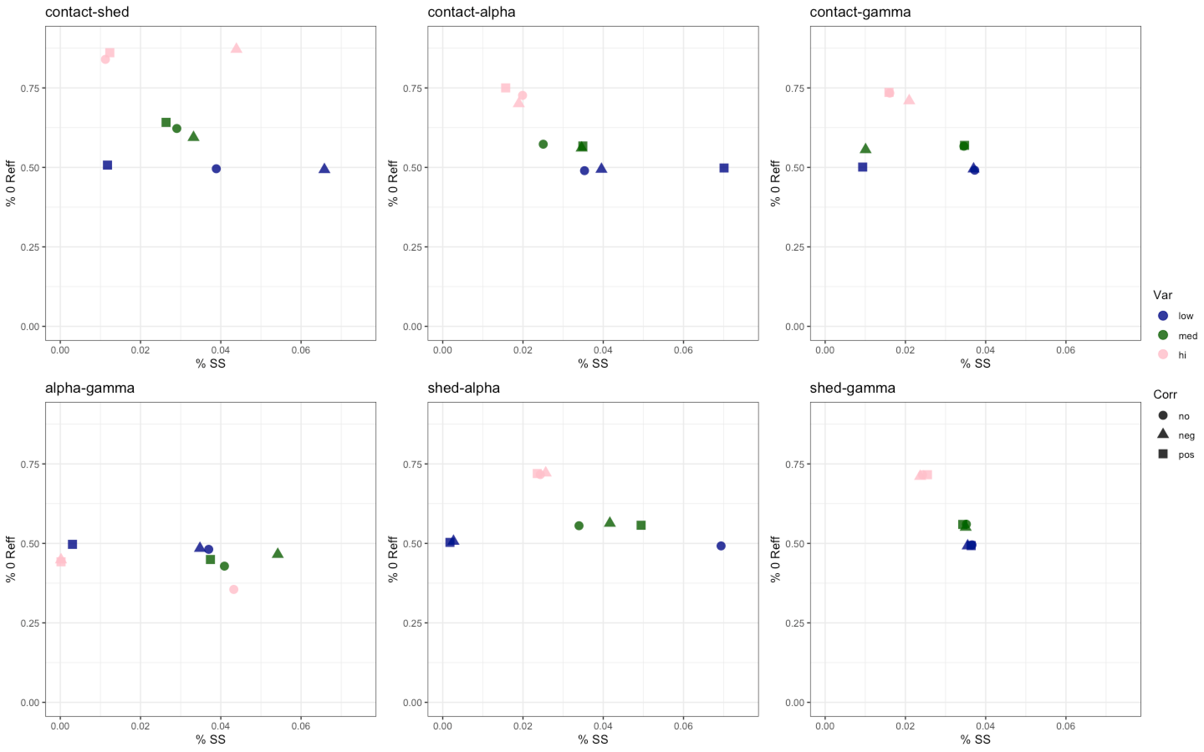

Slide 60
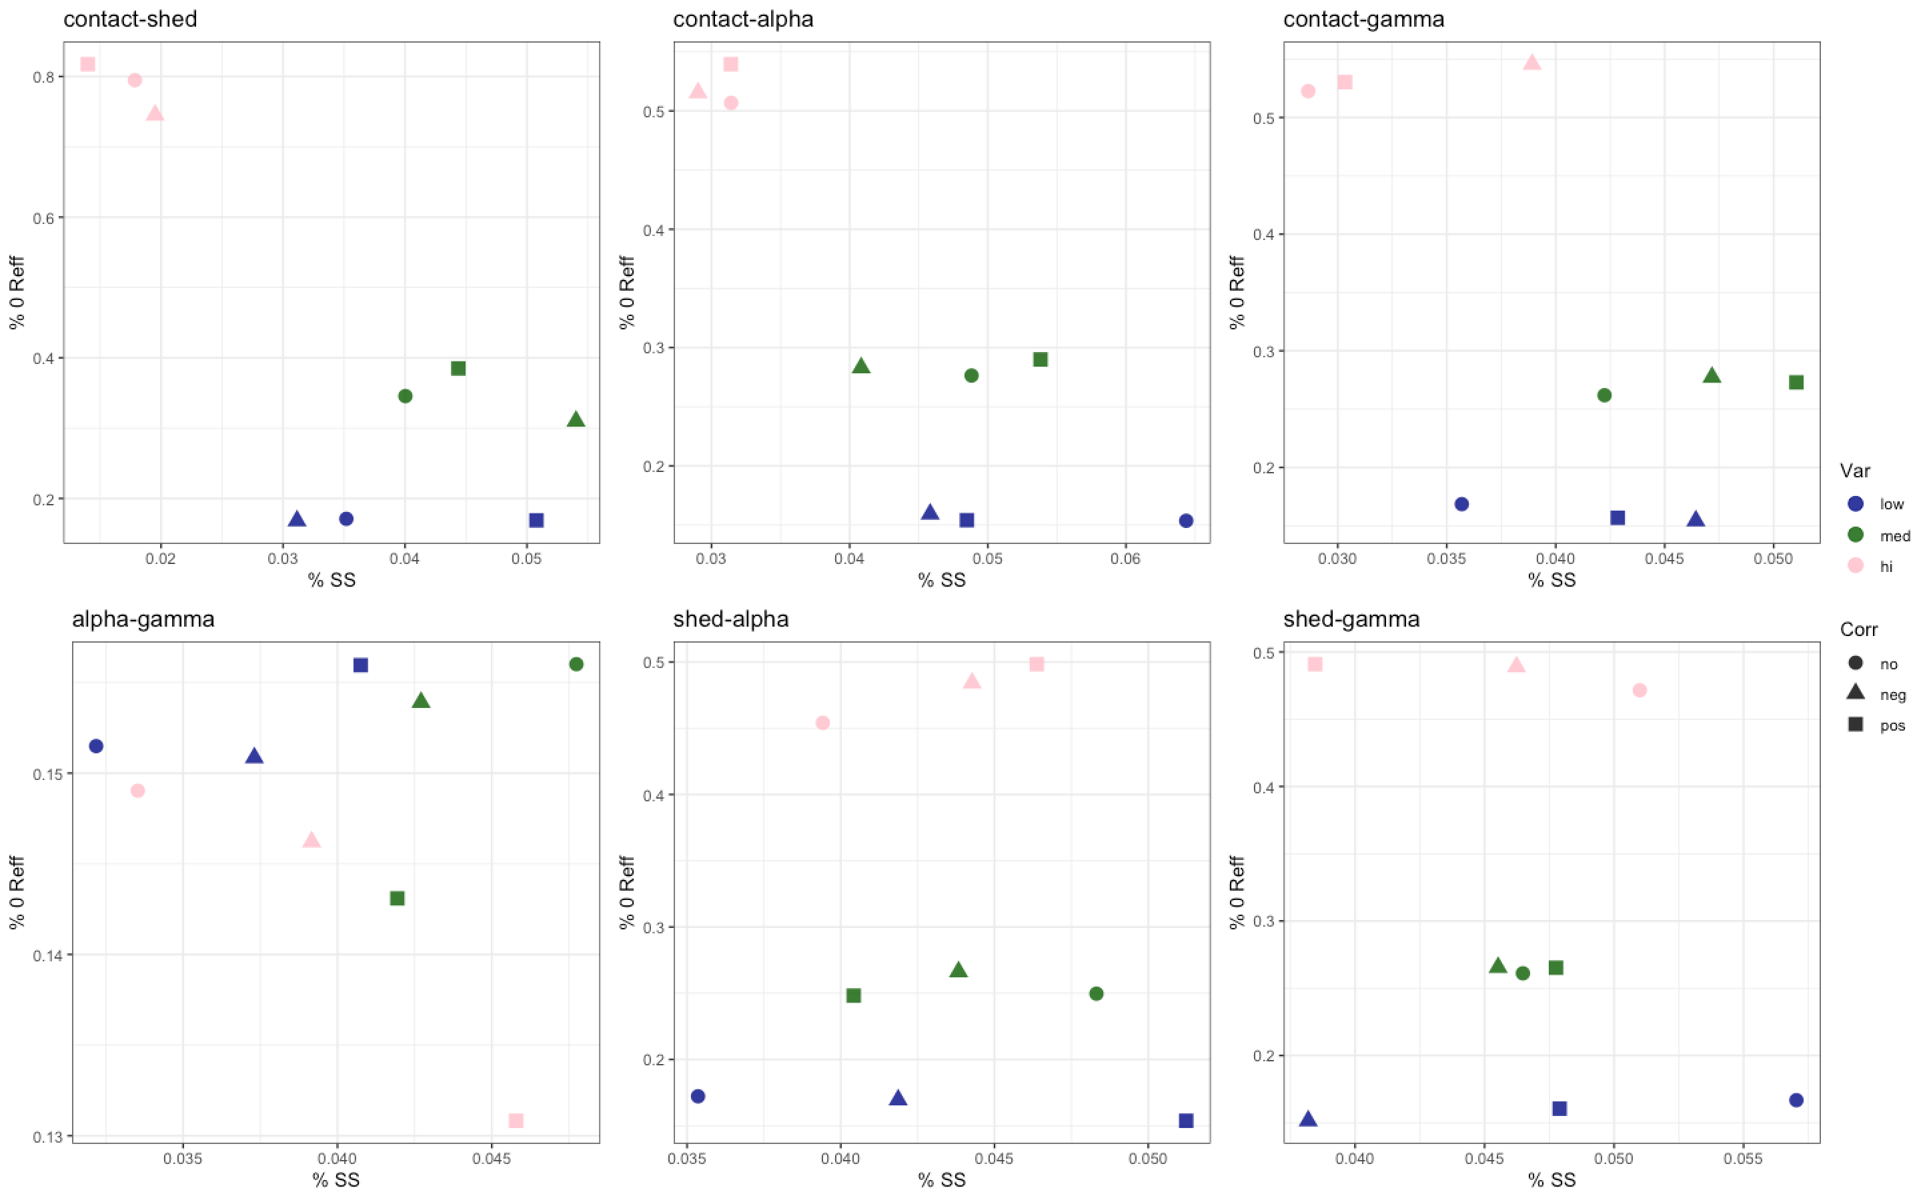
Hi R0

Slide 62
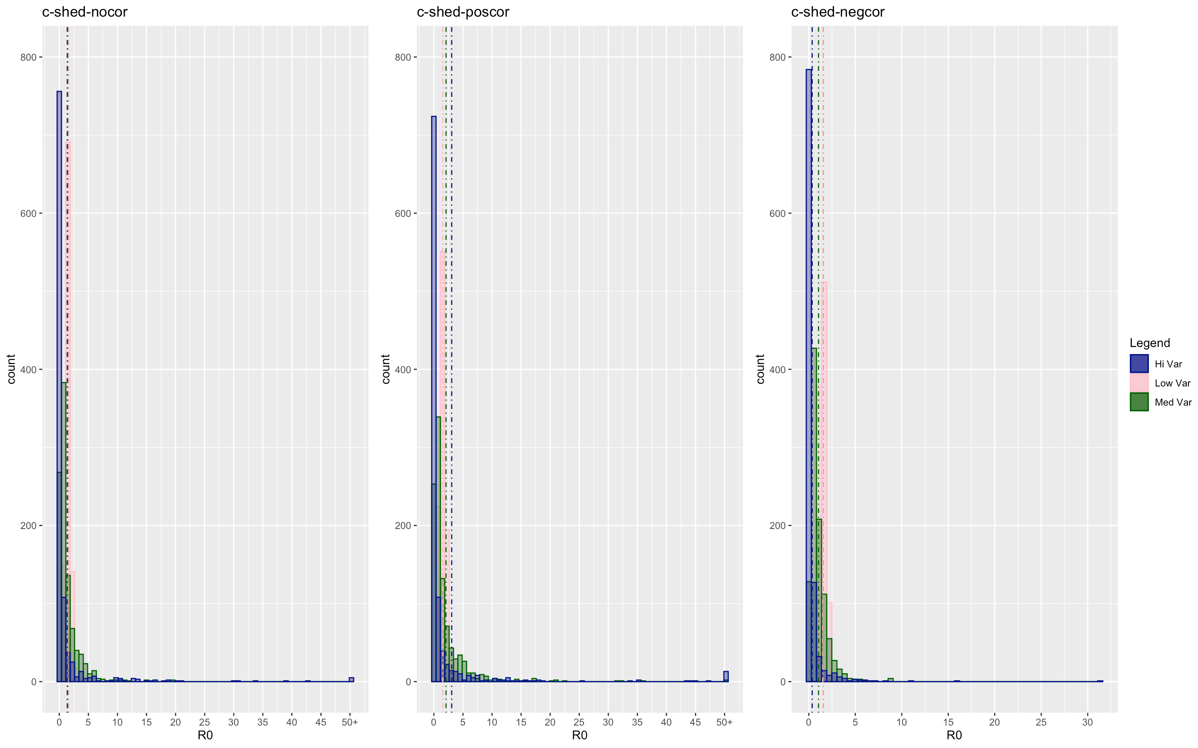

Slide 63
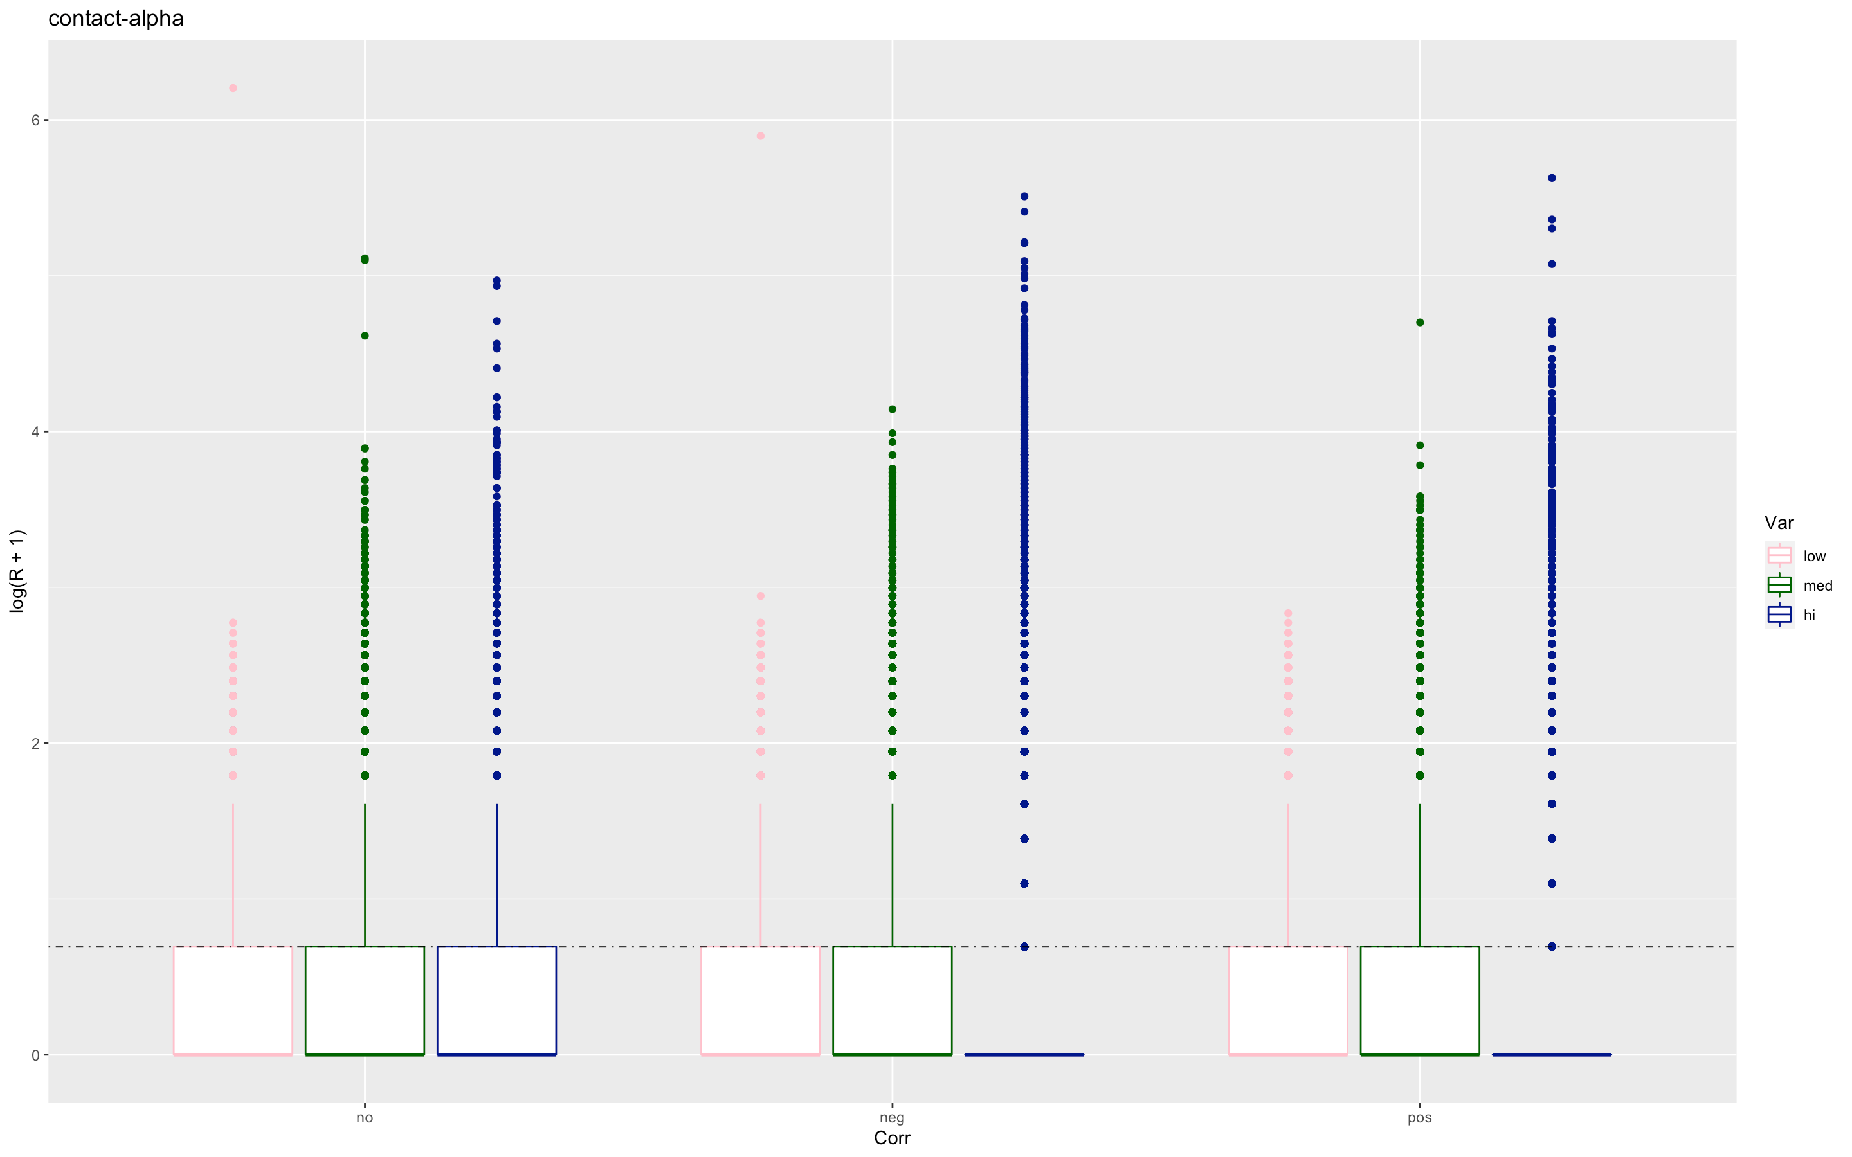

Slide 64
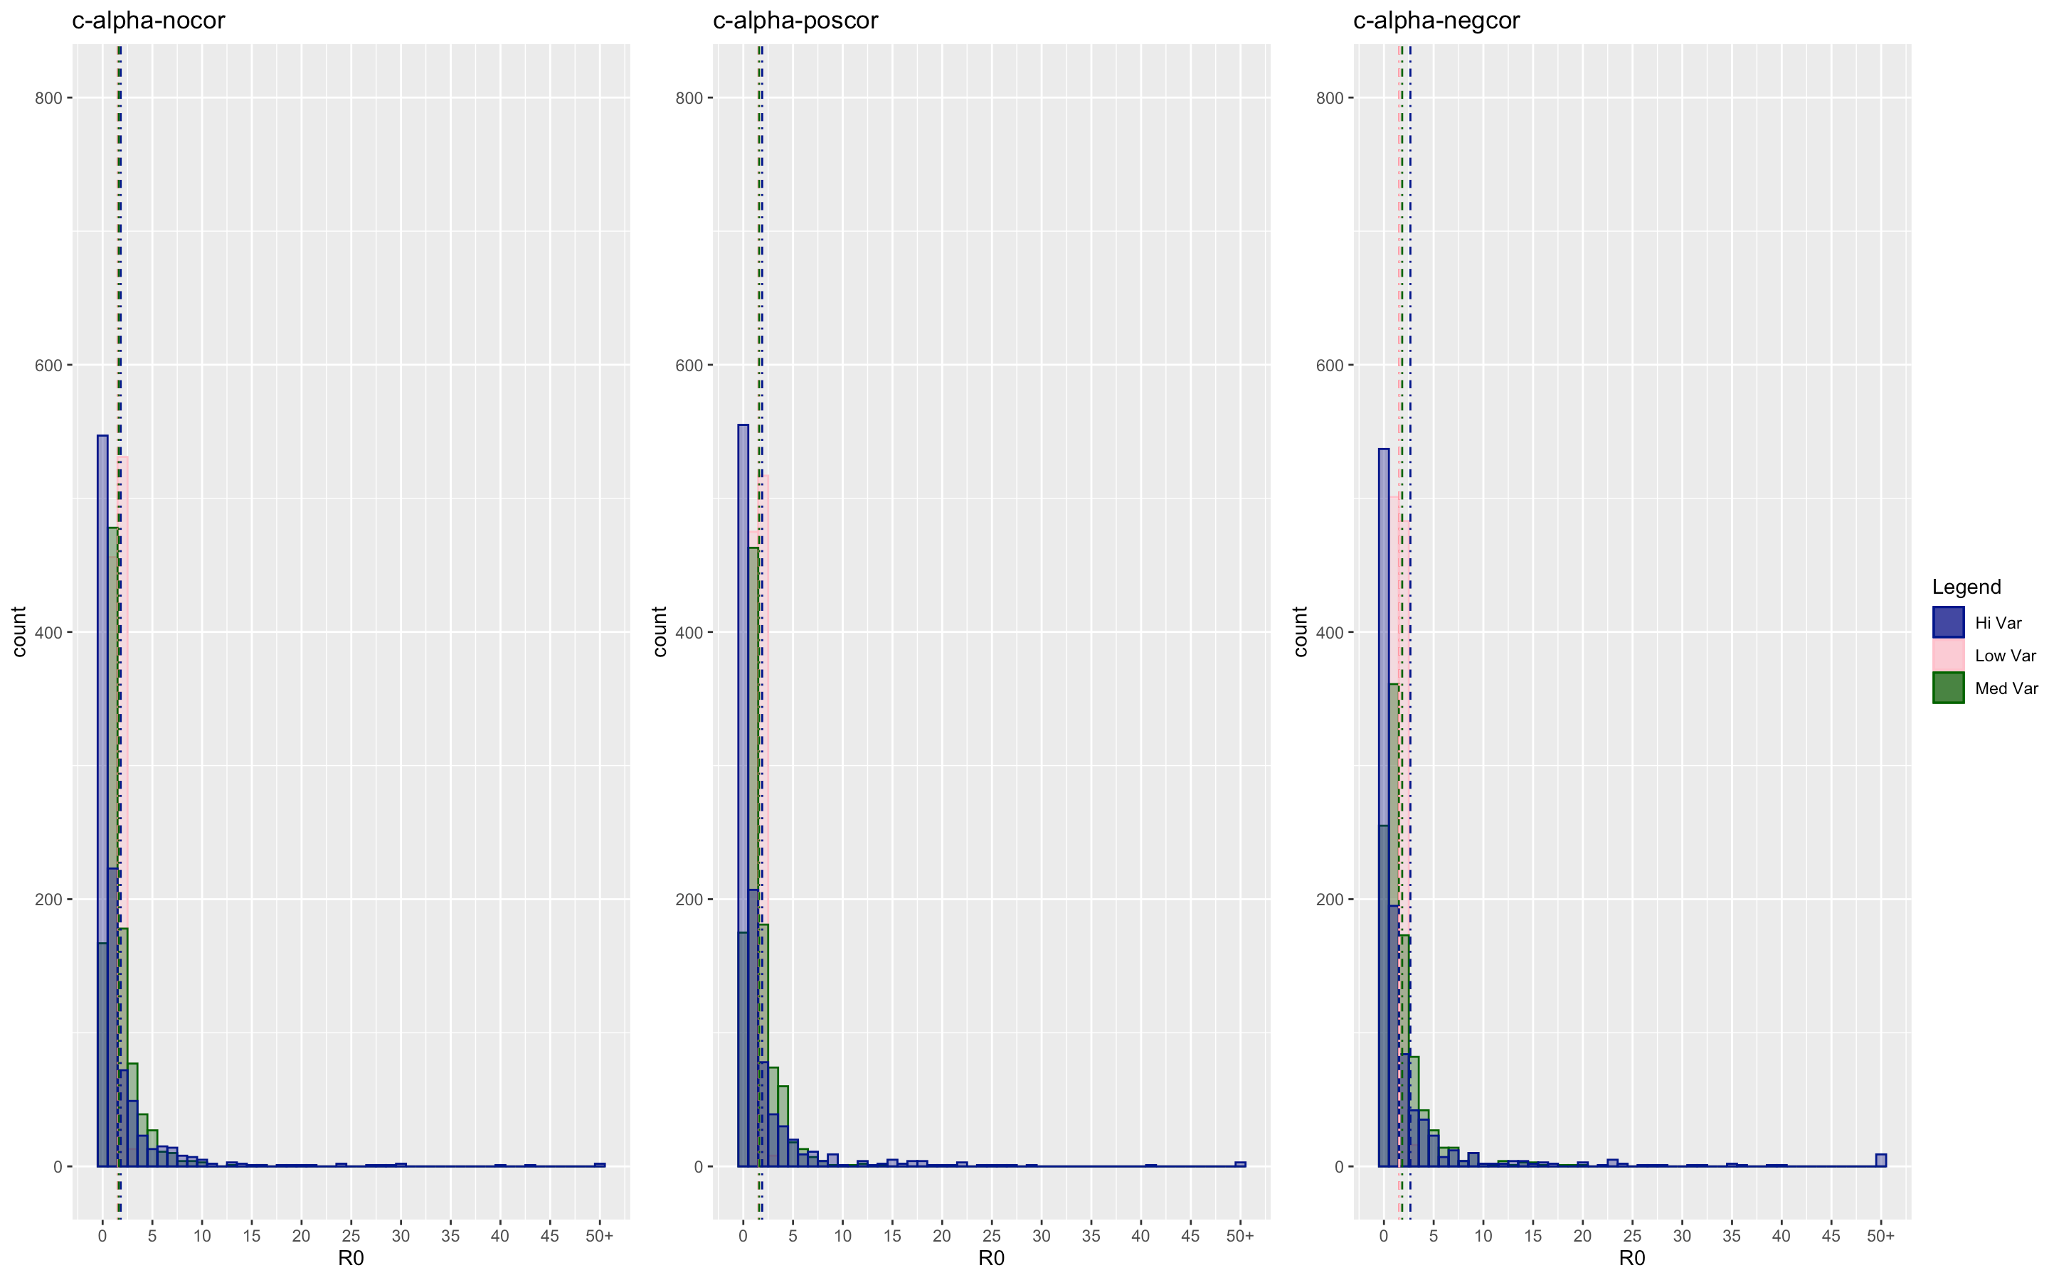

Slide 65


Slide 66


Slide 67


Slide 68


Slide 69


Slide 70


Slide 71


Slide 72


Slide 73
Epidemic Size
recovery
virulence
infectiousness
contacts
demography
within-host
between-host
coinfection
individual variation
community structure
abiotic factors
immune mechanisms
demography
Ecological interactions

Slide 74


Slide 75


Slide 76


Slide 77


Slide 78


Slide 79


Slide 80


Slide 81


Slide 82


Slide 83


Slide 84


Slide 85


